Slide 1
Tuesday 5th January
English
Learning Intentions:
3: To retrieve and record information from non-fiction.
5: To retrieve, record and present information from non-fiction.
6: To understand what he/she reads by summarising the main points (from non-fiction).

Slide 2
Experience Session
Our Term 3 topic is ‘The Frozen Kingdom’. We will be looking closely at polar explorers, such as Ernest Shackleton, and exploring Antarctica and the Arctic.
What do you know about polar regions? Have you heard of any explorers or famous expeditions?

Slide 3
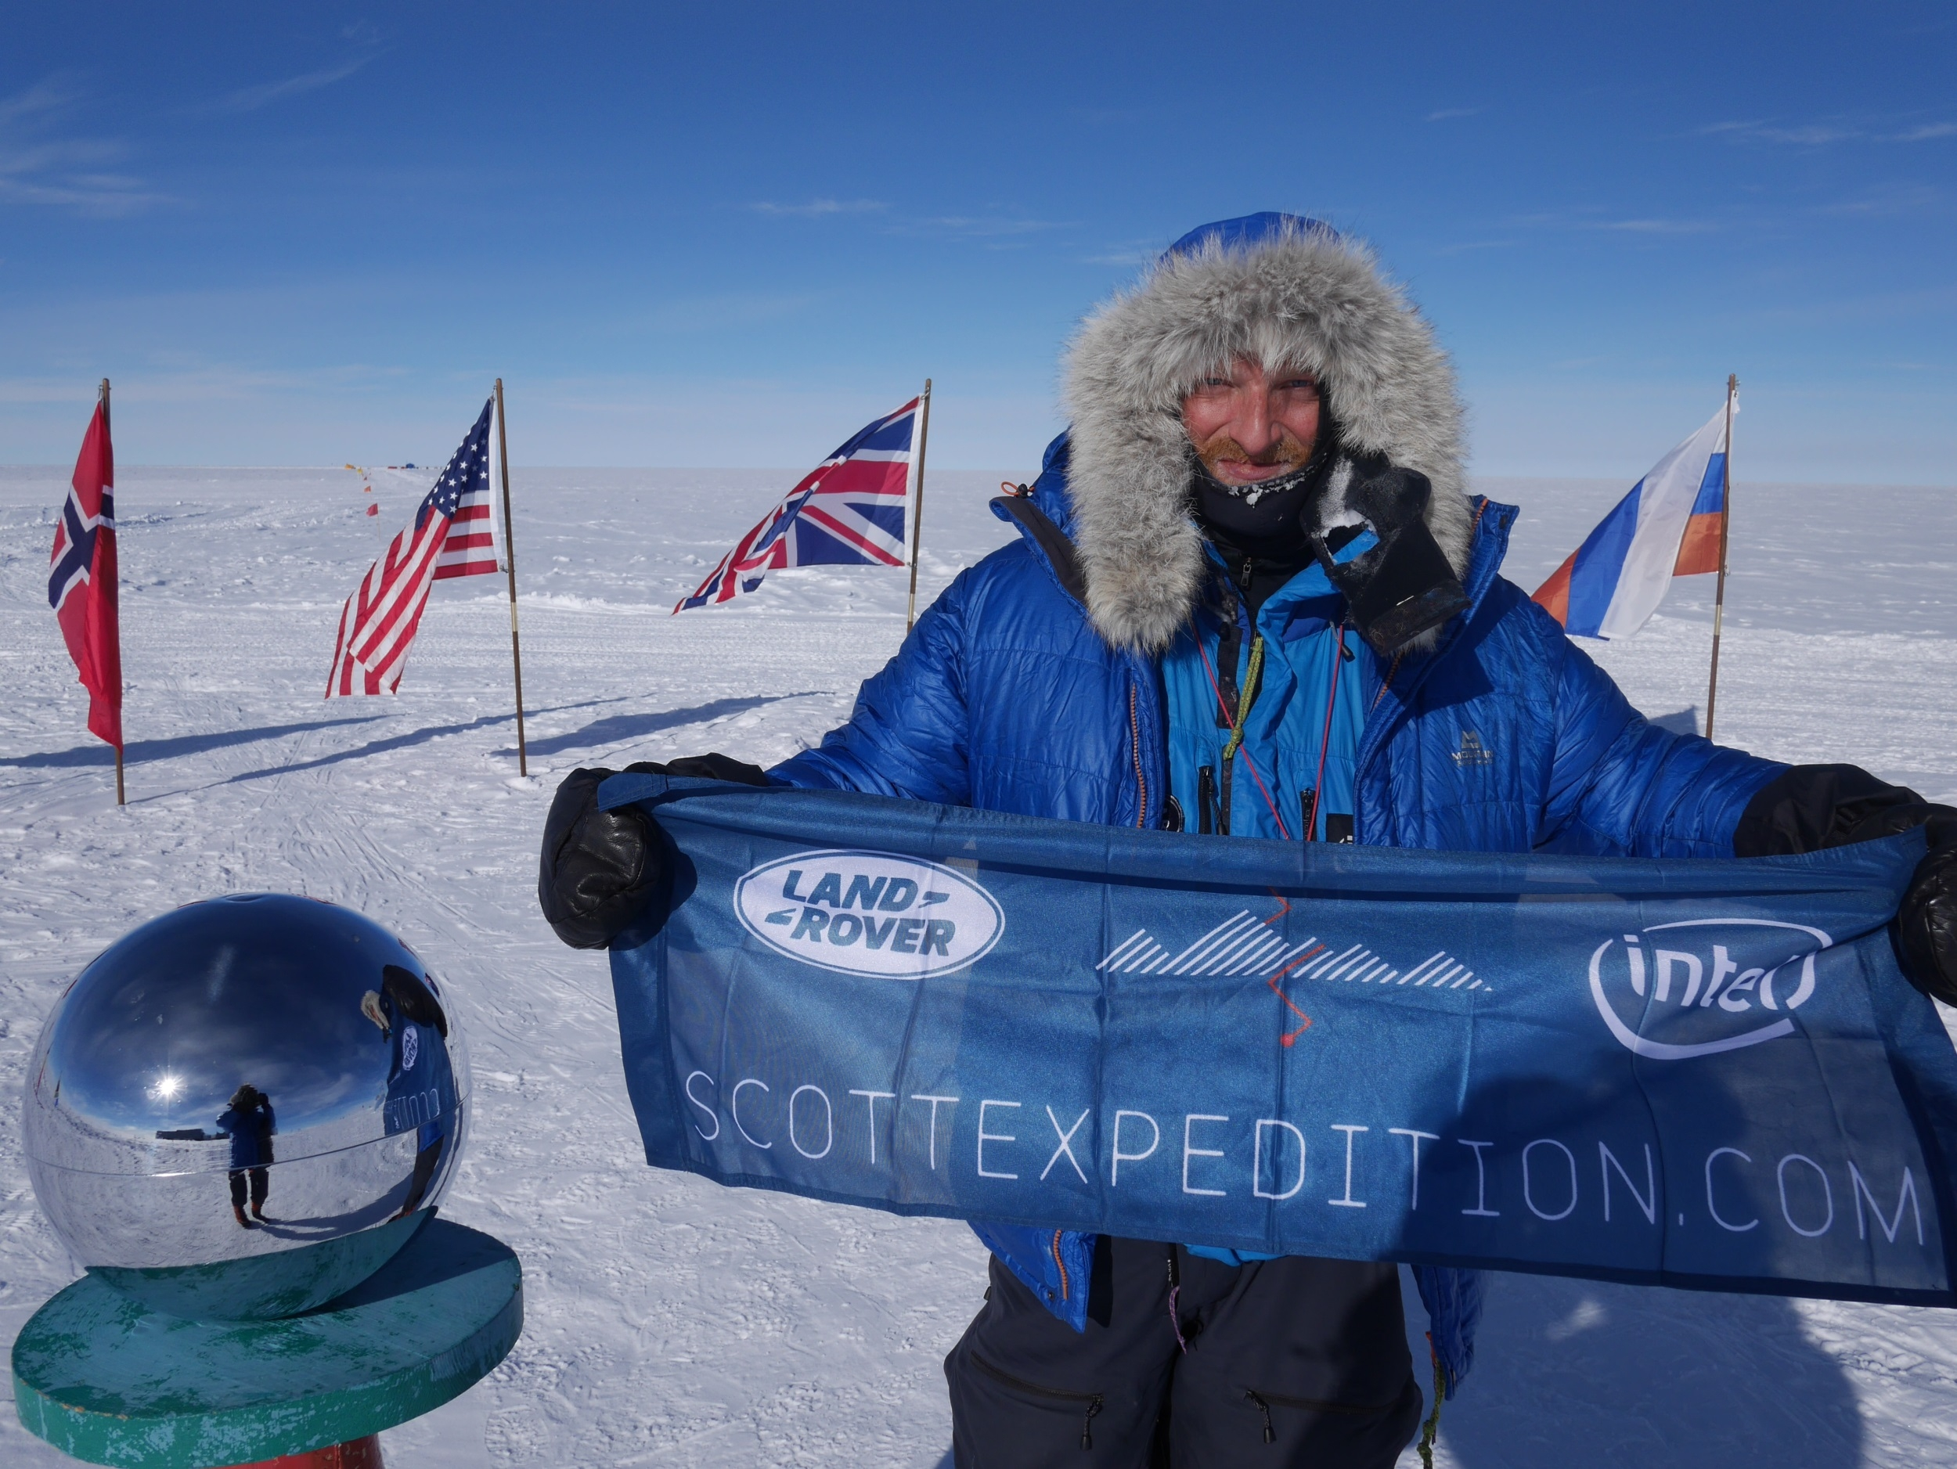
Below is a clip of Ben Saunders, one of the leading polar explorers who has covered more than 7,000 km on foot in the Polar Regions!
What questions would you ask him if you could? Write them down.
A Christmas Message from Ben Saunders in Antarctica – YouTube

Slide 4
Polar Explorers
Polar explorers travel the polar regions of the Earth. This is the Arctic and Antarctica. Usually, these brave explorers have the goal of reaching the North Pole and/or the South Pole.
Your task today:
Choose an explorer.
Read through the important facts about them.
If you are able to, carry out your own extra research, too.
In notes, write down the main facts about the explorer and their expeditions.
Share with us via Class Dojo (if you would like to) so that we can hear about explorers from different regions.
You could also include a sketch or a picture of the explorer himself, or a map of their travels.

Slide 5
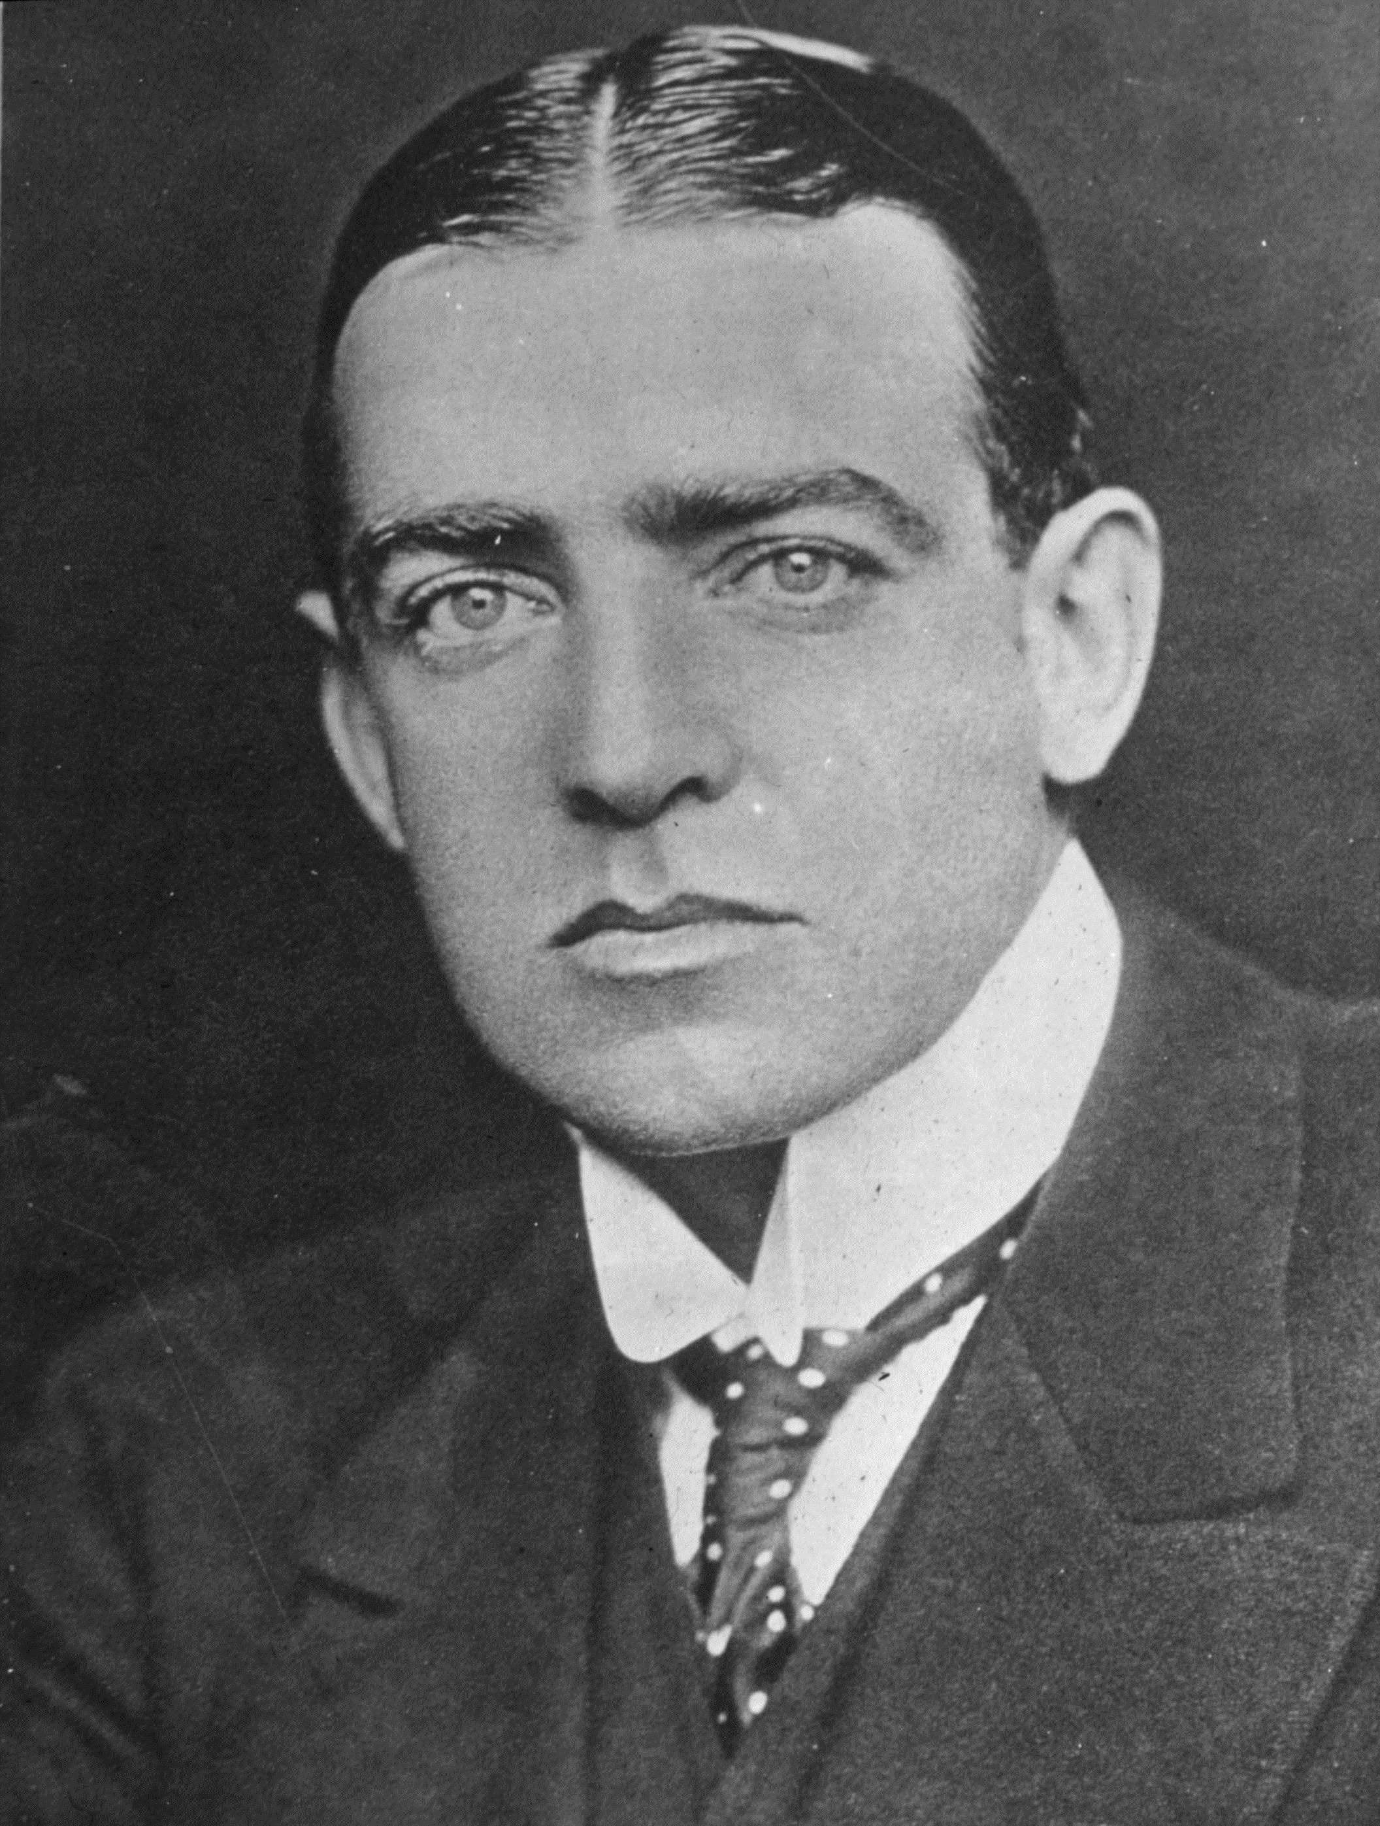
Ernest Shackleton
Watch:
Ernest Shackleton - EPIC Stories in 30 seconds – YouTube
Sir Ernest Shackleton was a famous polar explorer. He led three polar expeditions to the Antarctic. Our book for this topic is all about Shackleton’s polar adventures.
Mini homework: can you find the answers to the following questions about Ernest Shackleton?

Slide 6
Questions:
Where was Shackleton born?
Which year did Shackleton first travel to the polar regions?
What was the name of Shackleton’s ship which got trapped in ice?
What was the name of his final ship?
When did Shackleton die?

