Slide 1
LI: to be able to identify and understand the significance of latitude and longitude
Steps to Success:
I can compare the difference between latitude and longitude
I can identify different geographical features of the world
I can identify and plot co-ordinates on a world map
Any words highlighted in blue are instructions for you to complete an activity before moving on.

Slide 2
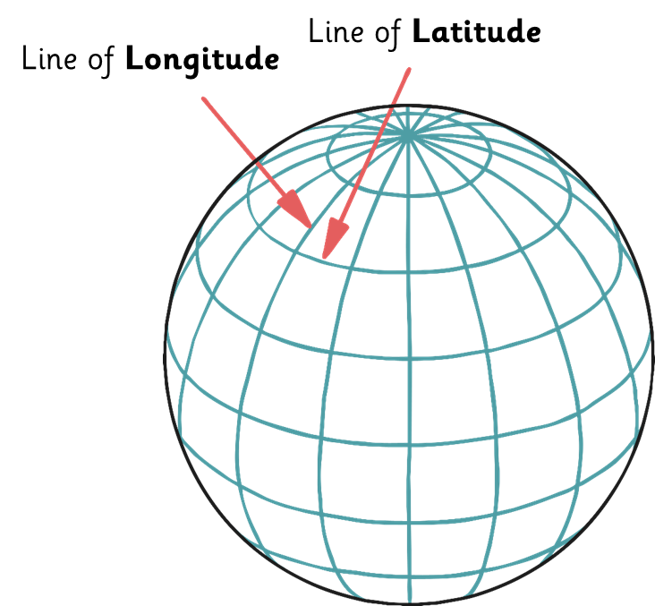
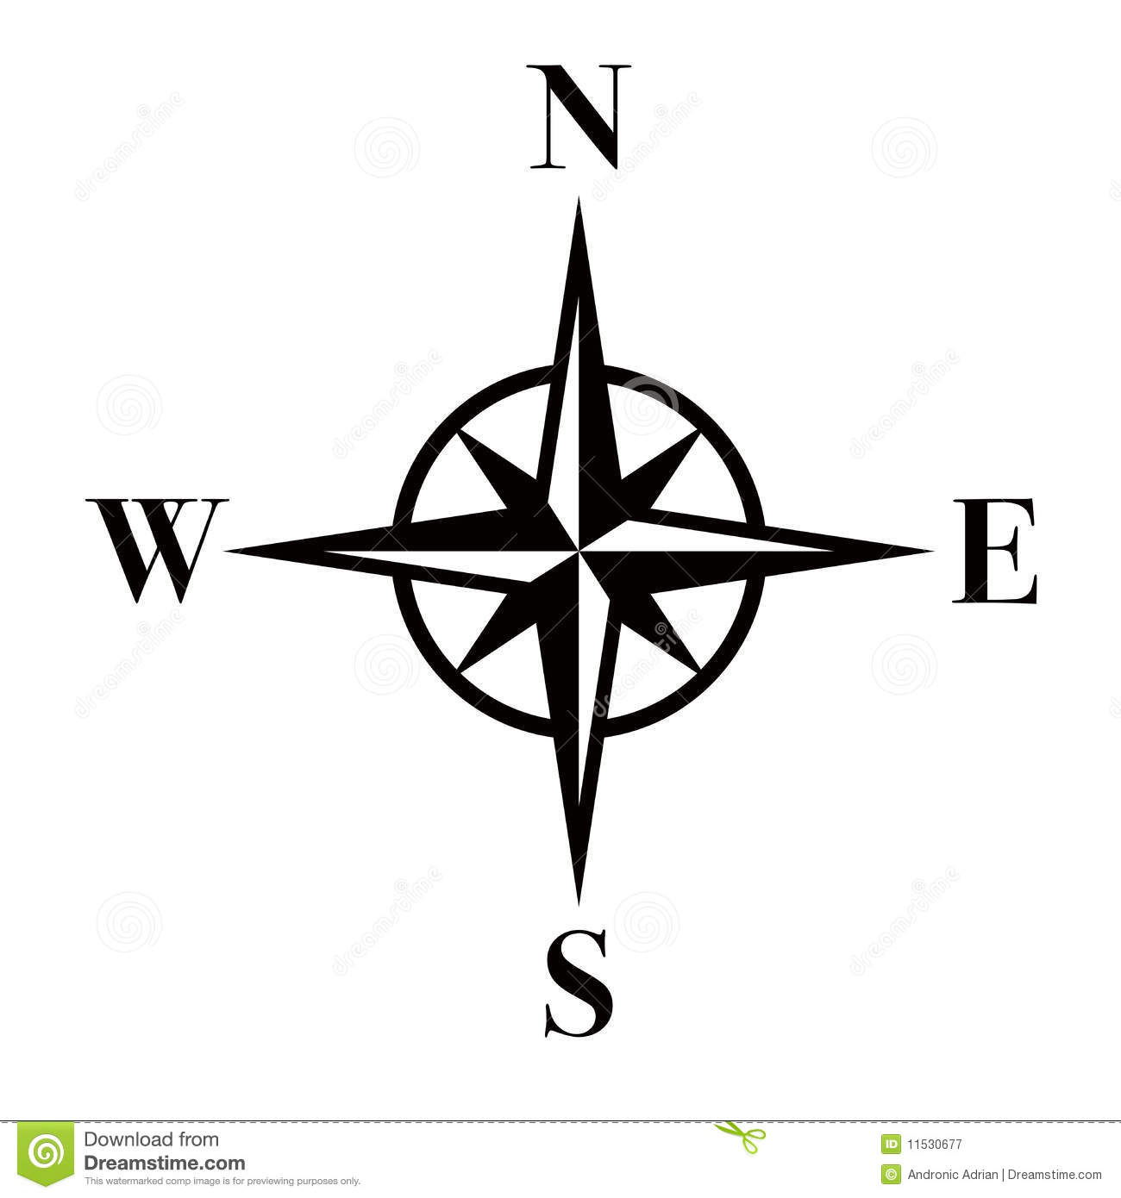
Imagine if you’re lost on a boat at sea, how do the Coastguard know where to go to rescue you?
Latitude and Longitude
Invisible lines of latitude and longitude form a grid over the Earth.
These lines help to create a co-ordinate to locate a place accurately.
Lines of latitude go from east to west.
Lines of longitude go from north to south.

Slide 3
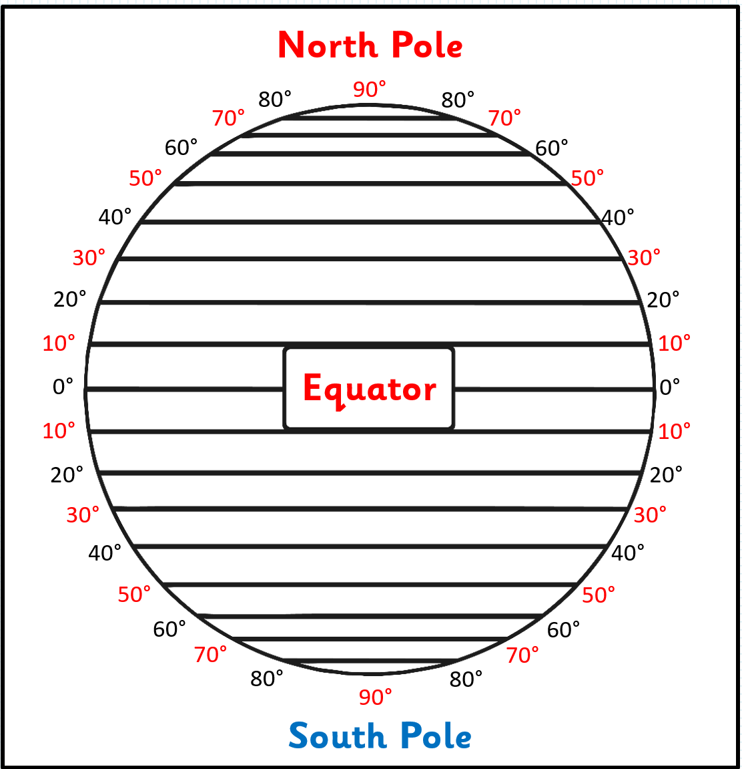
Lines of latitude circle the Earth from east to west.
These invisible lines are all the same distance apart. One line to the next is known as 1 degree.
Each degree of latitude is separated into smaller divisions called minutes.
There are 60 minutes in 1 degree.
The Equator is an important line of latitude. It is an imaginary line half way between the North and South Poles. Countries near to the Equator are very hot as this is the Earth’s closest point to the Sun.
Draw a line on your map to show the Equator. It should be exactly halfway down your map and be labelled ‘The Equator’.

Slide 4
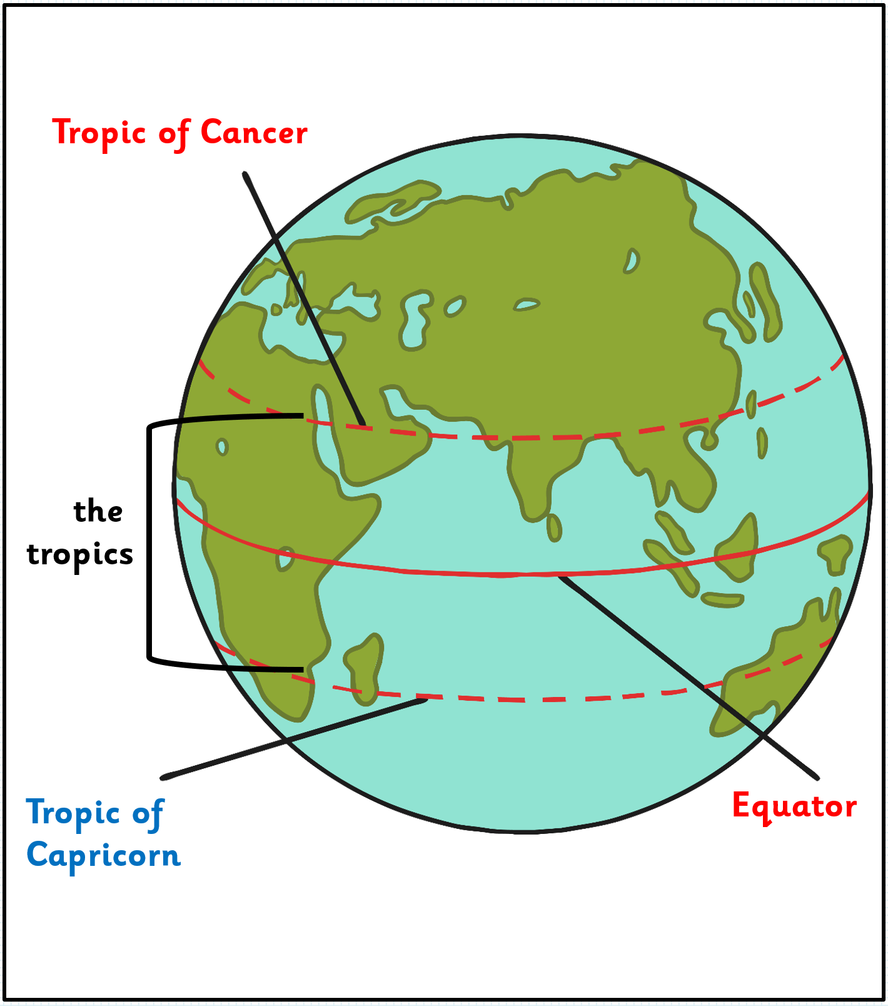
Other important lines of latitude
The Tropic of Cancer lies at 23.5 degrees north and the Tropic of Capricorn lies at 23.5 degrees south of the Equator.
The area of the Earth which lies between both of these lines is called the tropics.
Draw a line on your map to show both the Tropic of Cancer and the Tropic of Capricorn. Each of them should be halfway between the Equator and the North and South Pole. Label the ‘Tropic of Cancer’ and the ‘Tropic of Capricorn’.

Slide 5
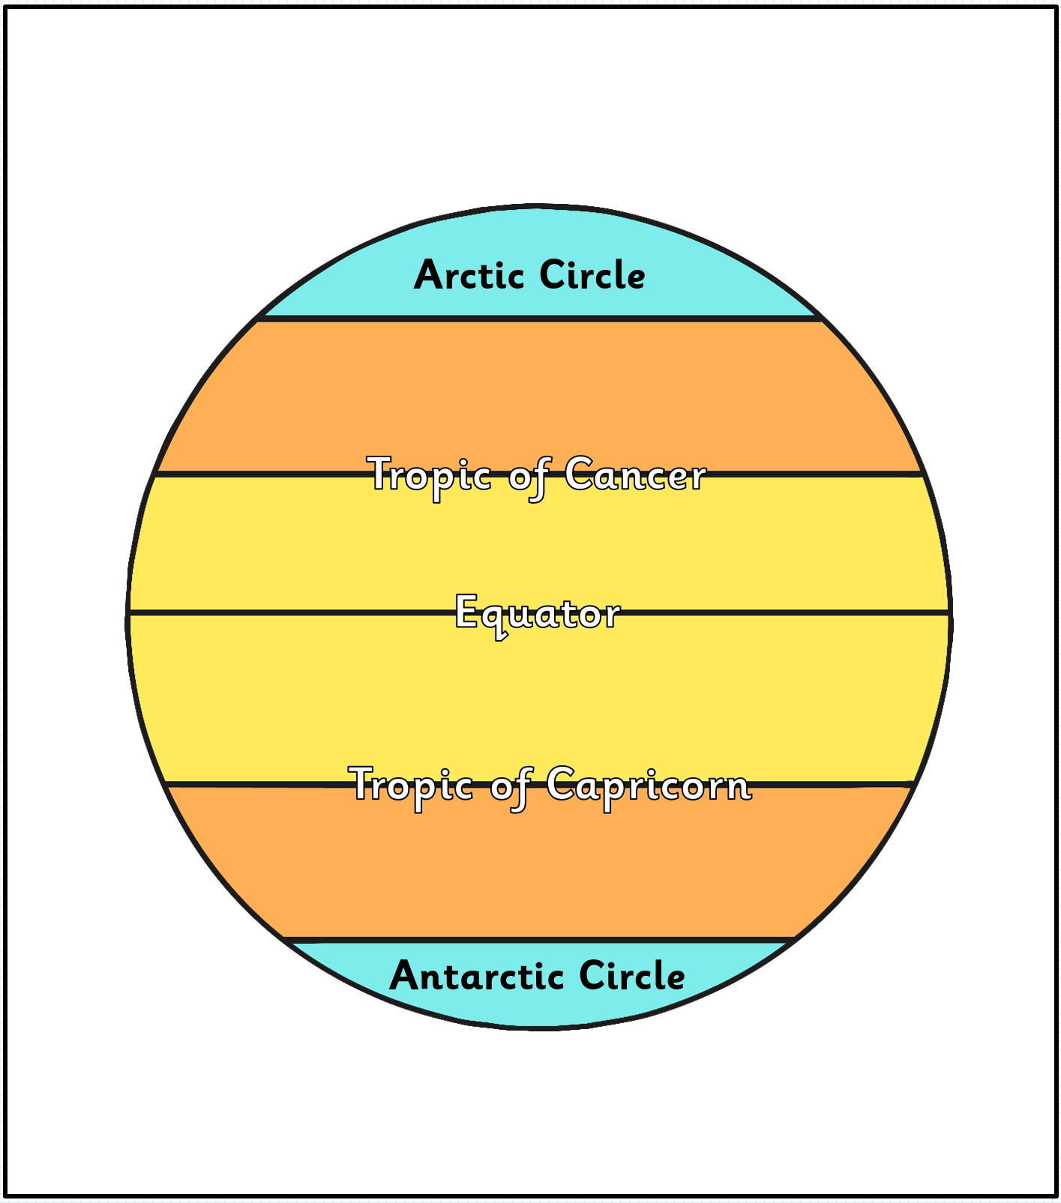
Other important lines of latitude
The Arctic Circle lies at 66.5 degrees north whilst the Antarctic Circle lies at 66.5 degrees south.
Draw a line on your map to show both the Artic Circle and the Antarctic Circle. Take particular care over where the lines should go. Label them ‘Artic Circle’ and ‘Antarctic Circle’.

Slide 6
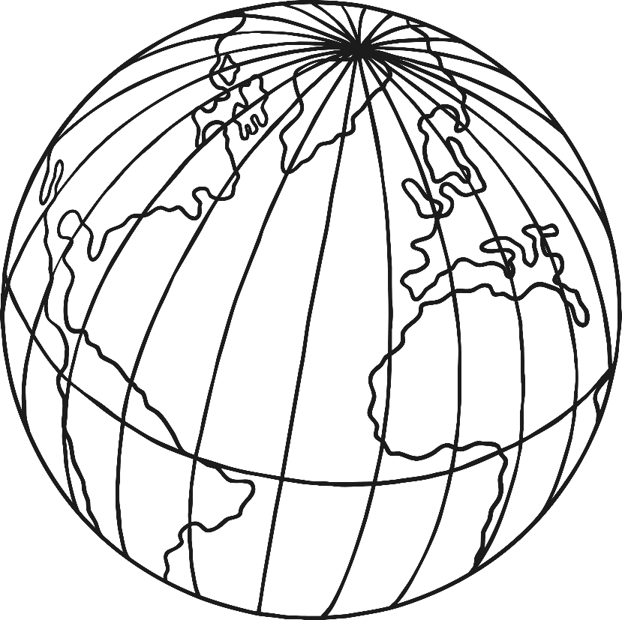
Longitude
These are the lines which run north and south and are known as lines of longitude These lines are measured in the same way as the lines of latitude (degrees).
Lines of longitude are not equal distances (equidistant) from each other.
The Prime Meridian or Greenwich Meridian line is a line of longitude at 0 degrees.
It passes right through Greenwich in London.
North Pole
Equator
South Pole

Slide 7
Co-ordinates
We use numbers and letters to create a co-ordinate.
The letters relate to north, south, east or west and are shown as capitals.
The latitude is always given first.
Then the longitude is given.
To locate the city of Edinburgh on a map, we would need the following co-ordinates:
55° N 03° W
Latitude
Longitude

Slide 8
Plotting co-ordinates
Help your teacher plot the following co-ordinates onto the map:
30‰ S 140‰ E
35‰ N 40‰ E
Using your Atlas, find the country the that the co-ordinate is plotted on and write this down next to the co-ordinates on your sheet.

Slide 9
Your Task
Using the copy of your world map, you need to write down the co-ordinates in your book, plot the co-ordinates on your map using a different coloured pencil for each co-ordinate. Then write down the name of the country next to your co-ordinate.
Challenge – Find a country in the Atlas and use this to find the co-ordinates of this country on your map. Plot the co-ordinates and write down the name of the country.

