Slide 1
Term 5 Week 1
Year 1
GPS

Slide 2
Learning Intentions
L.I: I can use capital letters and full stops in some of my writing.
L.I: I can add the suffix ‘est’ to the end of a word to make a new word.

Slide 3
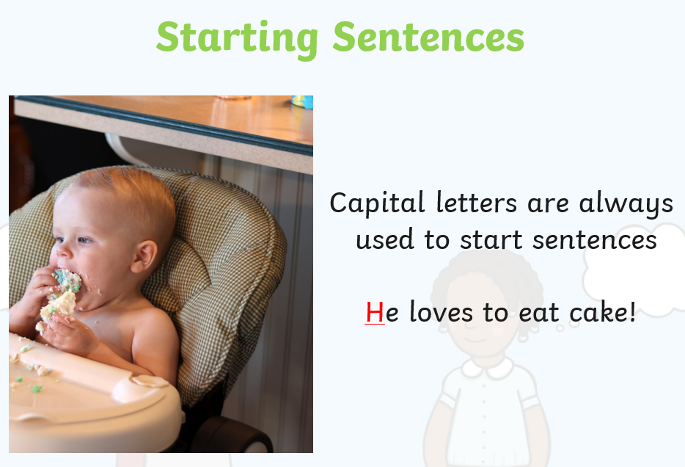
L.I: I can use capital letters and full stops in some of my writing.

Slide 4
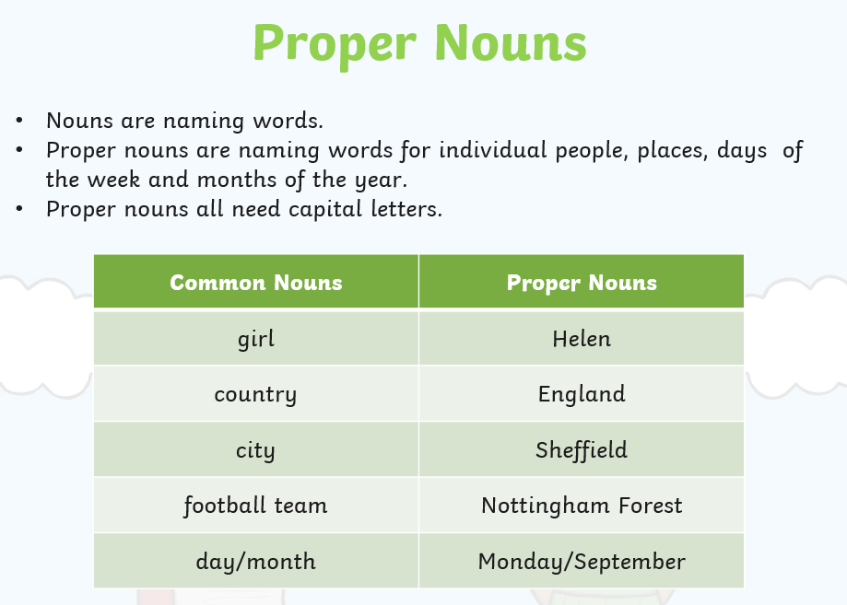

Slide 5
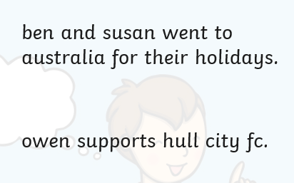
Can you work out where the capital letters should be?

Slide 6
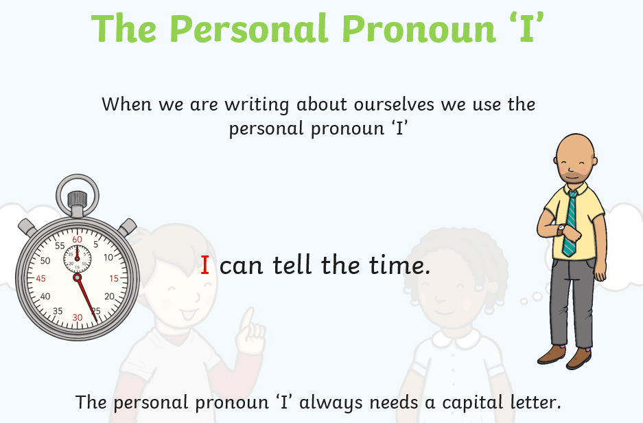

Slide 7
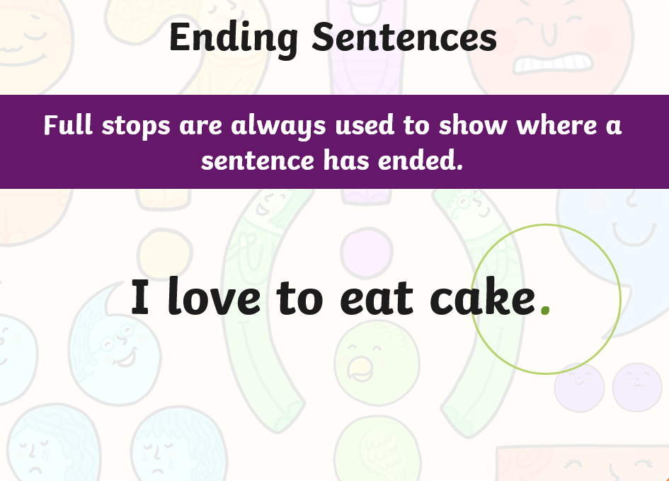
Where should full stops go?

Slide 8
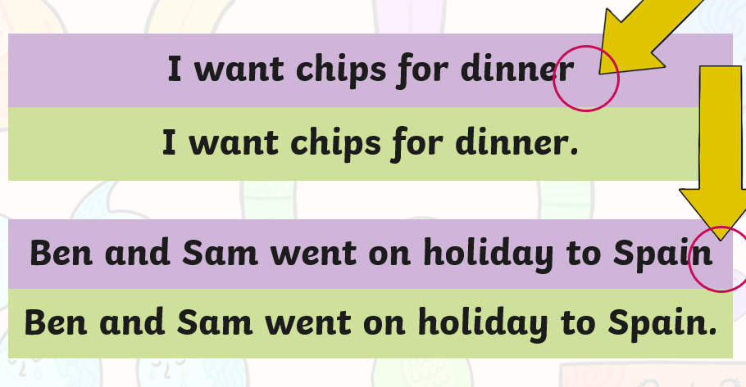
Full stops

Slide 9
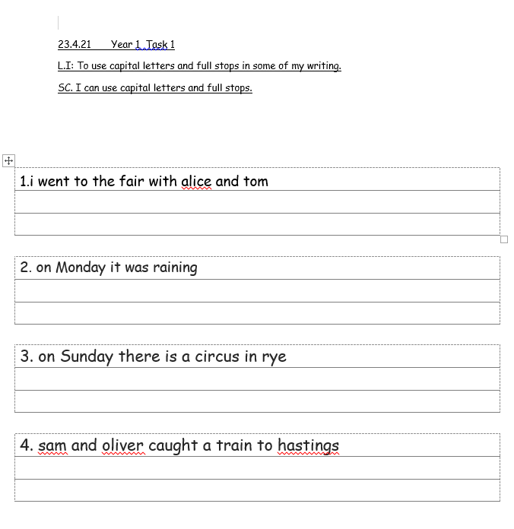
Task 1
Rewrite the sentences with a full stop and capital letters in the right place.

Slide 10
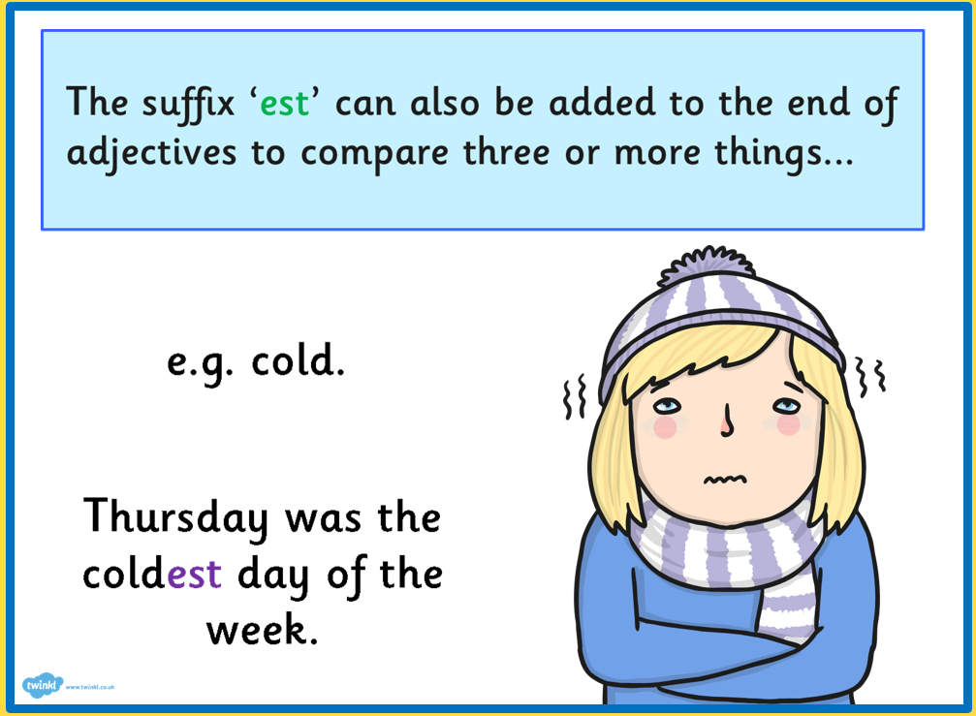
L.I: I can add the suffix ‘est’ to the end of a word to make a new word.

Slide 11
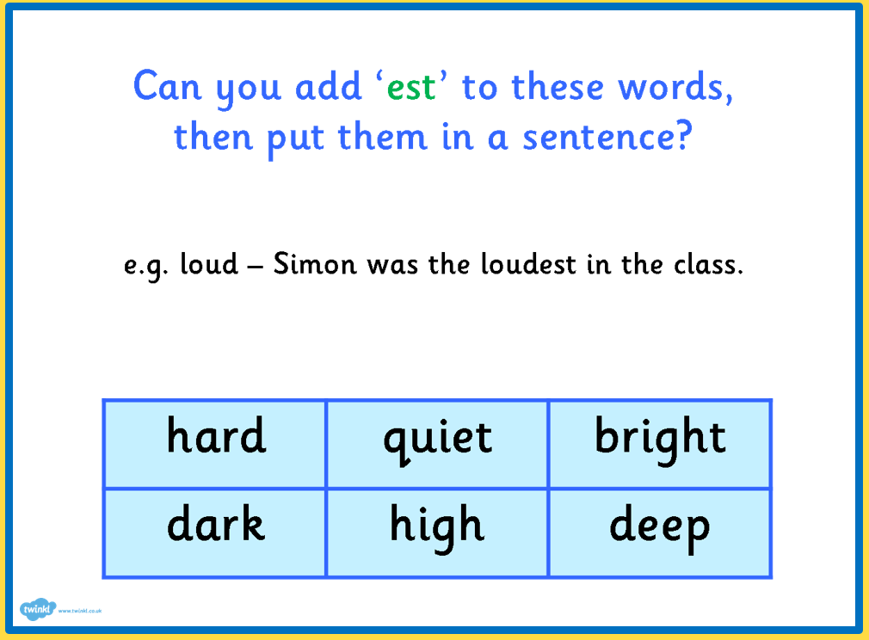
Add ‘est’ to the words below then compose a the sentences orally.

Slide 12
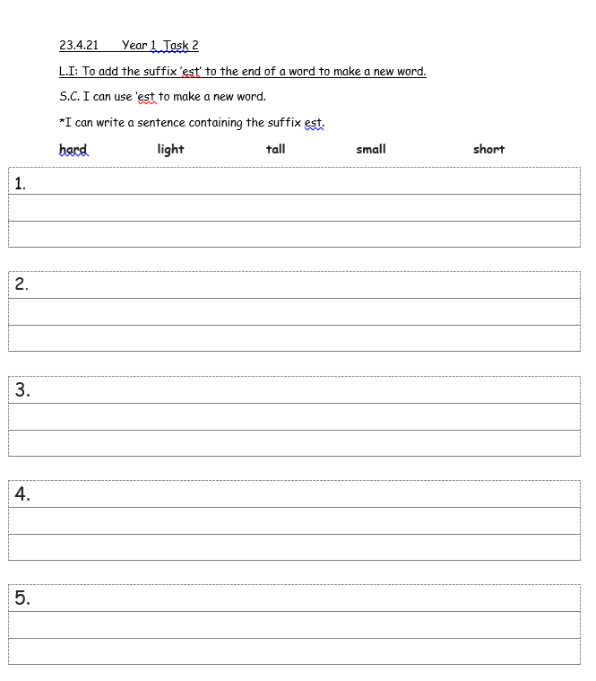
Task 2
Add ‘est’ to the words.
Then put these words in a sentence.

