Slide 1
Term 5 Week 5
P.S.H.E
L.I: To recognise and appreciate people who can help me in my family, my school and my community?
S.C. I understand how it feels to trust someone?

Slide 2
Learning Intentions
L.I: To recognise and appreciate people who can help me in my family, my school and my community?
S.C. I understand how it feels to trust someone?

Slide 3
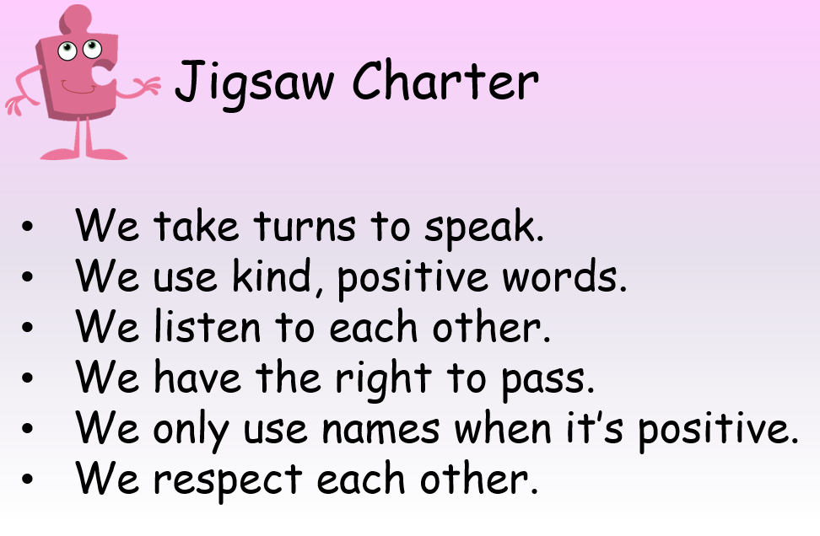

Slide 4
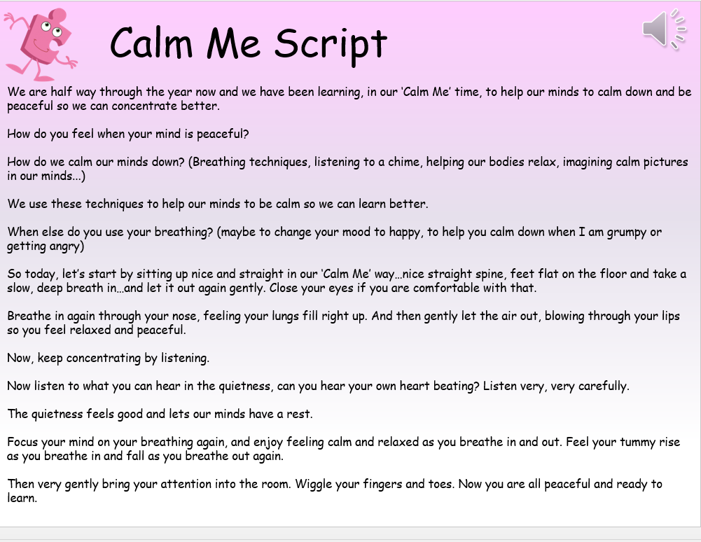

Slide 5
Input / Class Discussion
What does it mean to trust someone? Talk about the things that help trust grow, e.g. honesty, always being there, keeping good secrets, being a good listener, standing up for you, etc. Ask children for their ideas. Have a balloon ready and with each new suggestion add a puff of air to the balloon.
Explain to children that trust builds over time; just as the balloon is growing bigger, so does trust. Tie up the end of the balloon and keep for later.

Slide 6
Discussion
Discuss how telling lies and not being truthful can damage trust (look at the boy who cried ‘wolf.’) Holding the balloon explain that telling lies pop someone’s trust in you just like popping a balloon.
Discuss how telling lies and not being truthful can damage trust (look at the boy who cried ‘wolf.’)Holding the balloon explain that telling lies pop someone’s trust in you just like popping a balloon.

Slide 7
Group Activity
Use the people cards. In groups, children decide which people they would trust or not and why, sorting the cards into piles.
Debrief.
Reinforce the learning that some people we trust because we know them well, such as family and friends, and some we trust because we know it’s their job to look after us, such as a police officer or doctor.

Slide 8
Ask children to re-examine how they have sorted their cards, would they like to reconsider?
Who would you not trust? Ask children to share their ideas e.g. people you don’t know well enough, people who you think don’t really care about you, people who have let you down before.

Slide 9
Activity
Photograph evidence for books activity
Each group to have a piece of flip chart paper. Ask them to draw a stick figure in the middle to represent themselves, and then a circle around the figure.
Give each group a set of the ‘People’ cards. Tell children to place inside the circle
any that they feel sure they could trust; place the others outside the circle, closer if you think you might be able to trust them but are not sure, further away if you definitely would not trust them.
Encourage children to talk about these in their groups and see if different people have different ideas.

Slide 10
Stress that there are no right or wrong answers - it’s something each person has to judge for themselves.
Back in the circle, debrief this activity with the children.
Did they find it easy to agree on where to place the cards?
Which ones did they find it hard to decide or agree on?
Help them to see that there are many people who may be perfectly trustworthy, but until we know them well we can’t sure.

