Slide 1
Term 5 Week 4
Year 2 GPS

Slide 2
Learning Intentions
L.I: To use apostrophes to show where letters are missing and to show possession.
S.C: I can use apostrophes to show where letters are missing and to show possession.
L.I: To use the correct verb form to indicate actions in progress in the present or in the past. e.g. She is drumming. He was drumming.
S.C: I can use the correct verb form to indicate actions in the present and or in the past.

Slide 3
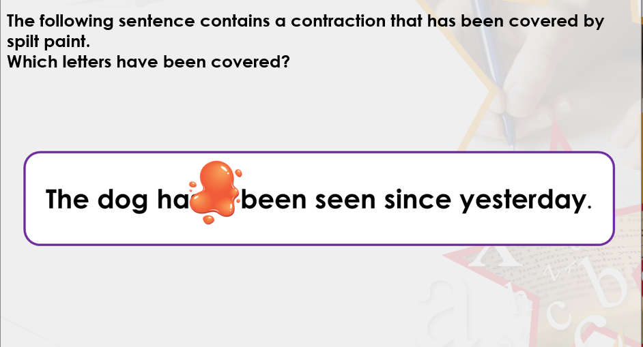

Slide 4
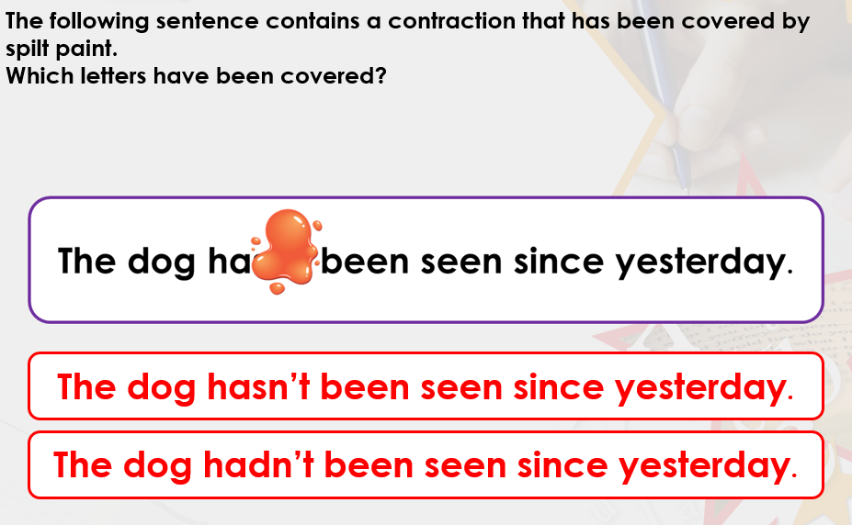

Slide 5
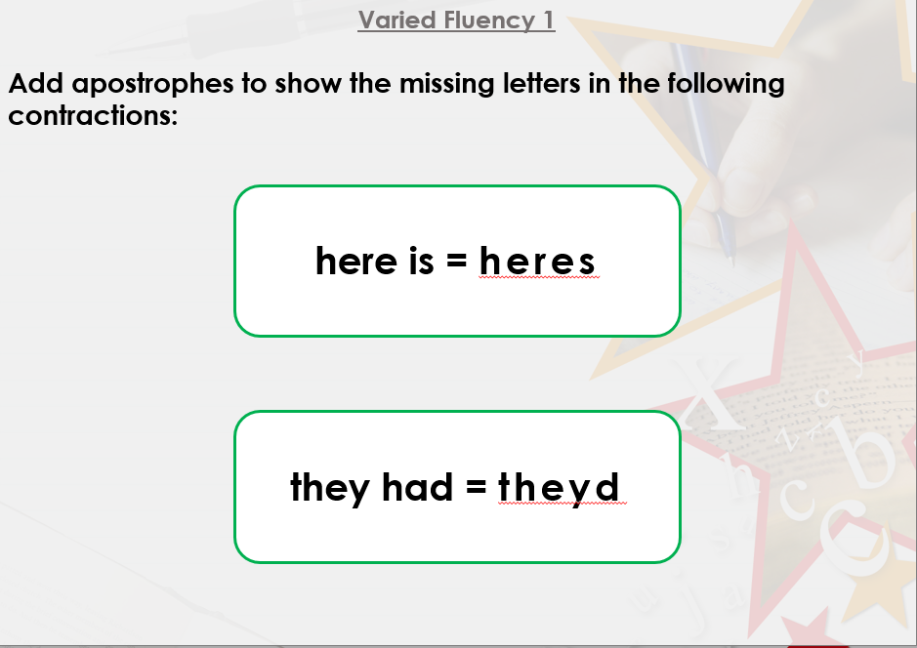

Slide 6
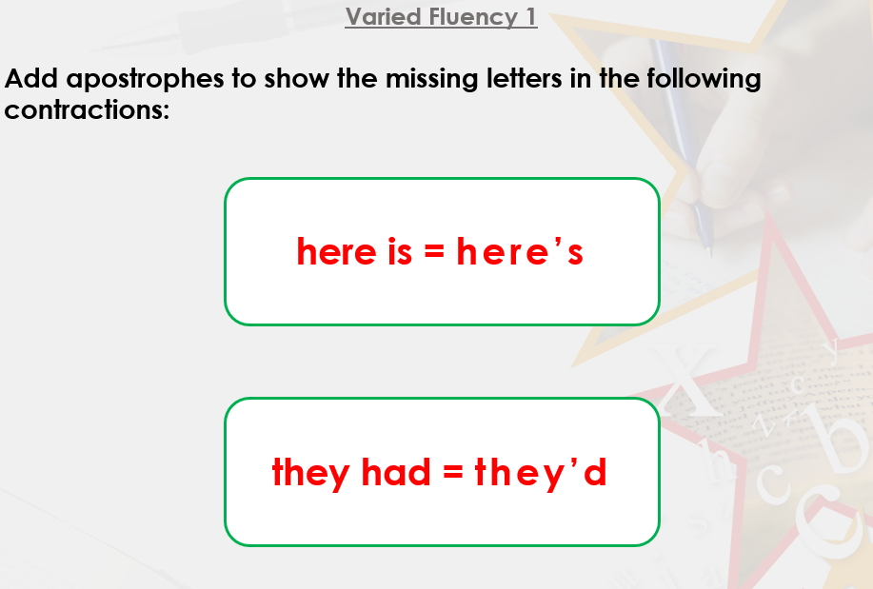

Slide 7
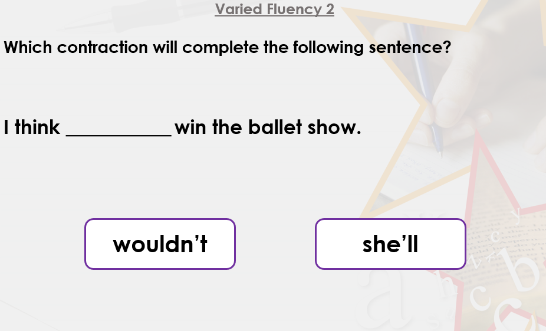

Slide 8
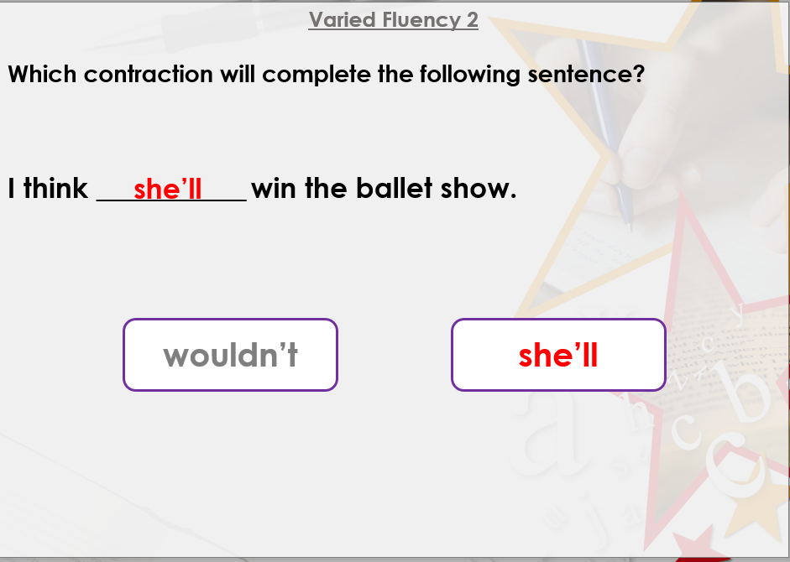

Slide 9
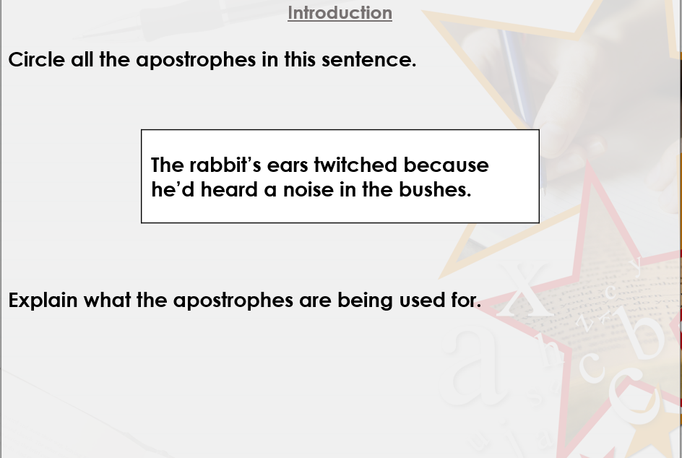
Apostrophes for Possession

Slide 10
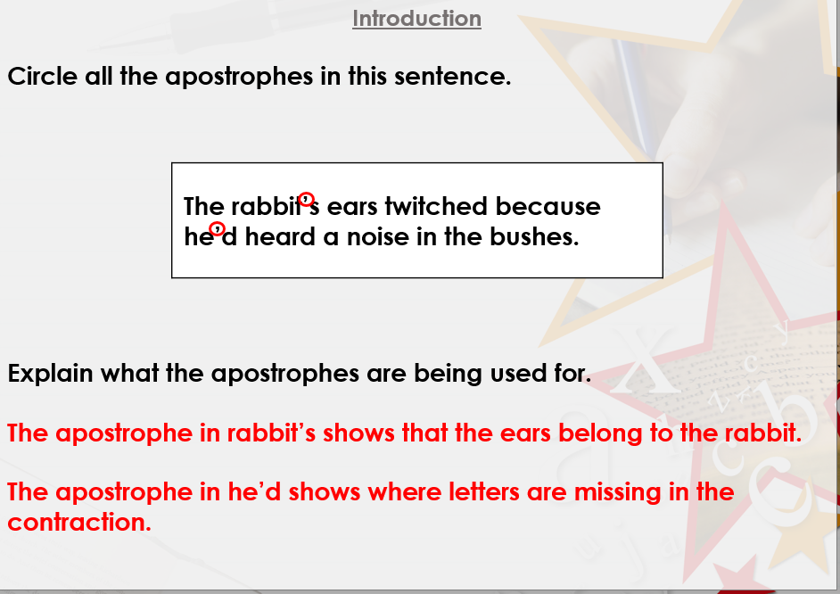

Slide 11
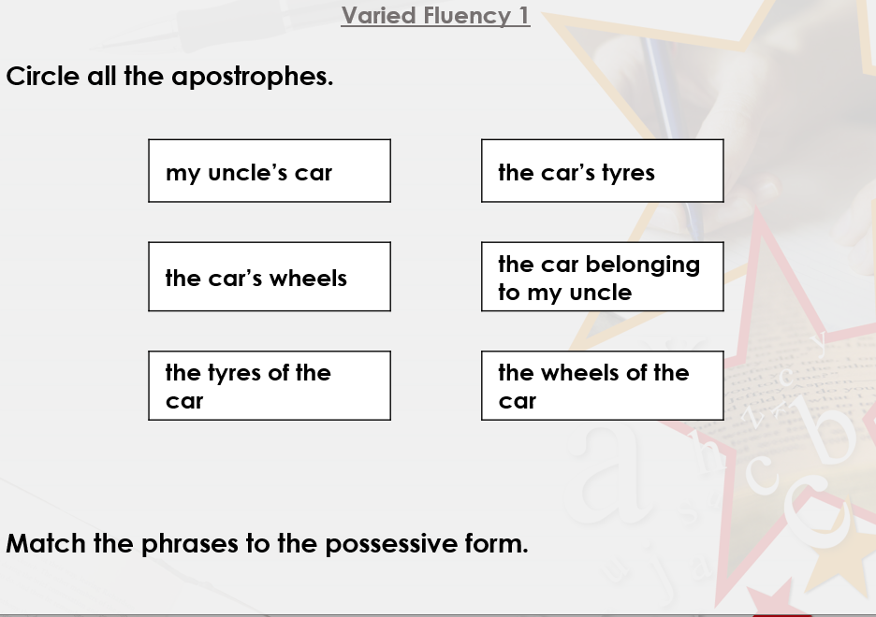

Slide 12
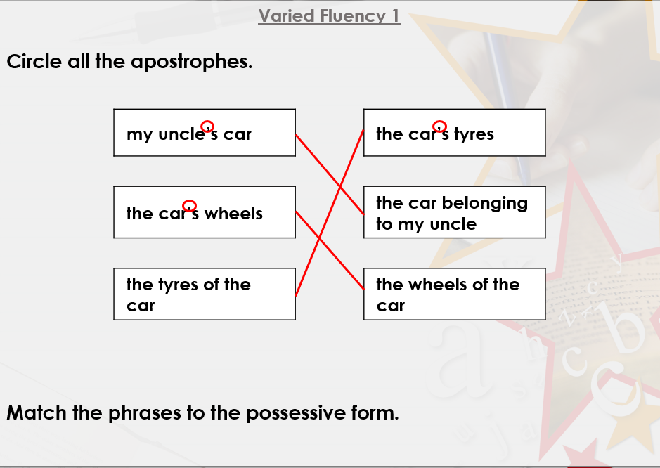

Slide 13
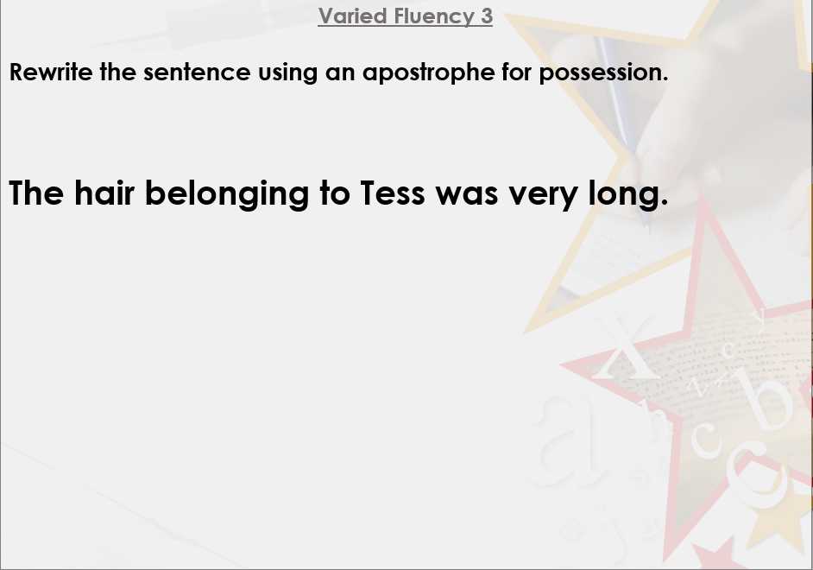

Slide 14
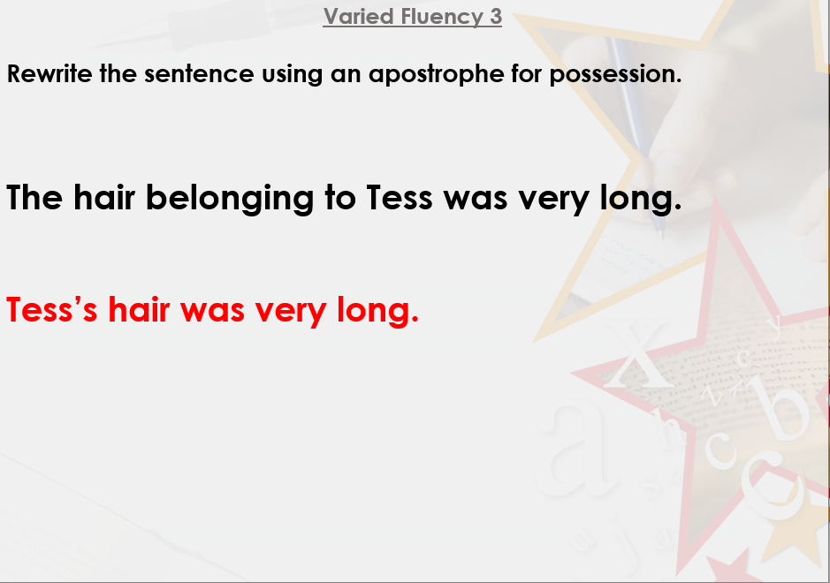

Slide 15
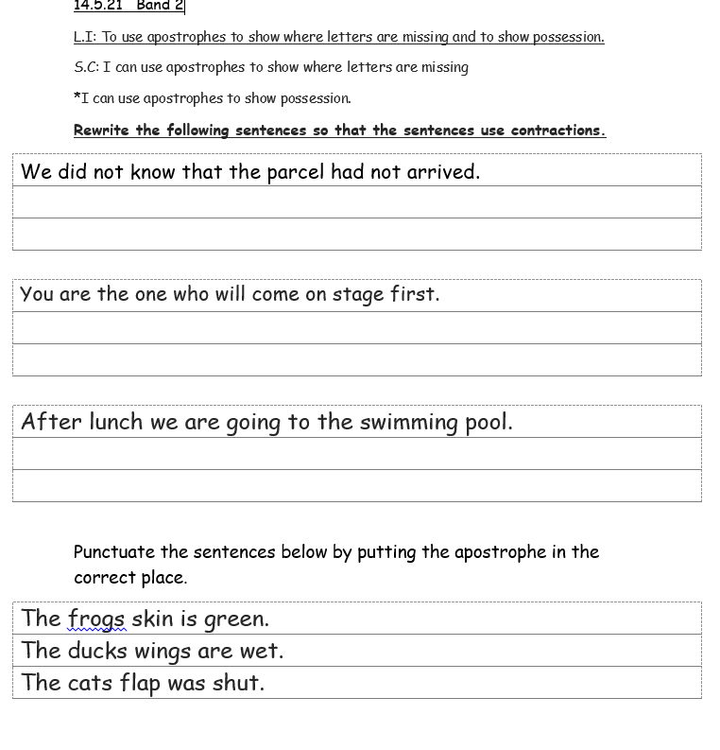
Task 1

Slide 16
L.I: To use the correct verb form to indicate actions in progress in the present or in the past. e.g.She is drumming. He was drumming.
S.C: I can use the correct verb form to indicate actions in the present and or in the past.
Using the correct verb to indicate actions in progress in the present and in the past .
Examples
He is jumping. (Present)
He was jumping. (Past)

Slide 17
Can you compose a sentence in the present and the past?
Discuss with the person next to you then feedback to the class.
Teacher to model writing the sentences.

Slide 18
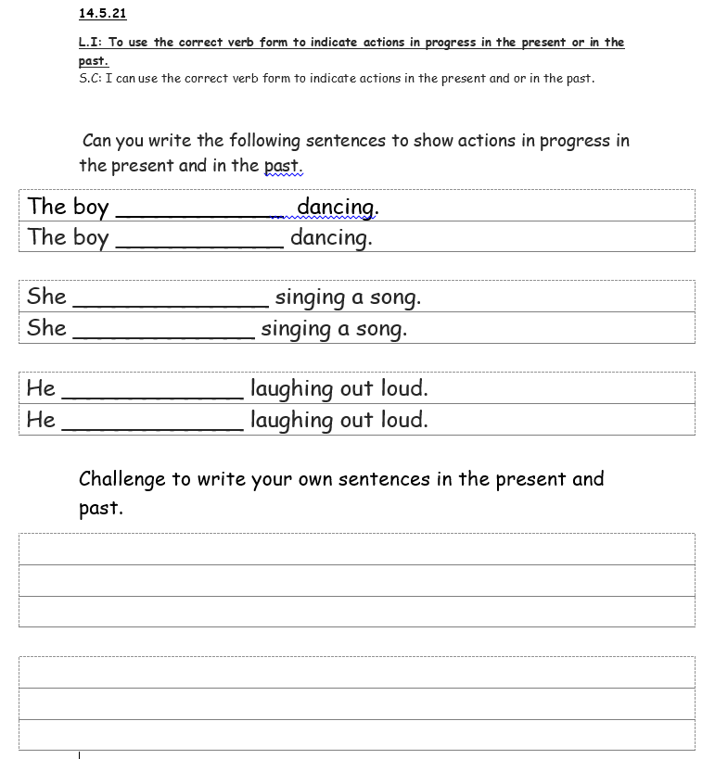
Task 2
To write sentences in the present and past.

