Slide 1
Term 5 Week 4
Afternoon Maths

Slide 2
Monday
PKS
L.I: To add single digit numbers.
Band 1
L.I: To answer multiplication questions using objects, pictures and arrays.
Band 2
L.I: To answer questions involving multiplication and division using arrays and repeated addition.

Slide 3
PKS
To add single digit numbers using counters, cubes or number line to support them.
4 + 5 =
2 + 4 =
7 + 2 =
8 + 4 =

Slide 4
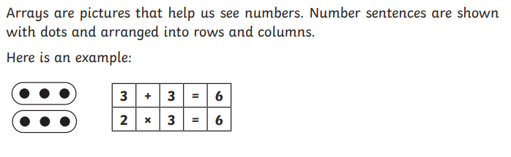
Band 1 and 2

Slide 5
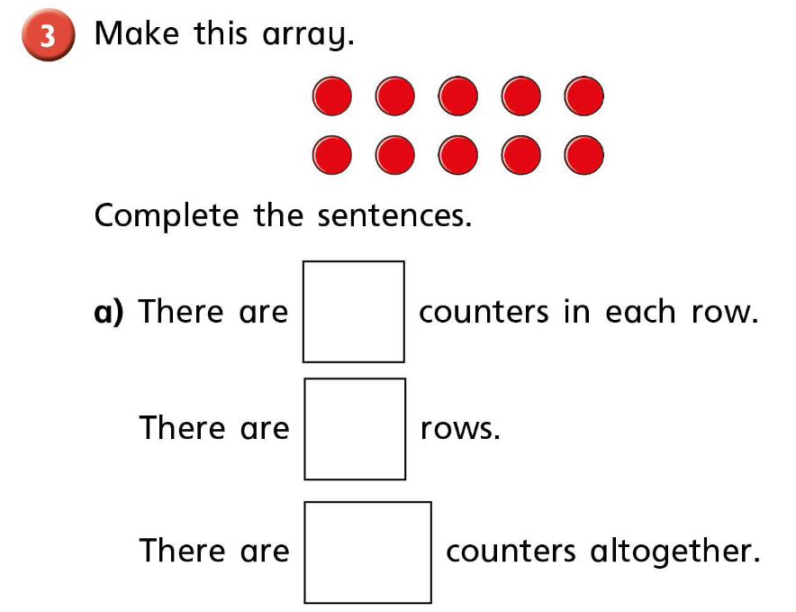

Slide 6
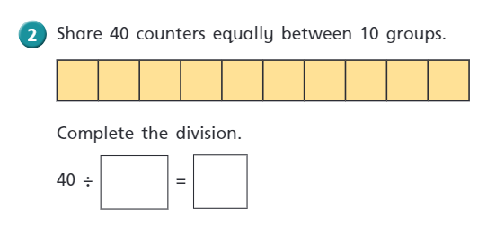
Band 2 Dividing with arrays

Slide 7
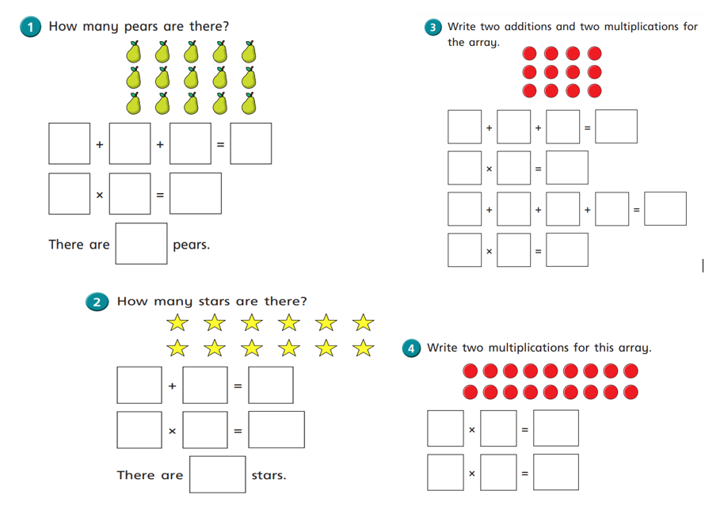
Activities
Band 1 and Band 2

Slide 8
Thursday PKS and Band 1
Children to add two single digit numbers .
Or Band 1
Add 2 two digit numbers .
Children to write their sums in their maths books.
Resources for support counter, Numicon, number line.

Slide 9
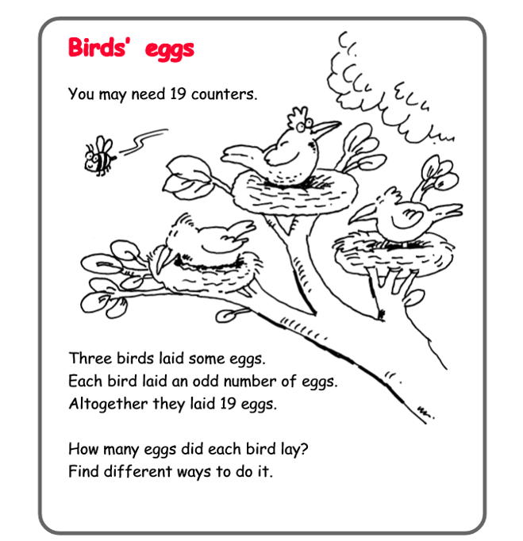
Thursday Band 2 Problem Solving
L.I: To add three single digit numbers.
S.C: I can add three single digit numbers.

Slide 10
Friday
PKS
L.I: To subtract single digit numbers.
Band 1
L.I: To answer division questions using objects, pictures and arrays.
Band 2
L.I: To compare and order numbers from 0 up to 100 use greater than , less than and = symbols.

Slide 11
PKS
Children to use counters, cubes or a number line to solve the subtract sums.
9 – 7 =
5 – 4 =
6 – 5 =

Slide 12
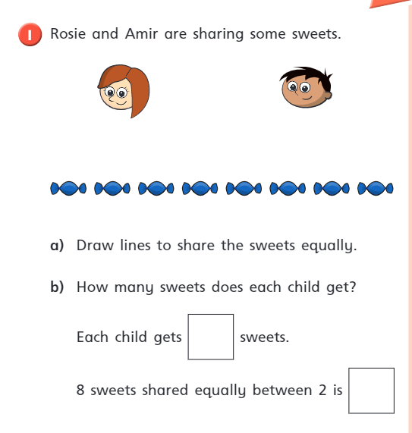
Band 1

Slide 13
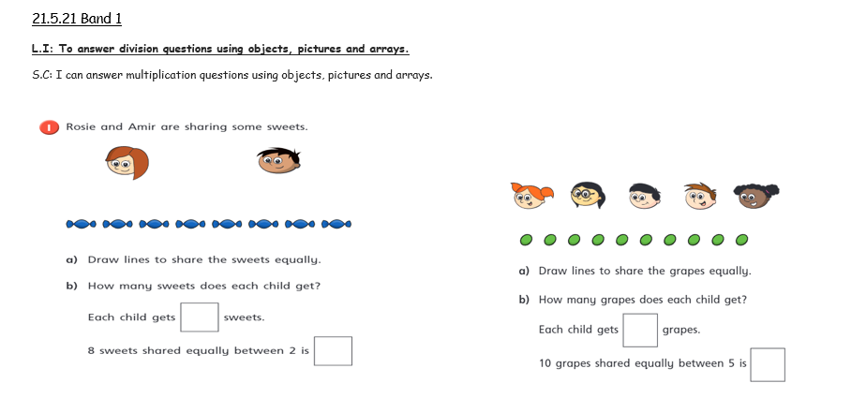
Activity

Slide 14
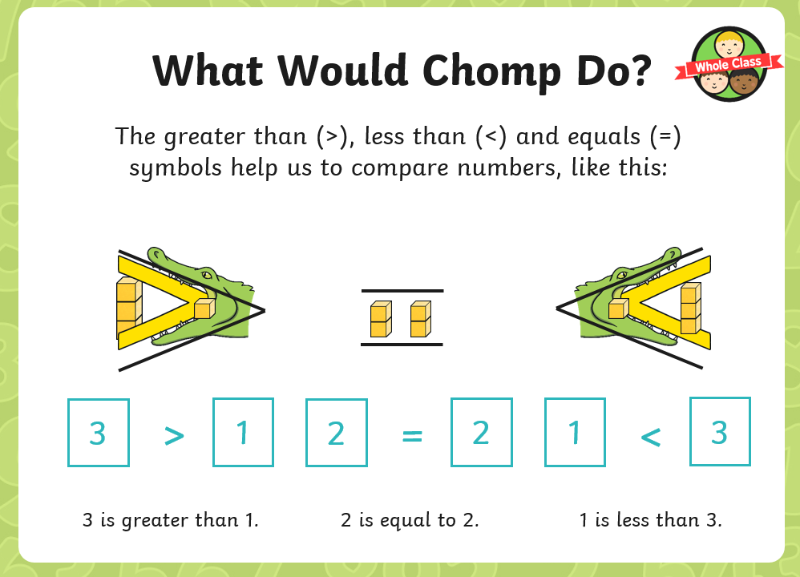
Band 2

Slide 15
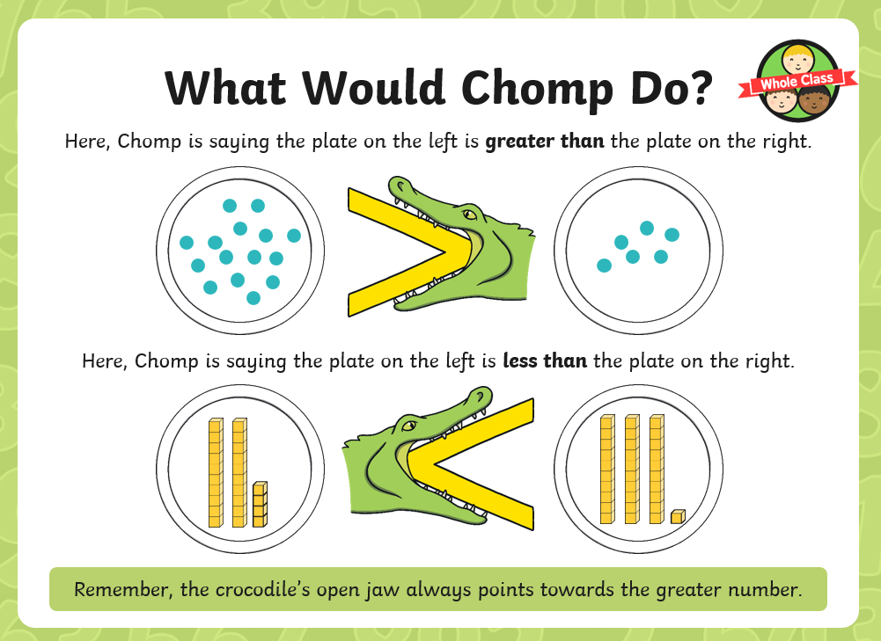

Slide 16
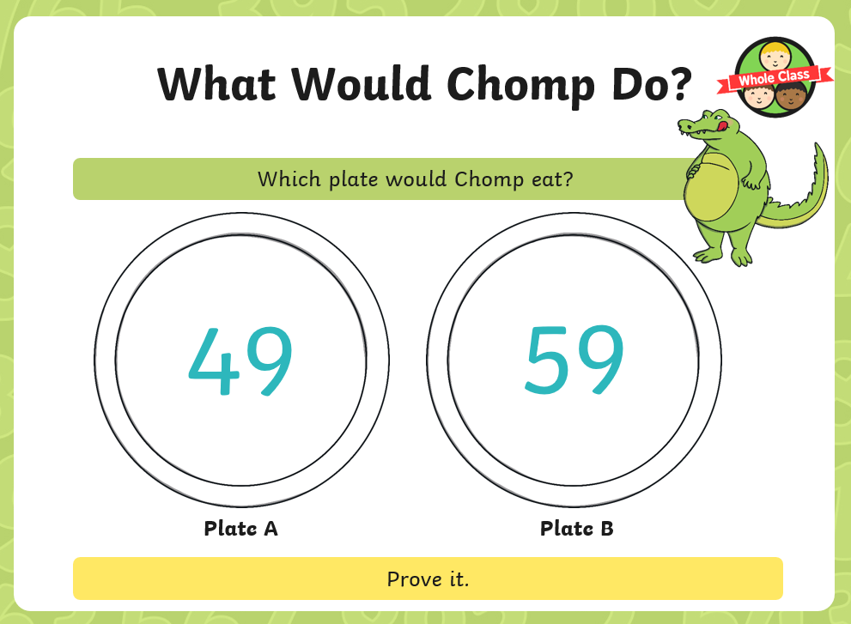

Slide 17
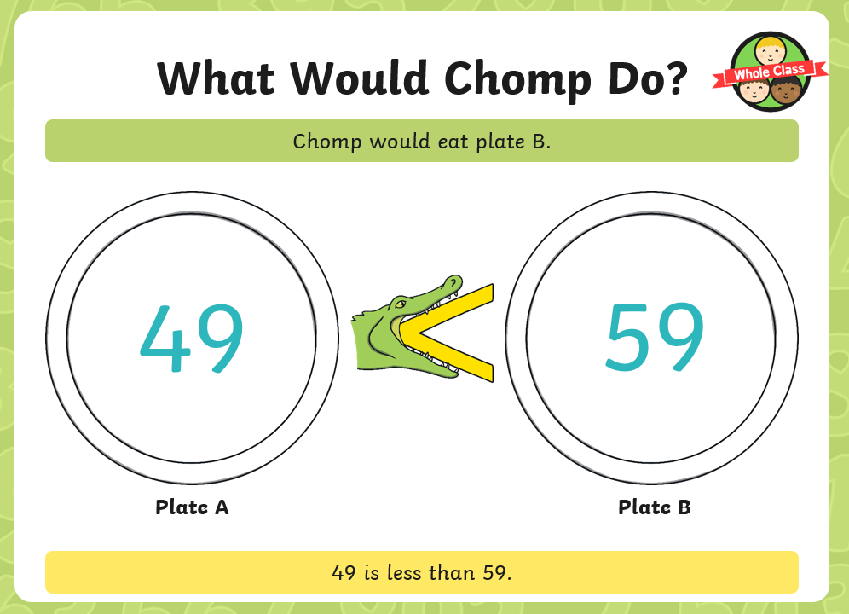

Slide 18
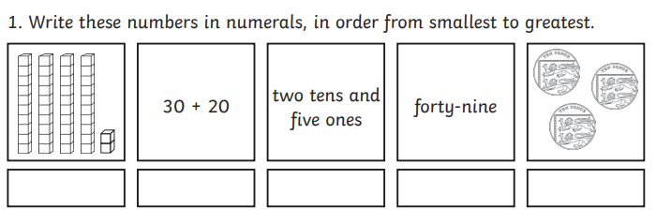
Ordering numbers for the smallest to the greatest.

Slide 19
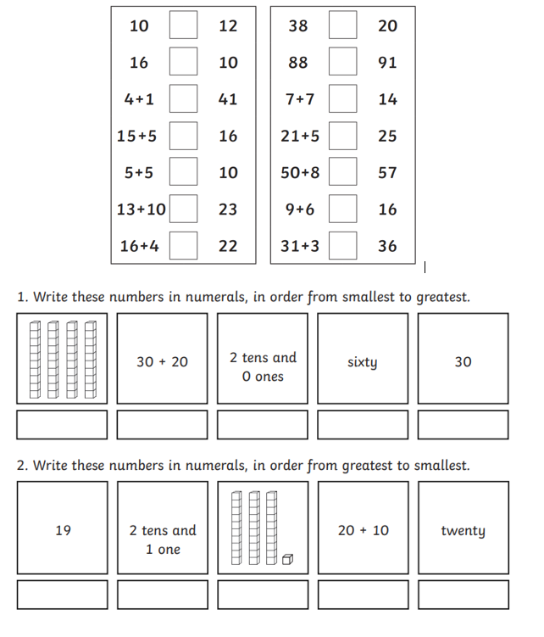
Activity

