Slide 1
Term 2 Week 2

Slide 2
Monday
L.I: To use coins to make different amounts.
Steps to success
* I can make a value using different coins.
* I can role play buying items using the correct coins.

Slide 3
Say what you see.

Slide 4
Coins

Slide 5
Notes

Slide 6
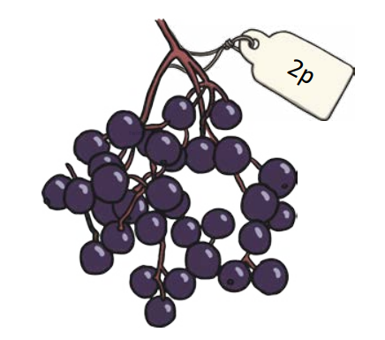
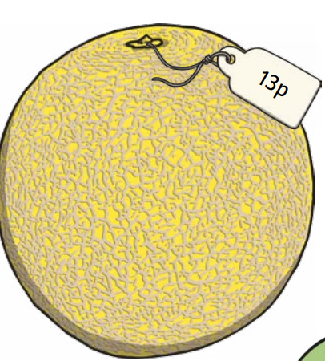
What coins can you use to buy this fruit?

Slide 7
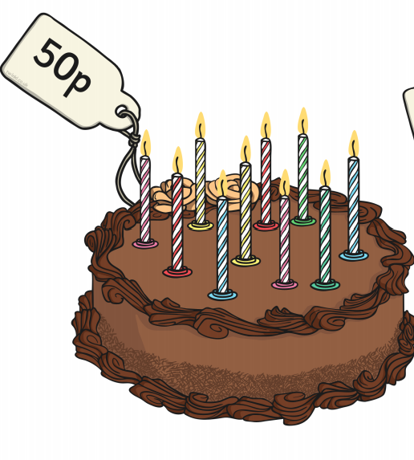
What coins can you use to buy these cakes?

Slide 8
Activity
To role play shops.
Children to buy various priced items using the correct coins and notes.

Slide 9
Challenge
Challenge: Can work out the price of the item using different coins?
e.g. 12p can be made with 2p + 10p or 5p + 5p + 2P
Can you think of a different way to make 12p with your coins?

Slide 10
Tuesday
L.I: To use coins to make different amounts.
Steps to success
* I can make a value using different coins.
* I can role play buying items using the correct coins.

Slide 11
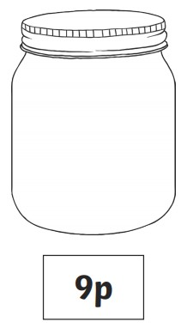
Say what you see.

Slide 12
Coins

Slide 13
Notes

Slide 14
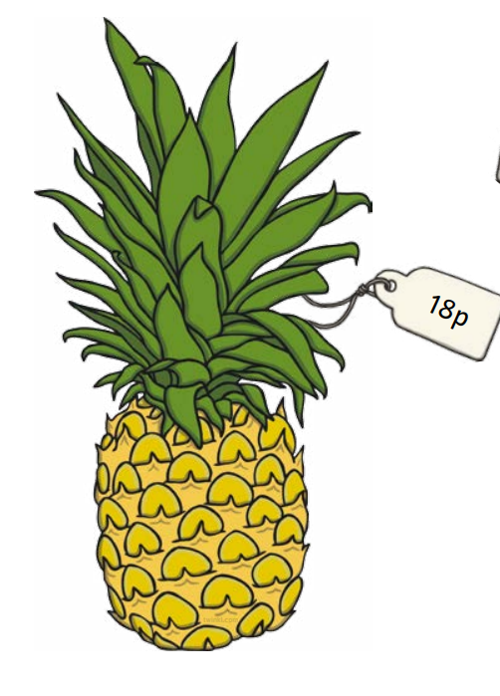
How many different ways can you make 17p and 18p?

Slide 15
Activity
To role play shops.
Children to buy various priced items using the correct coins and notes.
Can they use different coins and notes to pay for the items?
e.g. £1.25 can be made with £1 + 20p + 5p or 50p + 50p + 20P+ 5p
Can you think of a different way to make £1.25 with your coins?

