Slide 1
Session 1 Science
L.I: To describe why it is important for humans to have good hygiene.
Steps to success
* I know how to keep myself clean.
* I can perform a simple test.

Slide 2
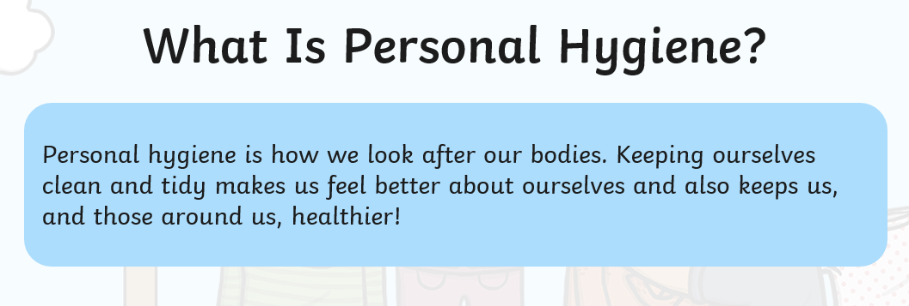
Hygiene

Slide 3
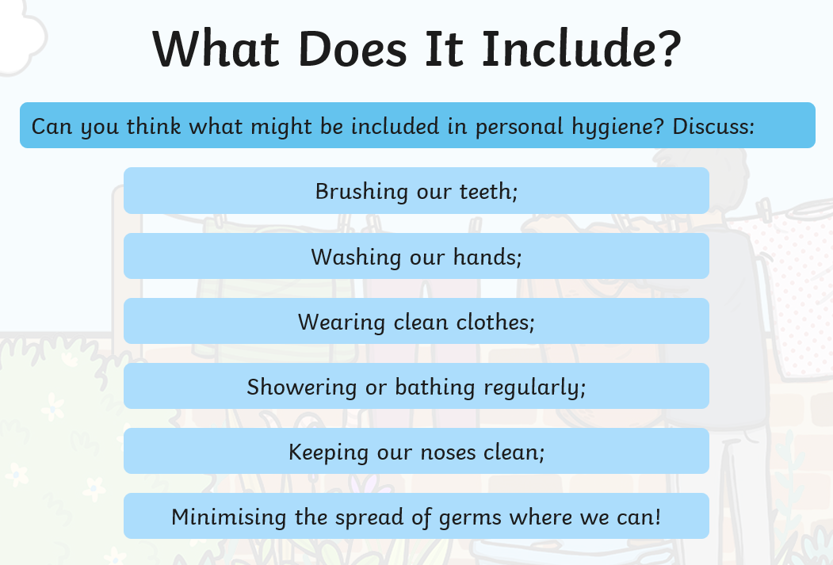

Slide 4
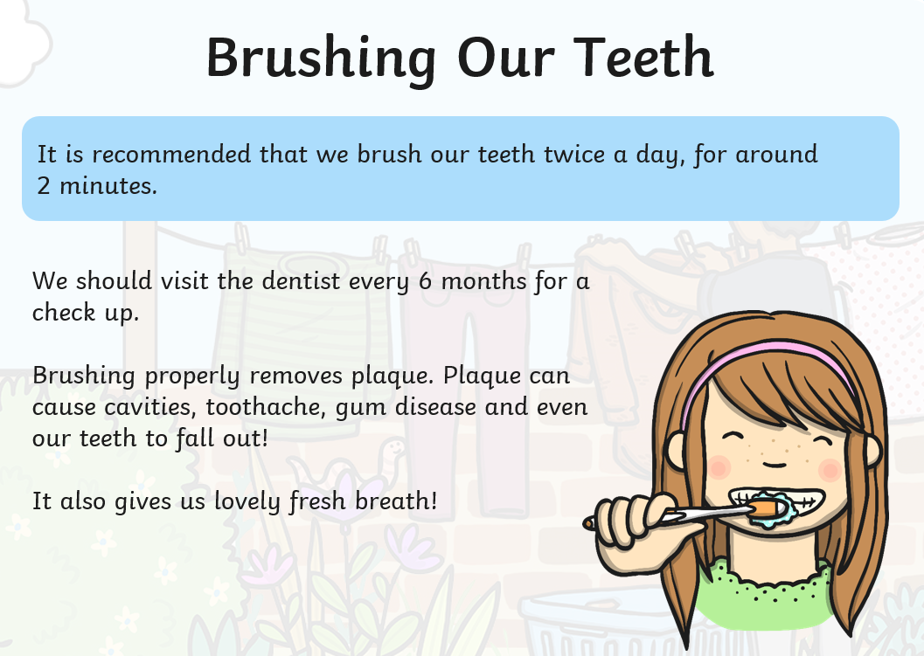

Slide 5
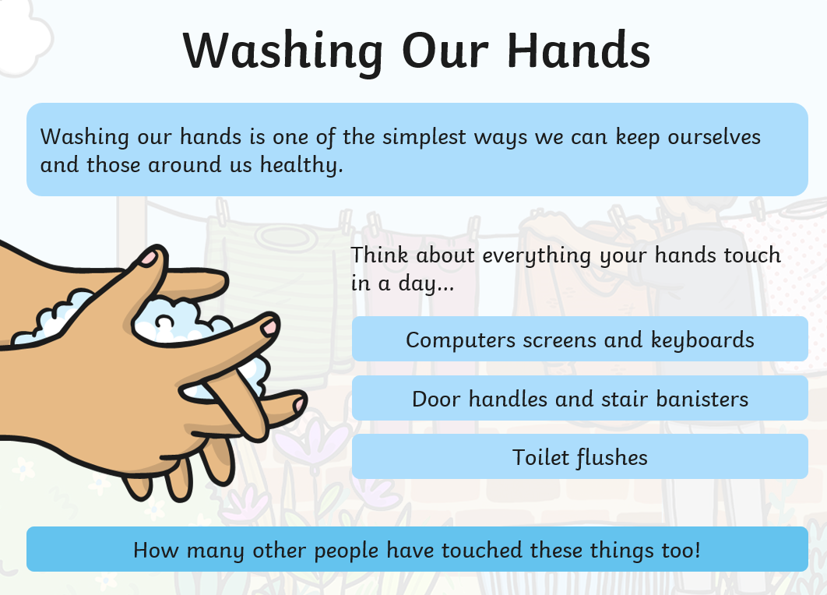

Slide 6
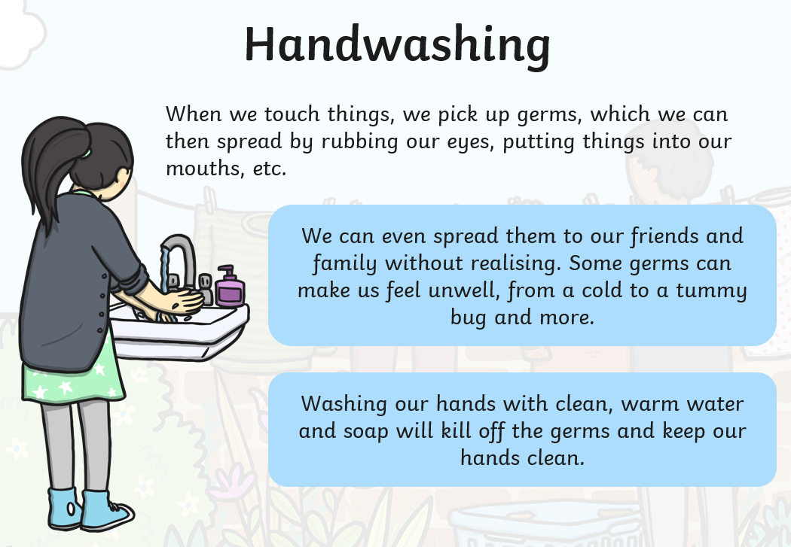

Slide 7
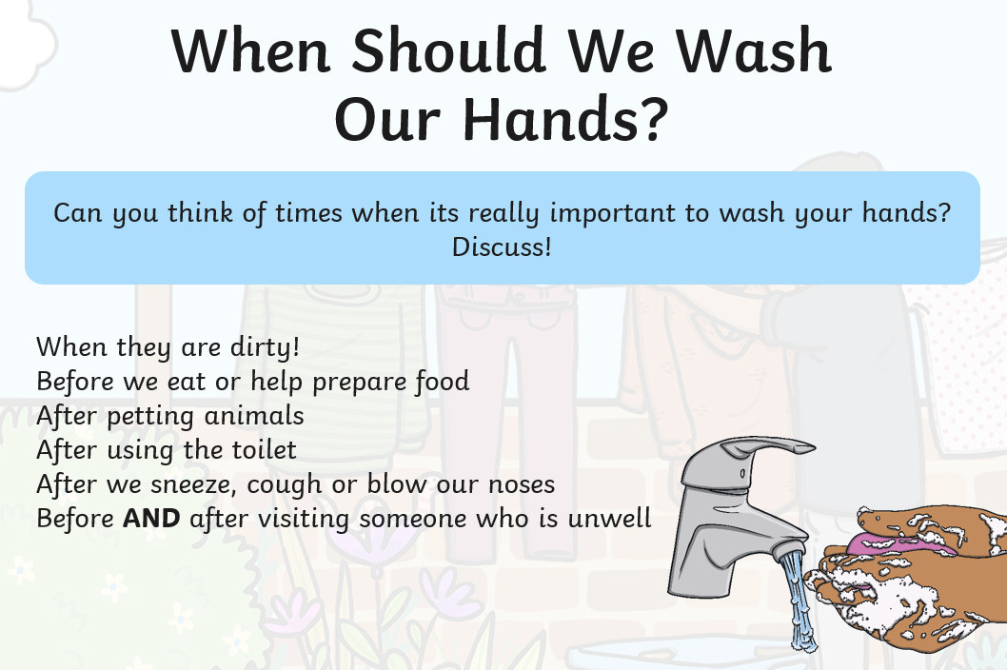

Slide 8
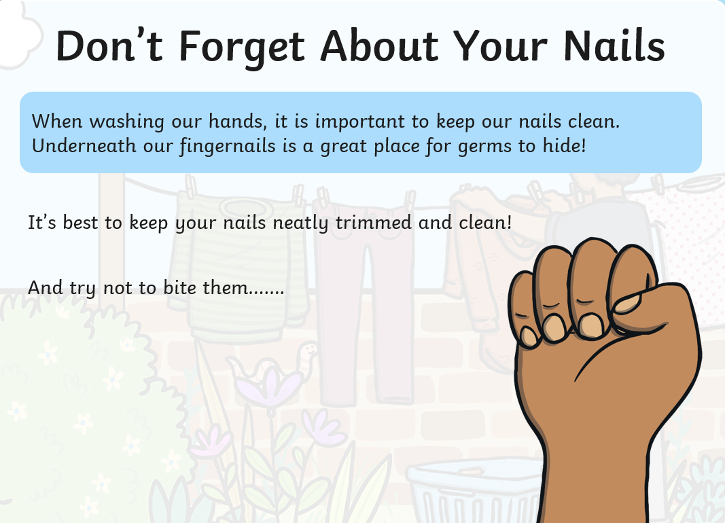

Slide 9
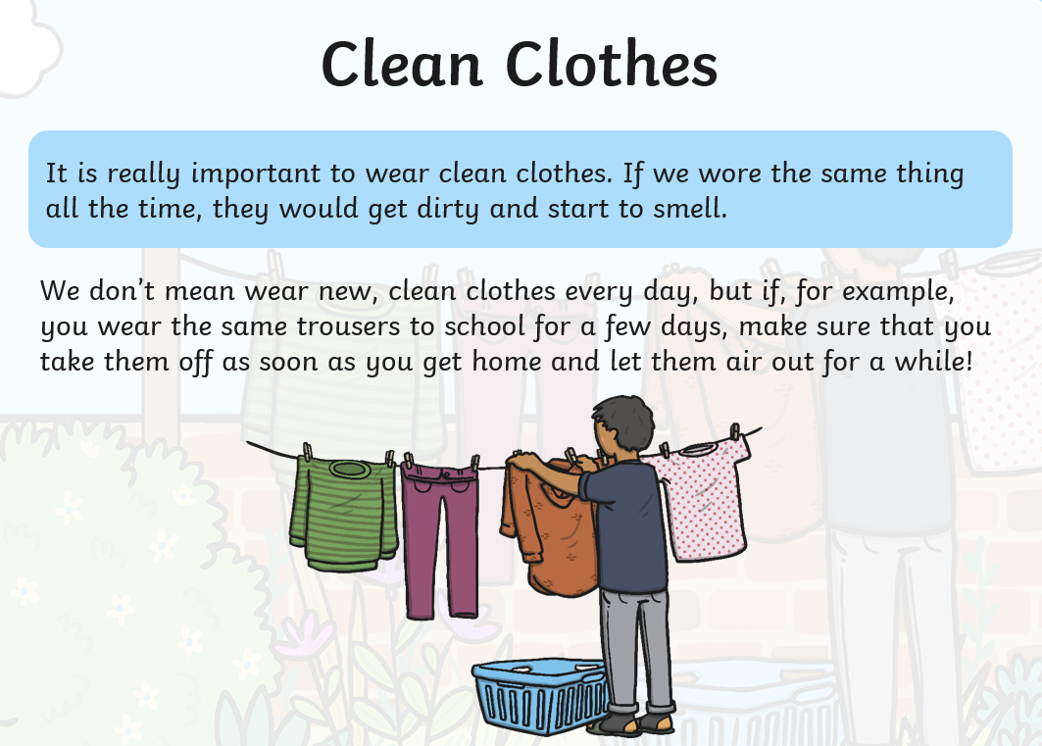

Slide 10
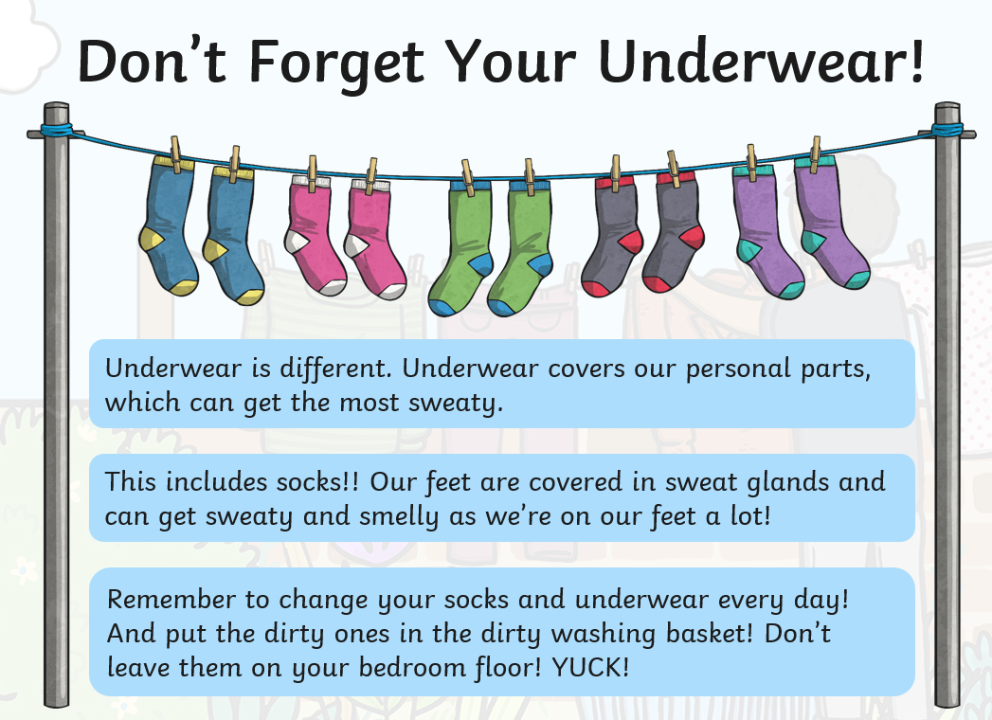

Slide 11
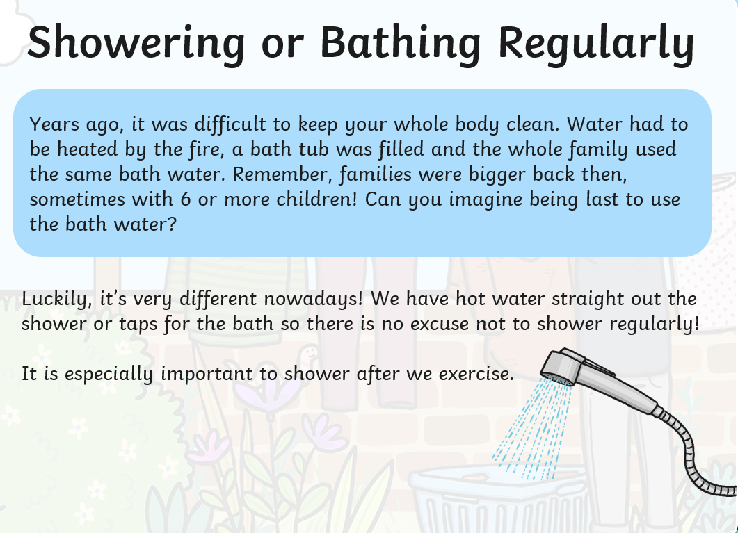

Slide 12
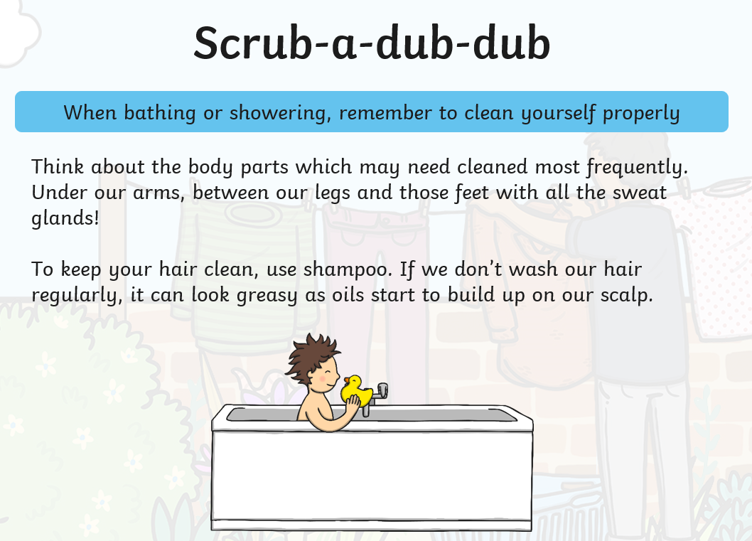

Slide 13
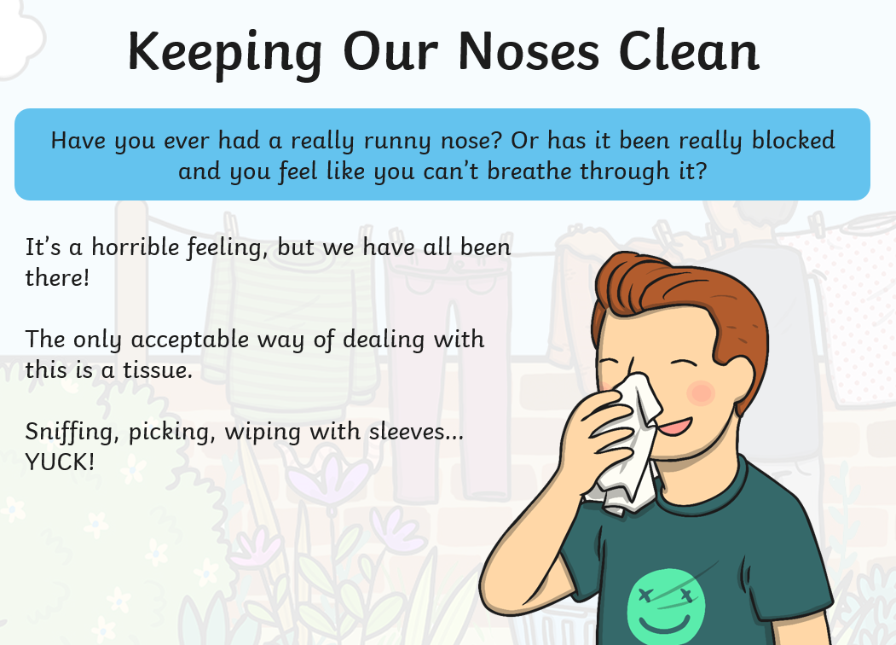

Slide 14
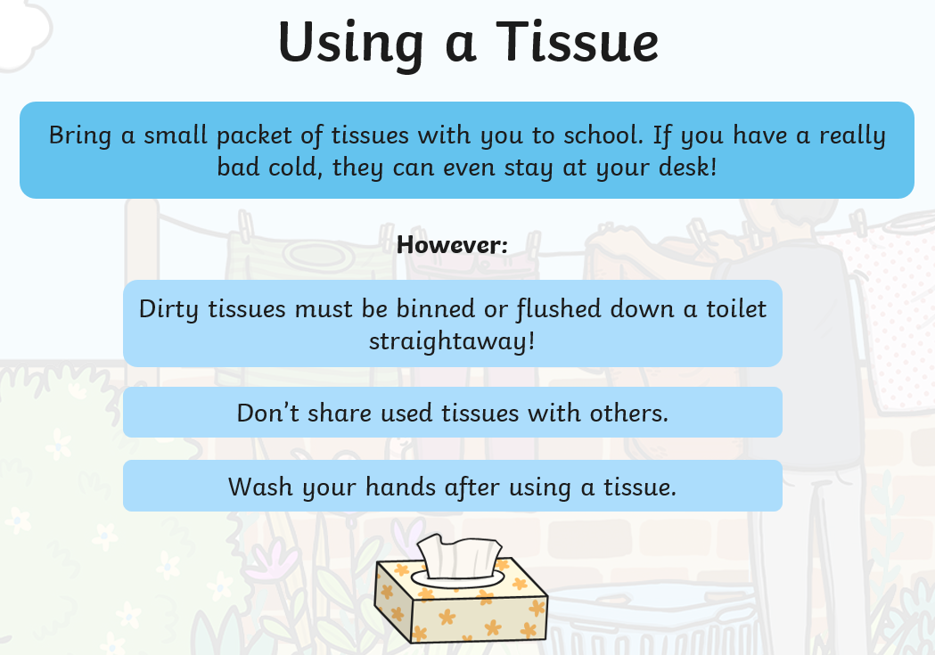

Slide 15
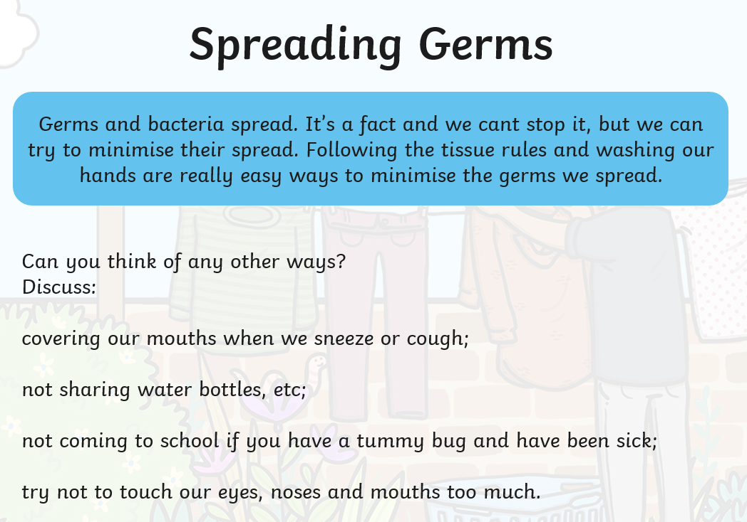

Slide 16
Experiment
Children to predict which round of washing will clean our hands.
Children to write their predictions.
After the experiment children to record their results.
Year 1- With pictures.
Year 2 – Writing sentences.

Slide 17
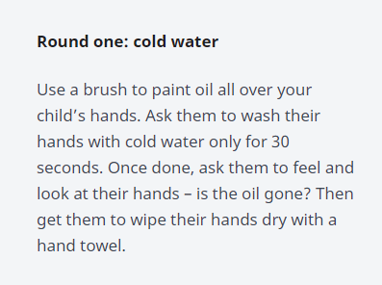
Experiment Round 1

Slide 18
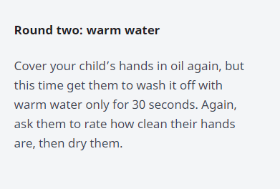
Round 2

Slide 19
