Slide 1
Book Talk
Year1/2
Week 7

Slide 2
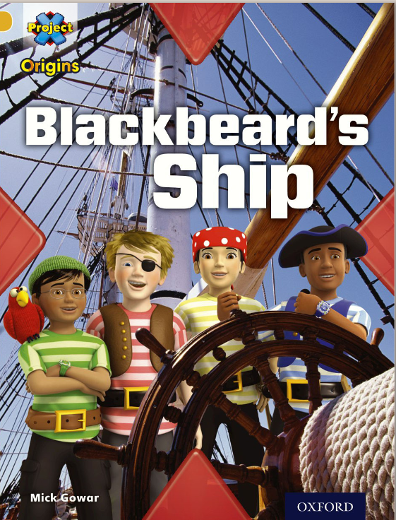
https://www.oxfordowl.co.uk/api/digital_books/2102.html

Slide 3
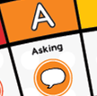
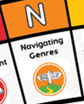
Monday Book Talk From page 12
Lenses

Slide 4
Thursday Model
.What disease killed a lot of pirates?
What is the pirate code?

Slide 5
Thursday Model
How many pirates were there on Blackbeard’s ship?
Can you name some of the pirates daily jobs?
What did pirates find in their food?

Slide 6
Thursday Model
How do you use a contents page?

Slide 7
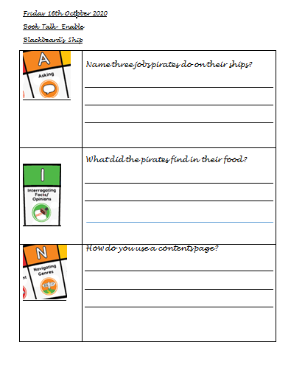
Friday Enable

