Slide 1
Geography
L.I: Name and locate the countries of the UK.
L.I: Name and locate London as England’s capital city.

Slide 2
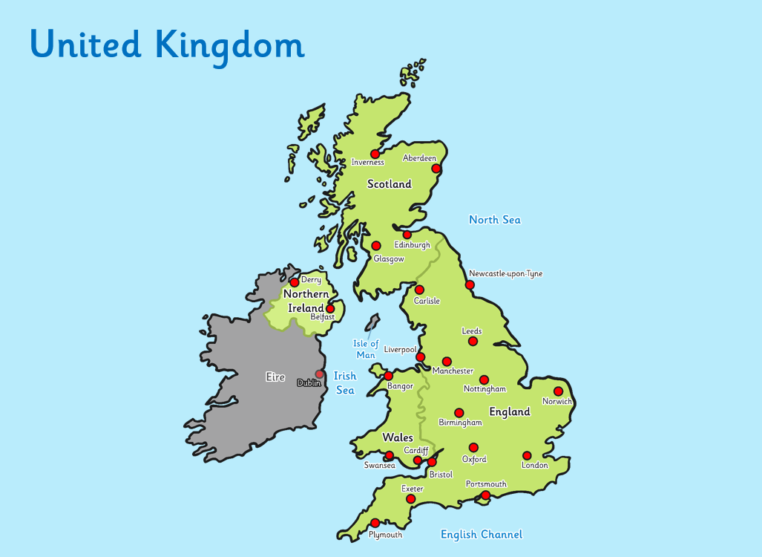

Slide 3
Look at a map of the United Kingdom
Using a map of the United Kingdom. Discuss and support your child in finding its four countries.
Do you know anything facts about England, Scotland, Wales or Northern Ireland?

Slide 4
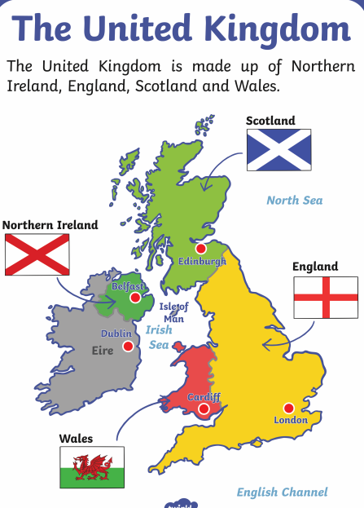
The United Kingdom is made up of four countries, England, Scotland, Wales and Northern Ireland.

Slide 5
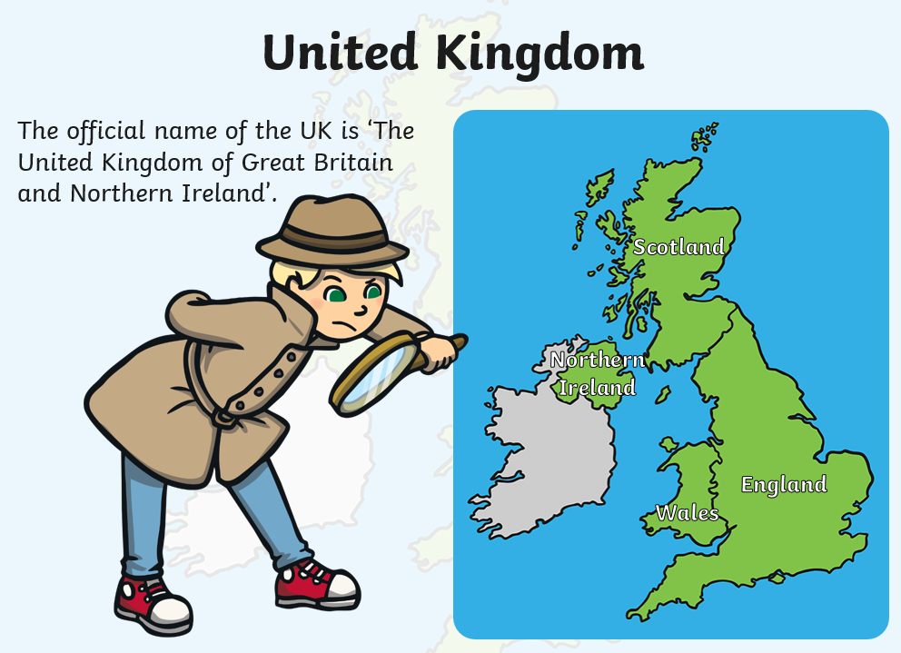

Slide 6
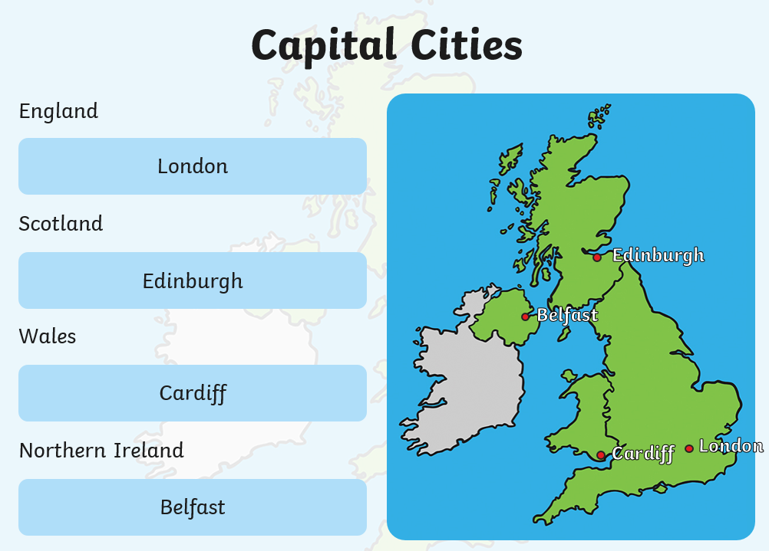
Capital Cities

Slide 7
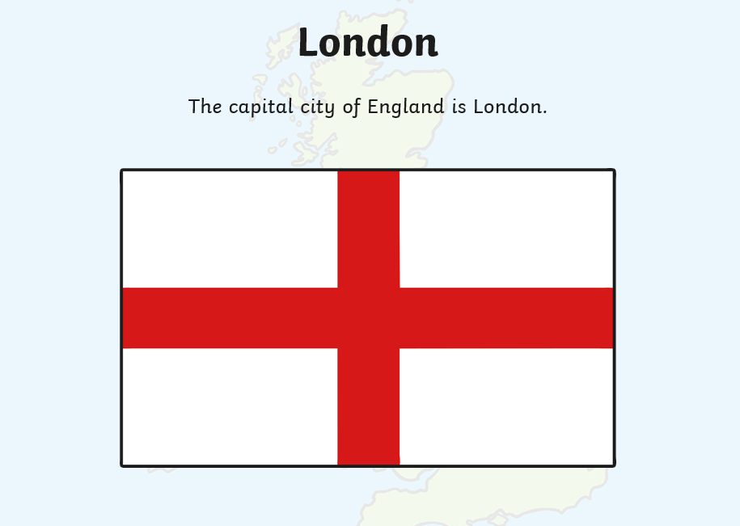
Look at your map of the UK and locate where London is.

Slide 8
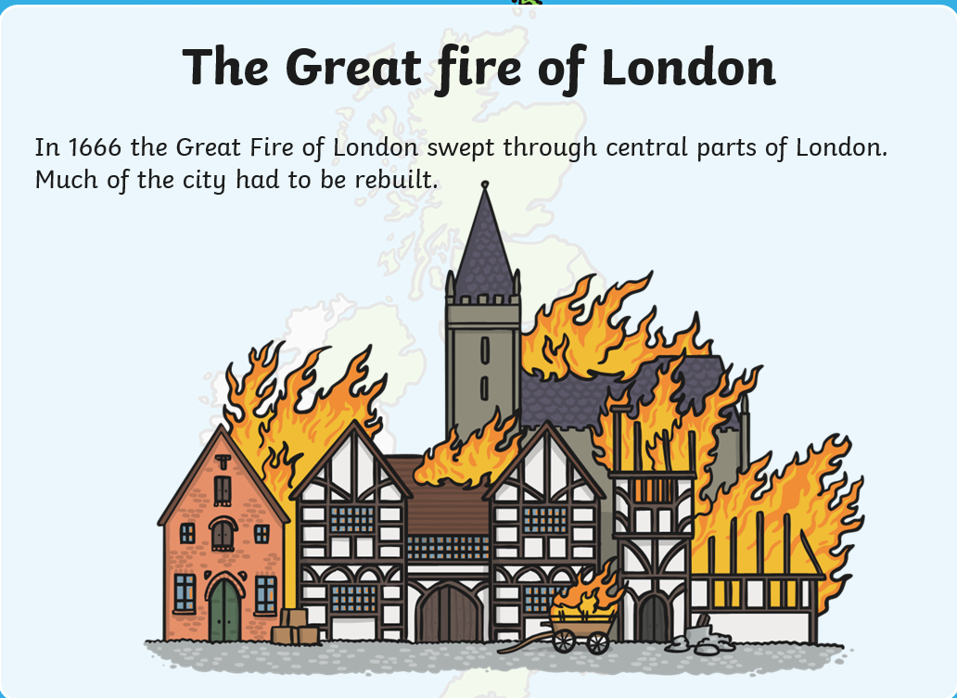
Facts about London

Slide 9
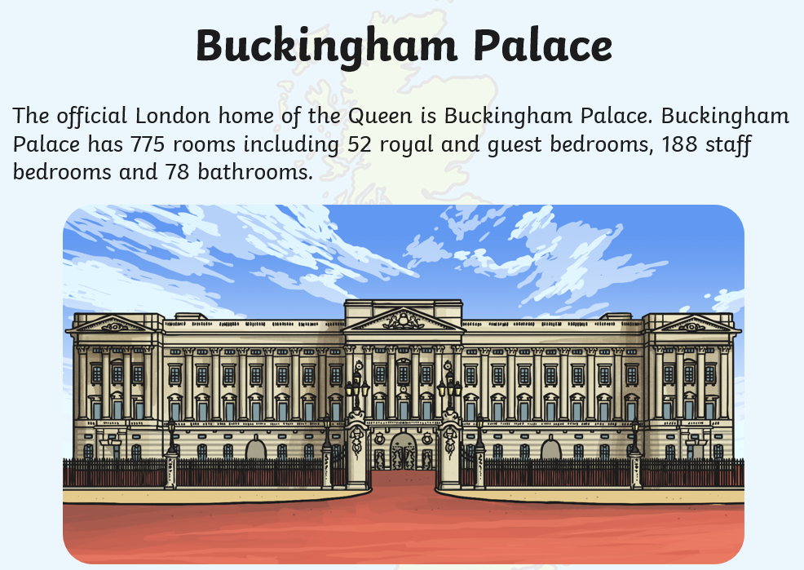

Slide 10
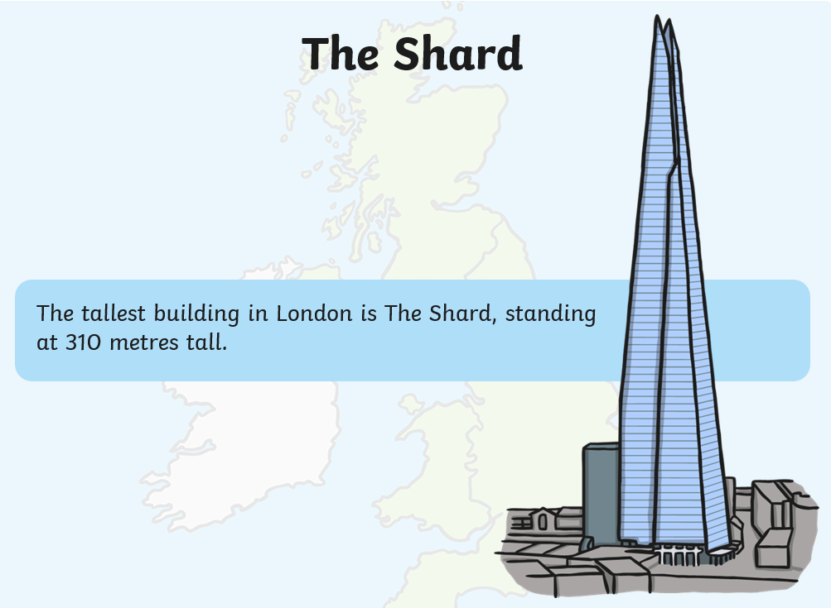

Slide 11
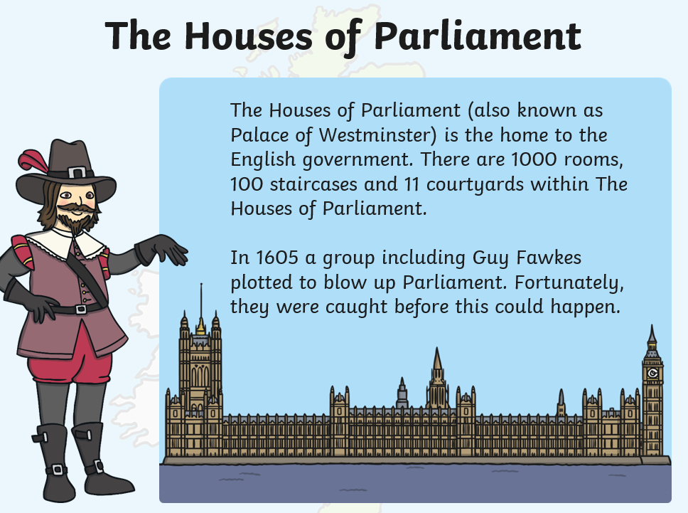

Slide 12
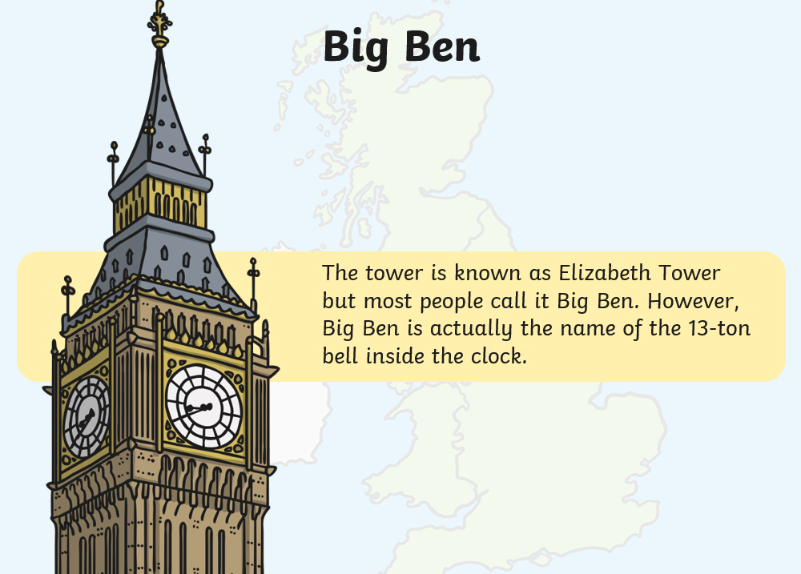

Slide 13
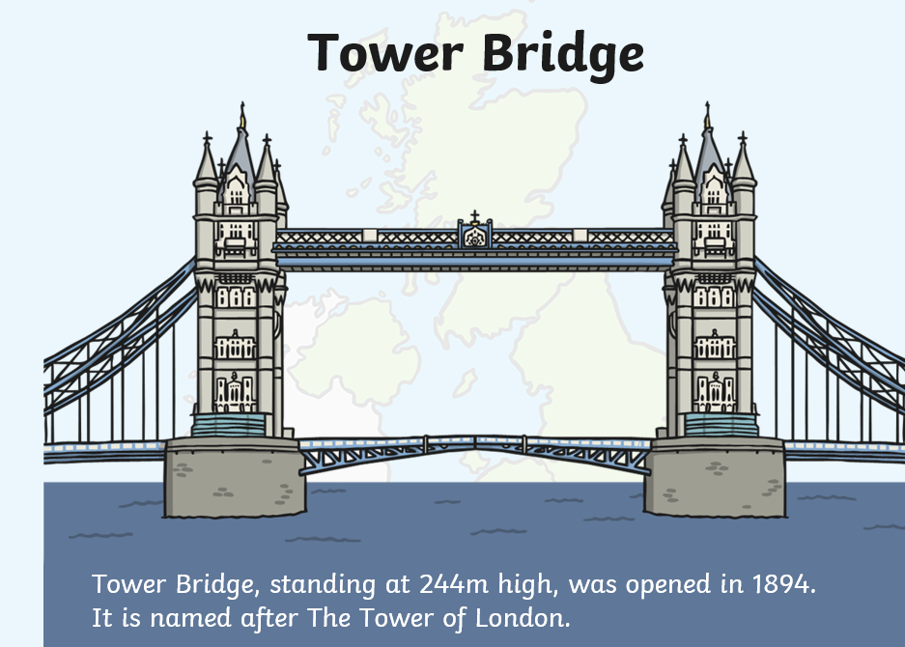

Slide 14
Tasks
To label the four countries on a map of the United Kingdom.
To locate where London is and label it on their map.
Extension : Children to use their computing skills to type up some facts about London.

