Slide 1
LIFE/work balance
We have started a #LIFEworkbalance campaign and we need your help to complete our LIFE/work balance survey.
We hope to publish the results soon, so please give 15 minutes of your time to help us get a true picture of school life.
Want to be a part of this campaign? Take the survey on our website and share it with your colleagues!
© Classroom Secrets Limited 2019

Slide 2
Year 1 – Summer Block 4 – Place Value – Comparing Numbers 1
About This Resource:
This PowerPoint has been designed to support your teaching of this small step. It includes a starter activity and an example of each question from the Varied Fluency and Reasoning and Problem Solving resources also provided in this pack. You can choose to work through all examples provided or a selection of them depending on the needs of your class.
National Curriculum Objectives:
Mathematics Year 1: (1N4) Identify and represent numbers using objects and pictorial representations including the number line, and use the language of: equal to, more than, less than (fewer), most and least
More Year 1 Place Value resources.
Did you like this resource? Don’t forget to review it on our website.
© Classroom Secrets Limited 2019

Slide 3
Year 1 – Summer Block 4 – Place Value
Step 3: Comparing
Numbers 1
© Classroom Secrets Limited 2019

Slide 4
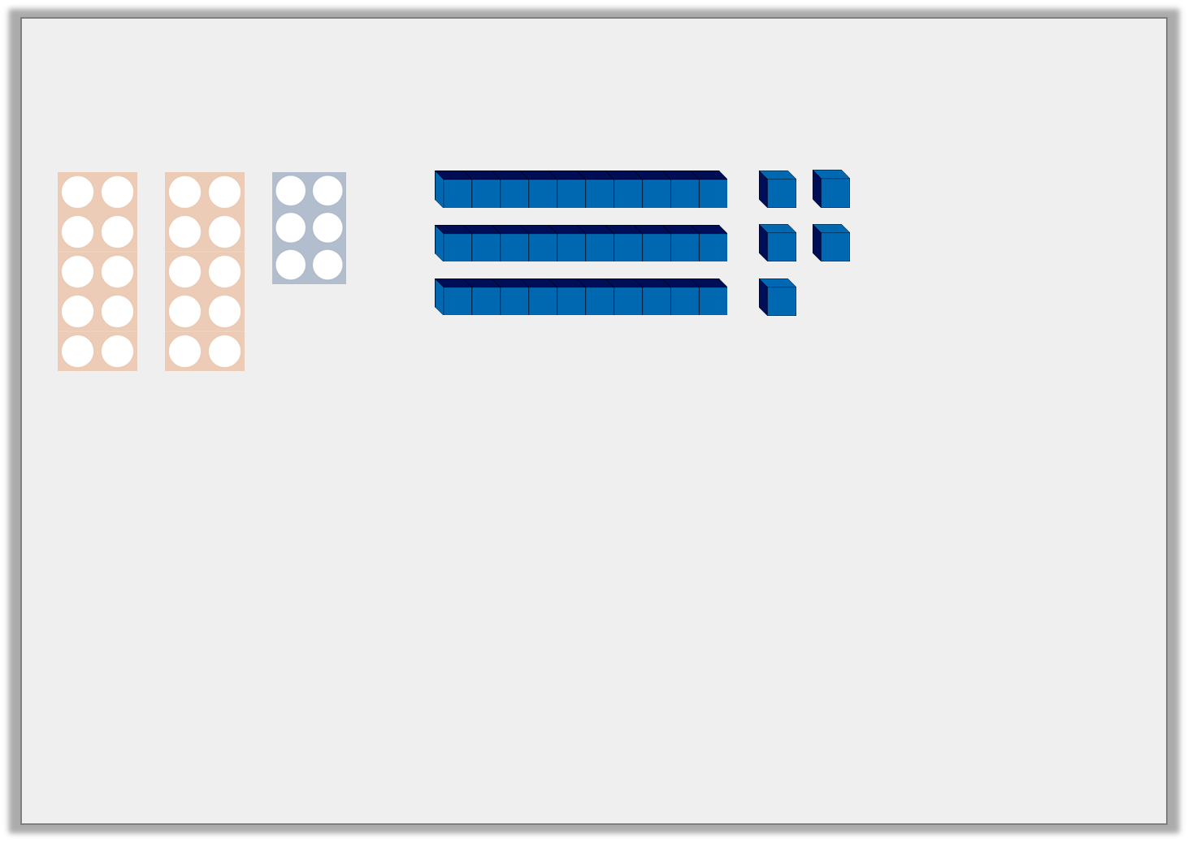
Introduction
Match the numbers to the diagrams.
Which number is the odd one out?
Tens | Ones
18 | 35 | 26 | 42
© Classroom Secrets Limited 2019

Slide 5
Introduction
Match the numbers to the diagrams.
Which number is the odd one out? 18
Tens | Ones
18 | 35 | 26 | 42
© Classroom Secrets Limited 2019

Slide 6
Varied Fluency 1
Colour the tens and ones to show a number which is less than 30.
© Classroom Secrets Limited 2019

Slide 7
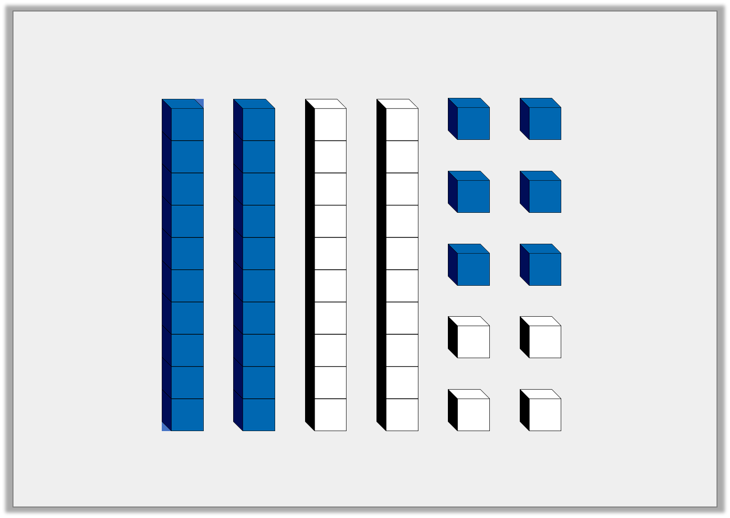
Varied Fluency 1
Colour the tens and ones to show a number which is less than 30.
Any number coloured between 11 and 29. For example 2 tens and 6 ones to show 26.
© Classroom Secrets Limited 2019

Slide 8
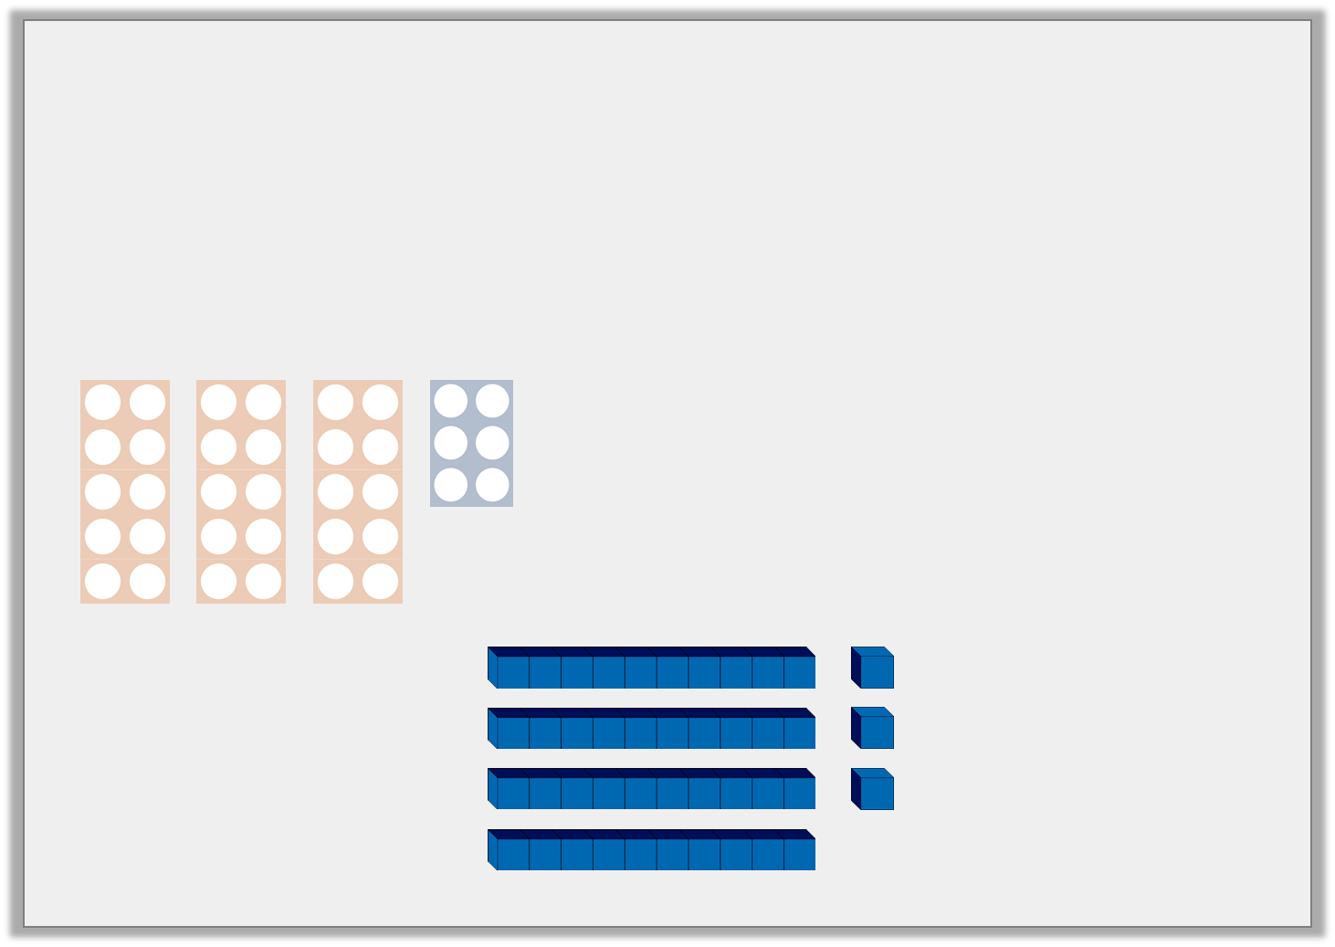
Varied Fluency 2
Circle the picture which matches the clue.
More than 30 but < 40.
© Classroom Secrets Limited 2019

Slide 9
Varied Fluency 2
Circle the picture which matches the clue.
More than 30 but < 40.
© Classroom Secrets Limited 2019

Slide 10
Varied Fluency 3
On the number track, write a number:
A) equal to 5 tens and 6 ones.
B) < 55 with 3 ones.
51 |  |  | 54 |  |  | 57
© Classroom Secrets Limited 2019

Slide 11
Varied Fluency 3
On the number track, write a number:
A) equal to 5 tens and 6 ones.
B) < 55 with 3 ones.
51 |  | B = 53 | 54 |  | A = 56 | 57
© Classroom Secrets Limited 2019

Slide 12
Problem Solving 1
Read the clues. Draw 2 possible answers in the grids.
I am less than 45 but more than 35. What numbers could I be?
Tens | Ones
Tens | Ones
© Classroom Secrets Limited 2019

Slide 13
Problem Solving 1
Read the clues. Draw 2 possible answers in the grids.
I am less than 45 but more than 35. What numbers could I be?
Any number from 36 to 44, e.g.
Tens | Ones
Tens | Ones
© Classroom Secrets Limited 2019

Slide 14
Problem Solving 2
Label the number line to show:
A number less than 30 but more than 20.
A number more than 30 with less than 6 ones.
20
40
© Classroom Secrets Limited 2019

Slide 15
Problem Solving 2
Label the number line to show:
A number less than 30 but more than 20.
Answers between 21 and 29
A number more than 30 with less than 6 ones.
Answers between 31 and 35.
Various possible answers, for example:
25
31
20
40
© Classroom Secrets Limited 2019

Slide 16
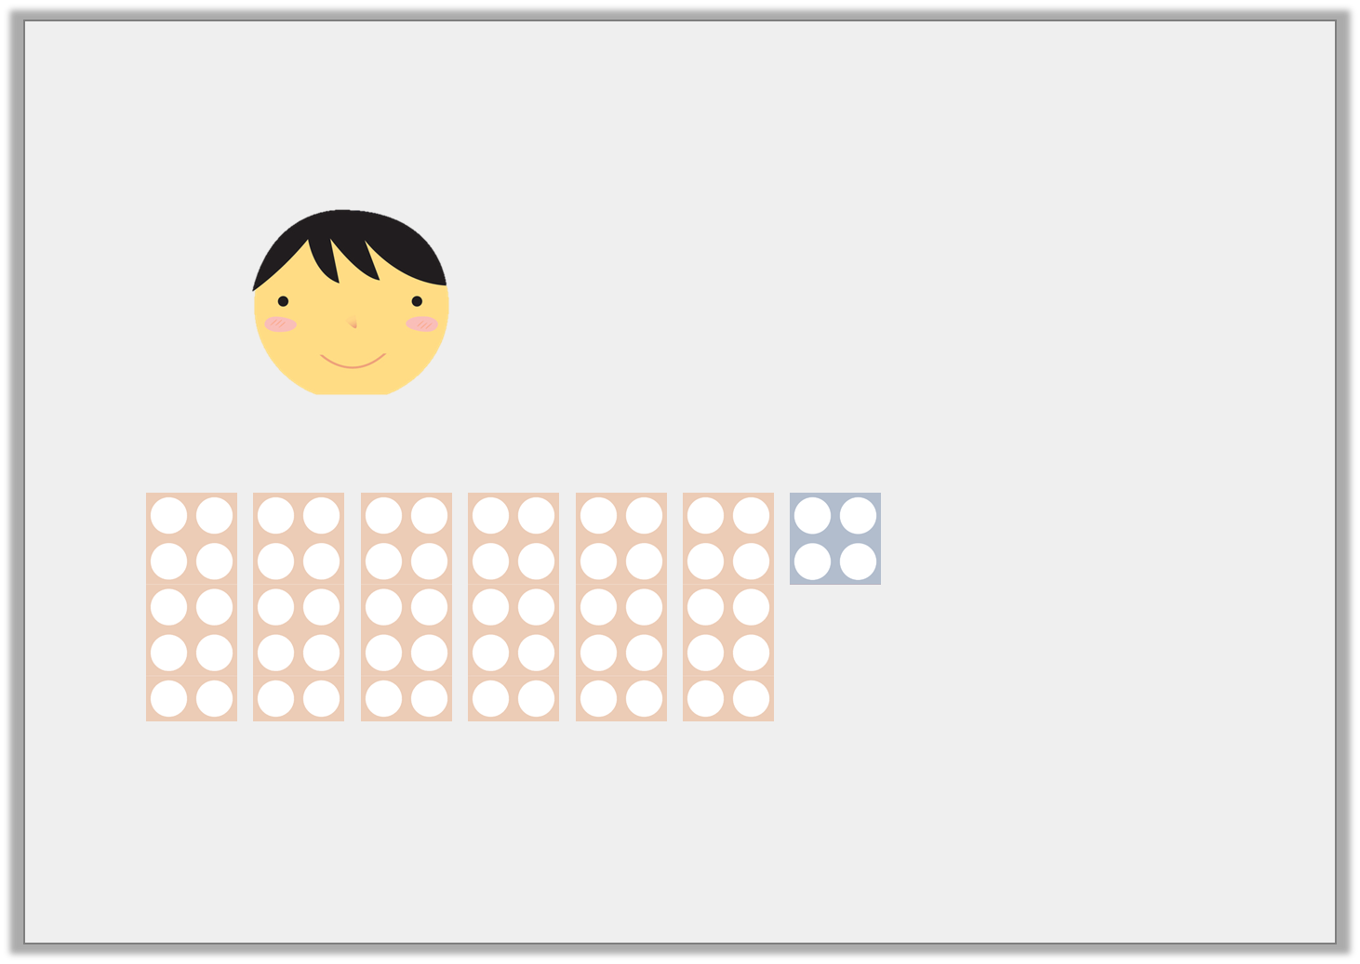
Reasoning 1
Rayyan says,
Is he correct? Explain why.
My number is equal to 6 tens and 4 ones and is > 65.
© Classroom Secrets Limited 2019

Slide 17
Reasoning 1
Rayyan says,
Is he correct? Explain why.
Rayyan’s number is ______ so he is incorrect because his number is ______ less than 65.
My number is equal to 6 tens and 4 ones and is > 65.
© Classroom Secrets Limited 2019

Slide 18
Reasoning 1
Rayyan says,
Is he correct? Explain why.
Rayyan’s number is ______ so he is incorrect because his number is ______ less than 65.
My number is equal to 6 tens and 4 ones and is > 65.
64
1
© Classroom Secrets Limited 2019

