Slide 1
LIFE/work balance
We have started a #LIFEworkbalance campaign and we need your help to complete our LIFE/work balance survey.
We hope to publish the results soon, so please give 15 minutes of your time to help us get a true picture of school life.
Want to be a part of this campaign? Take the survey on our website and share it with your colleagues!
© Classroom Secrets Limited 2019

Slide 2
Year 1 – Summer Block 5 – Sequencing Sentences – Recognising a Sentence
About This Resource:
This PowerPoint has been designed to support your teaching of this small step. It includes a starter activity and an example of each question from the Varied Fluency and Application and Reasoning resources also provided in this pack. You can choose to work through all examples provided or a selection of them depending on the needs of your class.
National Curriculum Objectives:
English Year 1: (1G3) Sequencing sentences to form short narratives
More resources from our Grammar, Punctuation and Spelling scheme of work.
Did you like this resource? Don’t forget to review it on our website.
© Classroom Secrets Limited 2019

Slide 3
Year 1 – Summer Block 5 – Sequencing Sentences – Recognising a Sentence
Notes and Guidance:
From previous learning in Year 1, children will have learnt how words can be put together to form a sentence and should know what is needed to make a complete sentence.
Children should be familiar with nouns and verbs or should be reminded about these word types.
Children should also be familiar with using the conjunctions ‘and’, ‘but’ and ‘or’ to join simple sentences together.
Following learning in previous blocks, children should be capable of identifying and using questions as a type of sentence and some children will understand the use of exclamation marks.
This step will draw on this previous learning and allow children the opportunity to recognise sentences and be able to say whether a sentence is accurate, whether it makes sense and whether it is a complete sentence or not.
Focused Questions
Read the words below and tick if it is a complete sentence.
Add a word to the words below to make a complete sentence that make sense.
Does the sentence below make sense? How do you know?
© Classroom Secrets Limited 2019

Slide 4
Year 1 – Summer Block 5 – Sequencing Sentences
Step 1: Recognising a Sentence
© Classroom Secrets Limited 2019

Slide 5
Introduction
Sort the words in the correct category.
Nouns | Verbs
jump | cheese | look | clap | cat
book | sing | school | pen | stand
© Classroom Secrets Limited 2019

Slide 6
Introduction
Sort the words in the correct category.
Nouns | Verbs
cheese | jump
cat | look
book | clap
school | sing
pen | stand
jump | cheese | look | clap | cat
book | sing | school | pen | stand
© Classroom Secrets Limited 2019

Slide 7
Varied Fluency 1
Tick the complete sentence below.
A. | Cam saw a bus and.
B. | Betty liked apples but not oranges.
C. | Black chair.
© Classroom Secrets Limited 2019

Slide 8
Varied Fluency 1
Tick the complete sentence below.
A. | Cam saw a bus and.
B. | Betty liked apples but not oranges. |  | ✓
C. | Black chair.
© Classroom Secrets Limited 2019

Slide 9
Varied Fluency 2
True or false? The sentence below is a complete sentence.
Kelly ran to her house and started to.
© Classroom Secrets Limited 2019

Slide 10
Varied Fluency 2
True or false? The sentence below is a complete sentence.
Kelly ran to her house and started to.
False
© Classroom Secrets Limited 2019

Slide 11
Varied Fluency 3
Underline the verbs and circle the nouns in the sentence below.
Tina is going to the cinema to watch a film and eat lots of yummy popcorn.
© Classroom Secrets Limited 2019

Slide 12
Varied Fluency 3
Underline the verbs and circle the nouns in the sentence below.
Tina is going to the cinema to watch a film and eat lots of yummy popcorn.
© Classroom Secrets Limited 2019

Slide 13
Varied Fluency 4
Choose the correct words and punctuation to complete the sentence below.
Can all animals _____________ and ____________ underwater
swim | but | eat
or | . | ?
© Classroom Secrets Limited 2019

Slide 14
Varied Fluency 4
Choose the correct words and punctuation to complete the sentence below.
Can all animals eat and swim underwater?
swim | but | eat
or | . | ?
© Classroom Secrets Limited 2019

Slide 15
Reasoning 1
Ruby is describing her bag.
She says,
Has Ruby used a complete sentence?
Convince me!
Blue and pink and yellow
© Classroom Secrets Limited 2019

Slide 16
Reasoning 1
Ruby is describing her bag.
She says,
Has Ruby used a complete sentence?
Convince me!
No she hasn’t used a complete sentence because…
Blue and pink and yellow
© Classroom Secrets Limited 2019

Slide 17
Reasoning 1
Ruby is describing her bag.
She says,
Has Ruby used a complete sentence?
Convince me!
No she hasn’t used a complete sentence because she has not described her bag in a full sentence or used a full stop. She has only described the colours.
Blue and pink and yellow
© Classroom Secrets Limited 2019

Slide 18
Application 1
Landon thinks he has written a complete sentence.
Rewrite this sentence to make it correct.
What say do we have fish chips and at school!
© Classroom Secrets Limited 2019

Slide 19
Application 1
Landon thinks he has written a complete sentence.
Rewrite this sentence to make it correct.
What day do we have fish and chips at school?
What say do we have fish chips and at school!
© Classroom Secrets Limited 2019

Slide 20
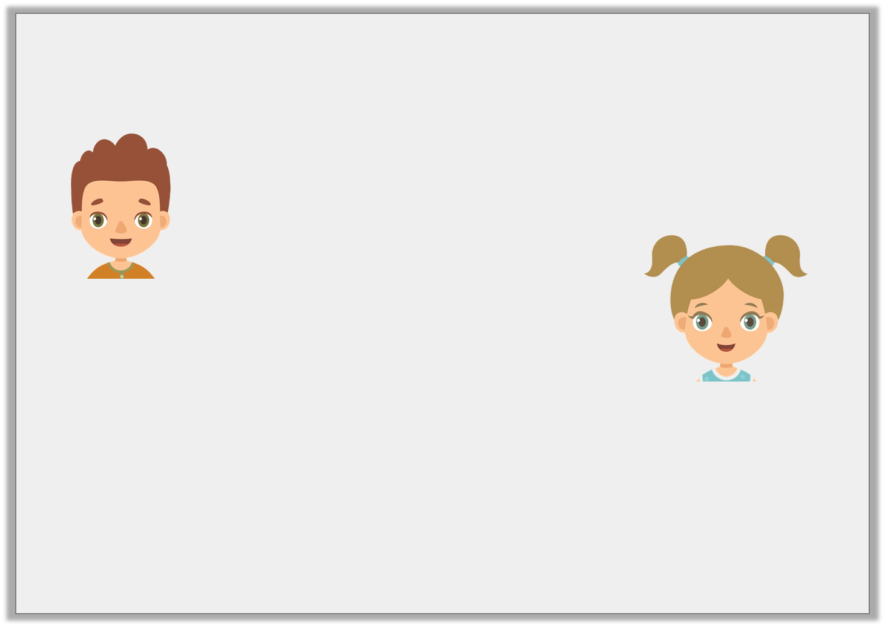
Reasoning 2
Joe and Tara are talking about their favourite colours.
Which sentence is correct? Explain your reasoning.
blue and black
Joe
I like grey and blue but not green.
Tara
© Classroom Secrets Limited 2019

Slide 21
Reasoning 2
Joe and Tara are talking about their favourite colours.
Which sentence is correct? Explain your reasoning.
Tara is correct because…
blue and black
Joe
I like grey and blue but not green.
Tara
© Classroom Secrets Limited 2019

Slide 22
Reasoning 2
Joe and Tara are talking about their favourite colours.
Which sentence is correct? Explain your reasoning.
Tara is correct because she has explained what her favourite colour is and has used conjunctions. She also used a full stop to complete her sentence.
blue and black
Joe
I like grey and blue but not green.
Tara
© Classroom Secrets Limited 2019

