Slide 1
Term 4 Week 2
Maths Meetings

Slide 2
Monday
Learning Intentions
Band 1
L.I: I can count to and across 100 from any number.
Band 2
L.I: I can count in 10’s forwards and backwards from any number.

Slide 3
Band 1
L.I: I can count to and across 100 from any number.
Practise counting to and across 100 from any number.
Use the 100 square on the next slide to help you.

Slide 4
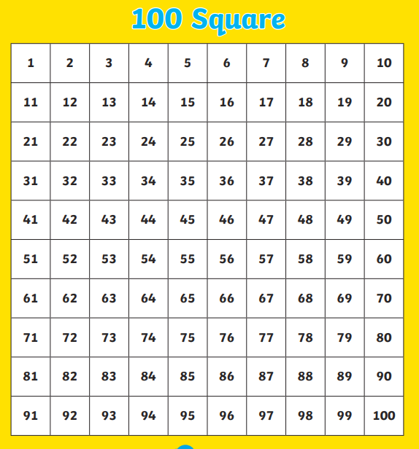

Slide 5
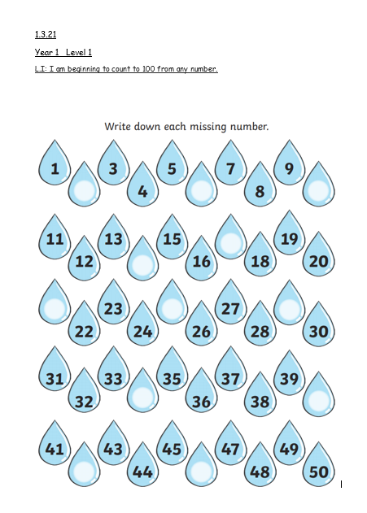
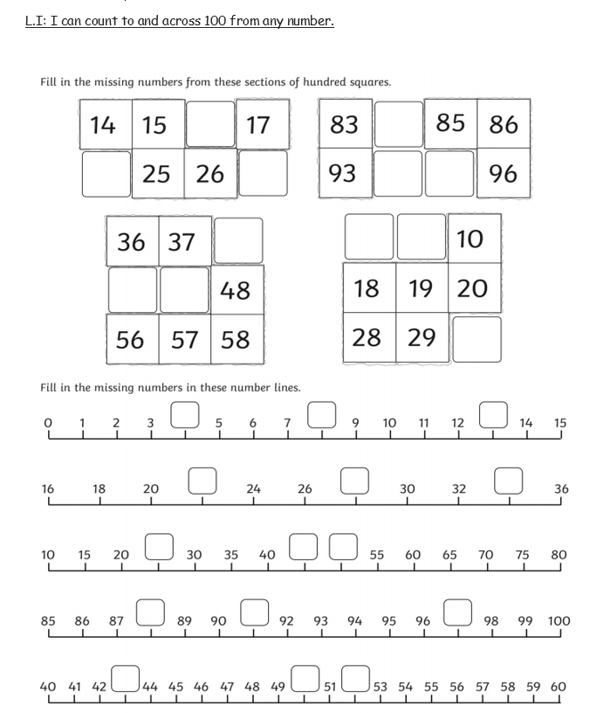
Level 1 and Level 2 Tasks
Count and fill in the missing numbers.

Slide 6
Band 2
L.I: I can count in 10’s forwards and backwards from any number.
Practise counting in 10’s forwards and backwards from any number.
For example 2, 12, 22, 32, 42, 52, 62, 72, 82, 92.
Use the 100 square on the next slide to help you.

Slide 8
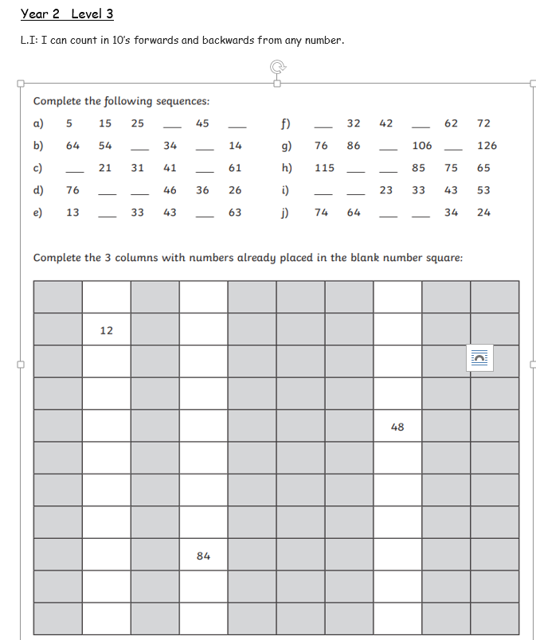
Level 3 Task
To complete the number sequences counting in tens.

Slide 9
Wednesday
Learning Intentions
Band 1
L.I: I can subtract one and two digit numbers.
Band 2
L.I: I can add three single digit numbers mentally.

Slide 10
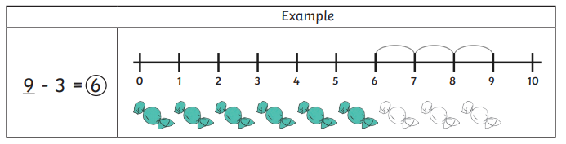
Band 1
L.I: I can subtract one and two digit numbers.
Remember when we subtract we start at the largest number and count backwards.
Use the number line to help you to solve the answers.

Slide 11
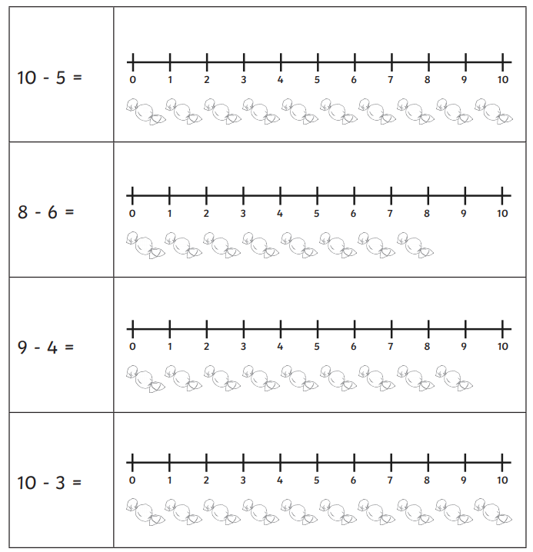
Can you solve these subtraction sums ?

Slide 12
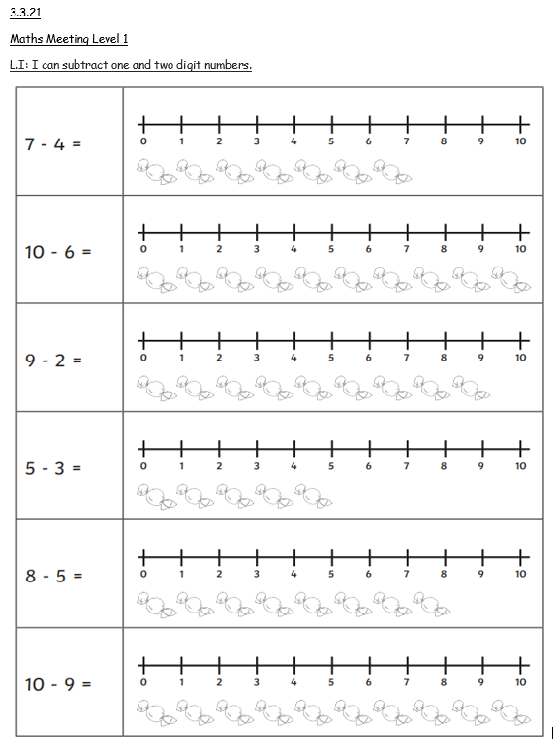
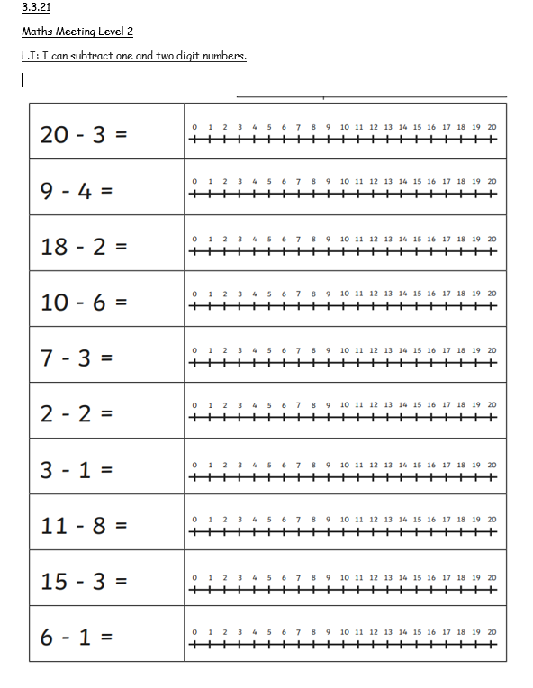
Level 1 and 2 Tasks

Slide 13
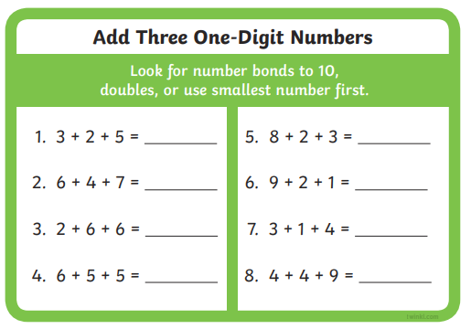
Band 2 Level 3
L.I: I can add three single digit numbers mentally.
Can you add these three one digit numbers mentally?

Slide 14
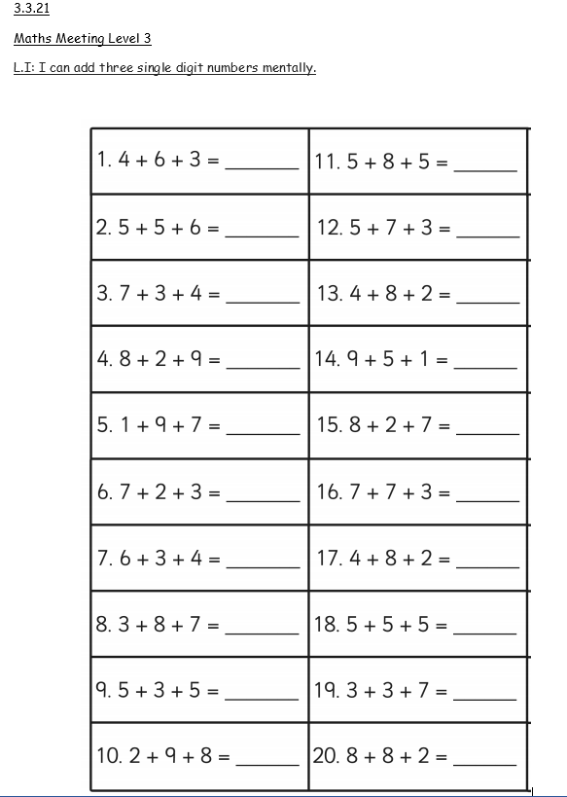
Level 3 Task
To add three one digit numbers mentally.

