Slide 1
Term 4 Week 2
Geography

Slide 2
Learning Intention.
L.I: To design a map referring to its key human features.

Slide 11
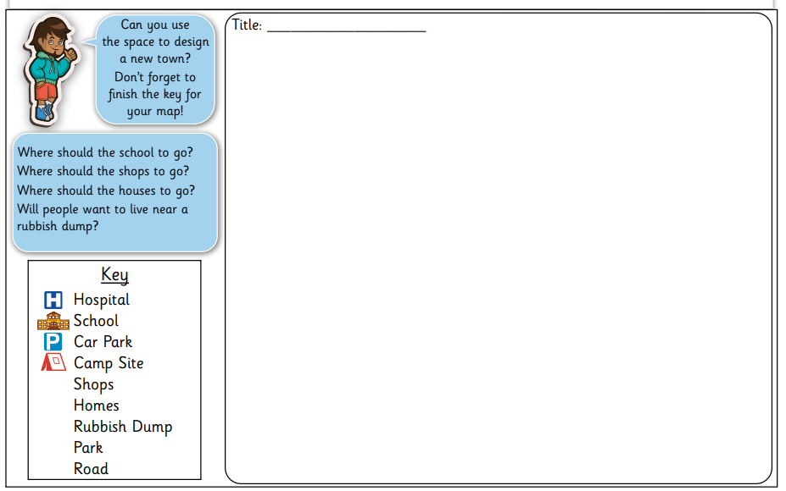
Activity
To build a new Spring Town.

