Slide 1
Handwriting
Letter families
c a d o g q
r n m h p b k
I l t u y f j
v w
e x z s

Slide 2
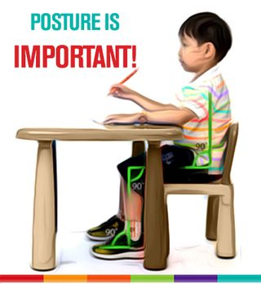
Before we begin...let's look ready to write!
Place both feet flat on the floor.
Move your elbows so they’re resting off the edge of the desk.
Move your bottom to the back of the chair.
Lean your head and shoulders slightly forward.
Keep your knees bent at a 90° angle.

Slide 3
Top exit letters – joining with the letter ‘e’
Remember NOT to join capital letters up!
Watch your teacher show you first, then you have a go.

Slide 4
e e
e
oe
oe
oe
re
re
re
ve
we
we
ure
ure
ure

Slide 5
Dictation (Set 27)
Your teacher will now read a sentence for you to write. Listen carefully and write it down in your neatest handwriting.
The man carried a large,
brown, oddly shaped sack
on his back.

