Slide 1
Tuesday 14th September
English
Learning Intentions:
5: I can use appropriate vocabulary and grammar in a task.
6: I can use grammar, punctuation and vocabulary which is suited to the purpose of my writing.

Slide 2
Shapes
Places where you can eat out.
The heading/sub-heading in your brochure.
Different interesting sights.
Options for people to choose from.
Adventurous activities to choose from.
An overview of the place.
A catchy slogan
The weather at the destination.
Data/figures to persuade people to visit.

Slide 3
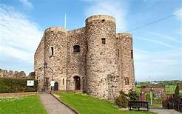
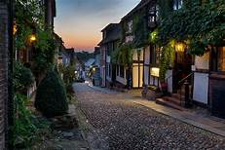
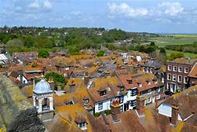
Sentence Stacking: Lesson 2
Over the next few lessons, we will be collecting vocabulary focusing on 2/3 lenses per lesson. These sentences will form our holiday brochure based on Rye.
At the end of some shorter sentence-stacking lesson, we will have a mini writing challenge. This is to keep us in the habit of writing independently.

Slide 4
Sentence Stacking:
Today’s shapes:
Heading and Overview
Today’s lenses:
Rich language, questions and a chatty reply

Slide 5
Rich language
Facts about Rye:
It is two miles from the open sea and is beside three beautiful rivers.
Rye is packed with spooky history, including its smuggling gang roots!
Beautiful bars set in underground caves and delicious restaurants.
It has a number of fashionable hotels and guest houses right by the town centre.
You can charter a yacht right from Rye Harbour.
Rye is the home of many famous writers and artists.
There are lots of award-winning antique shops full of bargains.
It is close by the beautiful, sand-dune beach, Camber Sands.
To persuade people to want to visit Rye, we are going to tell our readers that Rye was voted ‘England’s Favourite Weekend Getaway’.
Read through the facts about Rye and choose your two favourites.

Slide 6
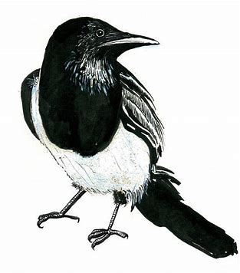
Rich language
Adjective for Rye:
Inspiring
Interesting
Wonderful
Cultural
Splendid
Enriching
Delightful
Quaint
Perfect
Facts about Rye:
*Previous slide*
It is two miles from the open sea and is beside three beautiful rivers.
Rye is packed with spooky history, including its smuggling gang roots!
Beautiful bars set in underground caves and delicious restaurants.
It has a number of fashionable hotels and guest houses right by the town centre.
You can charter a yacht right from Rye Harbour.
Rye is the home of many famous writers and artists.
There are lots of award-winning antique shops full of bargains.
It is close by the beautiful, sand-dune beach, Camber Sands.
We will use the rich language lens to enhance our sentence.
Chot down an adjective for Rye. This will make up your next heading.
Pick your fact about Rye. You can choose your own from your notes.
*CT to chot down on flipchart for working wall!*

Slide 7
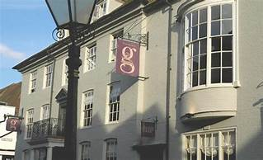
Rich language
Model: An Inspiring Destination
Rye has been voted England’s Favourite Weekend Getaway – thank to its beautiful walks and antique shops.
Your turn: Using facts about Rye and extra adjectives, create your sentence.
Challenge: can you deepen the moment by creating your own award that Rye could have been the winner of?

Slide 8
Think back to your facts from the previous lens or your notes.
We can use question words such as How, Have, Would, Why, Will to turn these into a question for our reader!
Questions
How…
Have…
Would…
Why…
Will…
E.g.
How would you like to wander around the beautiful Camber Sands?

Slide 9
Questions
We will use our facts and question words for this next sentence.
Pick a fact and turn it into a question using one of the question words below:
How about a…
Would you like to…
Have you ever thought about…
Why not take a…
Did you ever want to…
Facts about Rye:
*Previous slide*
It is two miles from the open sea and is beside three beautiful rivers.
Rye is packed with spooky history, including its smuggling gang roots!
Beautiful bars set in underground caves and delicious restaurants.
It has a number of fashionable hotels and guest houses right by the town centre.
You can charter a yacht right from Rye Harbour.
Rye is the home of many famous writers and artists.
There are lots of award-winning antique shops full of bargains.
It is close by the beautiful, sand-dune beach, Camber Sands.
Examples:
Did you ever want to visit a beautiful bar set in an underground cave?
Why not take a yacht right from Rye Harbour?
Did you ever want to take a trip to the home of many famous writers and artists?

Slide 10
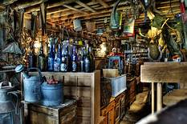
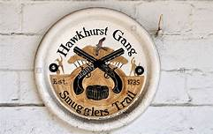
Question
Model: Have you ever fancied a trip to the home of many famous artists, writers and poets?
Your turn: Using a question word at the start, create a question based on a fact about Rye.
Challenge: can you add a second question with a different question starter?

Slide 11
A chatty reply
See for yourself!
Come on over!
What’s stopping you?
What’s delaying you?
Book that ticket!
Think: Sometimes holiday brochures have ‘chatty’ ways of inviting people to visit that area. What other examples can you come up with?
Hop on that train!
Hurry up and come on over!

Slide 12
A chatty reply
In this sentence, we will use a chatty, informal way of inviting people to Rye.
Chot down a chatty phrase to use.
Chot down another adjective meaning ‘interesting’.
‘Chatty’ phrases:
come on over, come see for yourself, pack your bags, book that ticket, what’s stopping you? Take the plunge!
Adjectives for interesting:
Interesting, – fascinating, remarkable, captivating, enthralling, intriguing, exciting

Slide 13
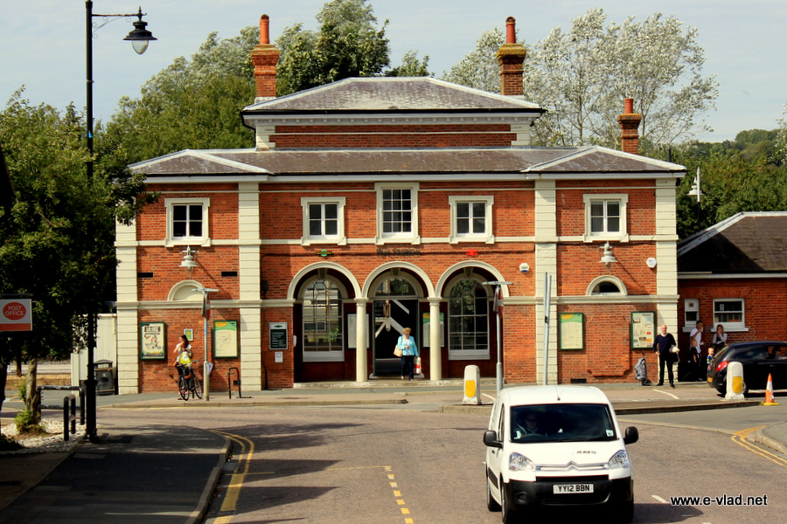
A chatty reply
Model: Well, what’s stopping you? The fascinating Rye is the destination for you!
Your turn: Using a chatty phrase and adjectives, create your sentence persuading people to come to Rye.
Hint: If you need to, start by changing the underlined vocabulary to help.
Challenge: can you deepen the moment by adding extra description about Rye?

Slide 14
Partner Editing Activity:
Please spend 5 minutes checking over each station.
Read back through your sentence stacking from the last two days.
Work through each station independently. Make sure you use your purple polishing pen and a dictionary or a word bank to help.
Topic words
Names
Longer descriptive words
*Dictionary*
Commas (after fronted adverbials).
Capital letters for names of places.
Commas in a list.
? for questions.
Full stops.
Exclamation marks
Missing words
Does it all make sense?
Have you repeated a word too many times?

