Slide 1
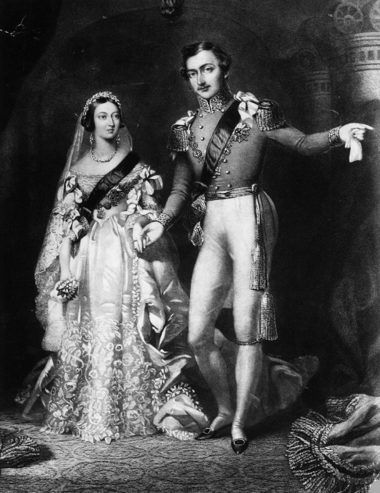
Revolution
Our topic and class text are about the Victorian Era.
Today we will be finding out more about the workhouses.

Slide 2
Experience session 2
Talk through the PowerPoint about the workhouses. Make notes and research what it was like in a workhouse.
Chot notes looking through these lenses
Looking, Adjectives, Feeling (negative intent)

Slide 3
Experience session 2
Watch Oliver Twist opening scenes in the Workhouse. https://www.youtube.com/watch?v=hpgPaxoC7XU
Look at contrasts between rich and poor- clothing, quality of food, work.
Should the children be made to work because they have no money to pay for their board and lodgings?

