Slide 1
Good morning, Year 5/6!
Counting stick:
Counting Stick - 5-11 year olds - Topmarks
Zero times 6 is 0…
Whole class questions
Starting with… Daisy! You say the first number sentence ‘0 x 6 = 0’, and then pick someone else to carry it on.
6

Slide 2
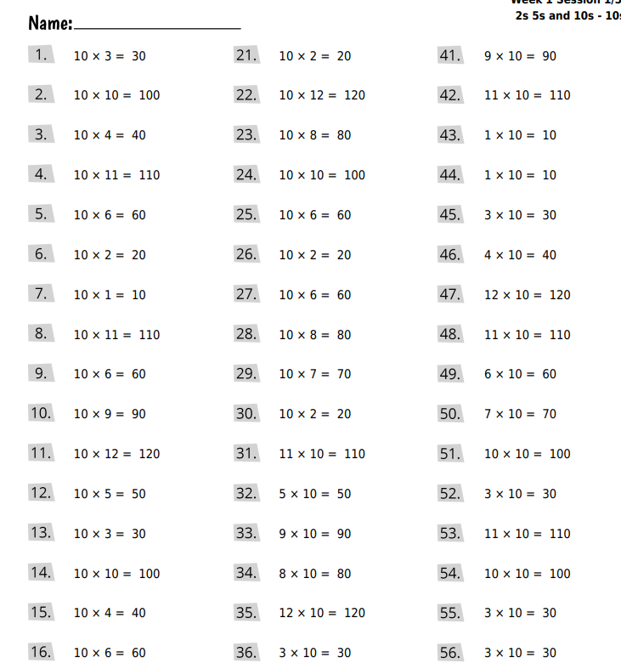
Part 2
3 mins

Slide 3
09.03.22
(continued)

Slide 4
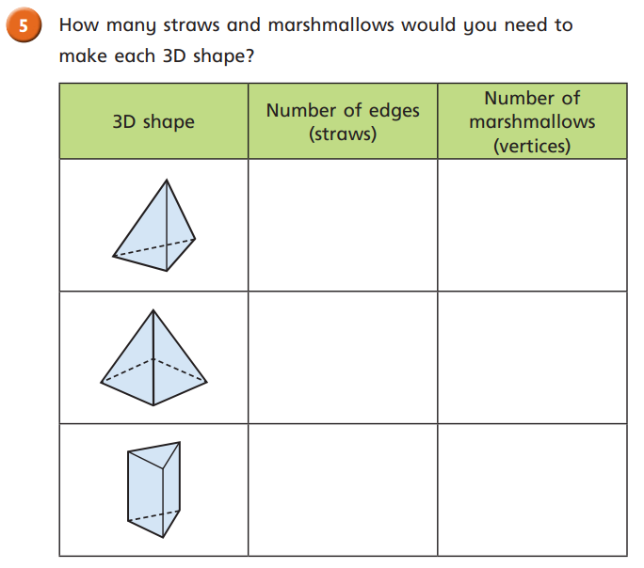
Stick this question into your book.

Slide 5
In Focus Please write the following: -We completed our task from yesterday to check our understanding.

Slide 7
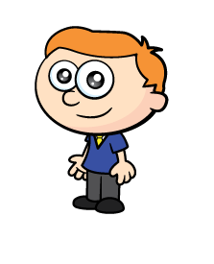
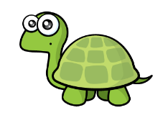
Talk Task
Ron is using marshmallows and straws to build 3D shapes.
Have a think
He starts by making a rectangular base.
What shape do you think Ron is making?
Ron has made a cuboid.
I can see 8 vertices and 12 edges.

Slide 8
Answer into your book.
1.
a)
b)
c)
d)

Slide 9
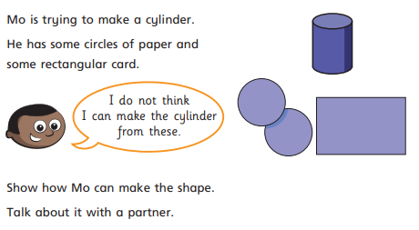
Stick the question in.
Have a go at creating the shape.
Write your answer next to it.
2. Mo can make the shape by…

Slide 10
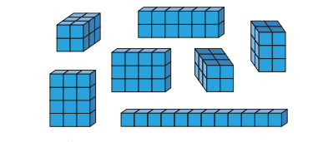
Firstly, make these cuboids.
Afterwards, write in your book how many different cuboids you have made.
Remember – some of them might be exactly the same, but at a different angle in the photo.
3. I made ____ different types of cuboids.

Slide 11
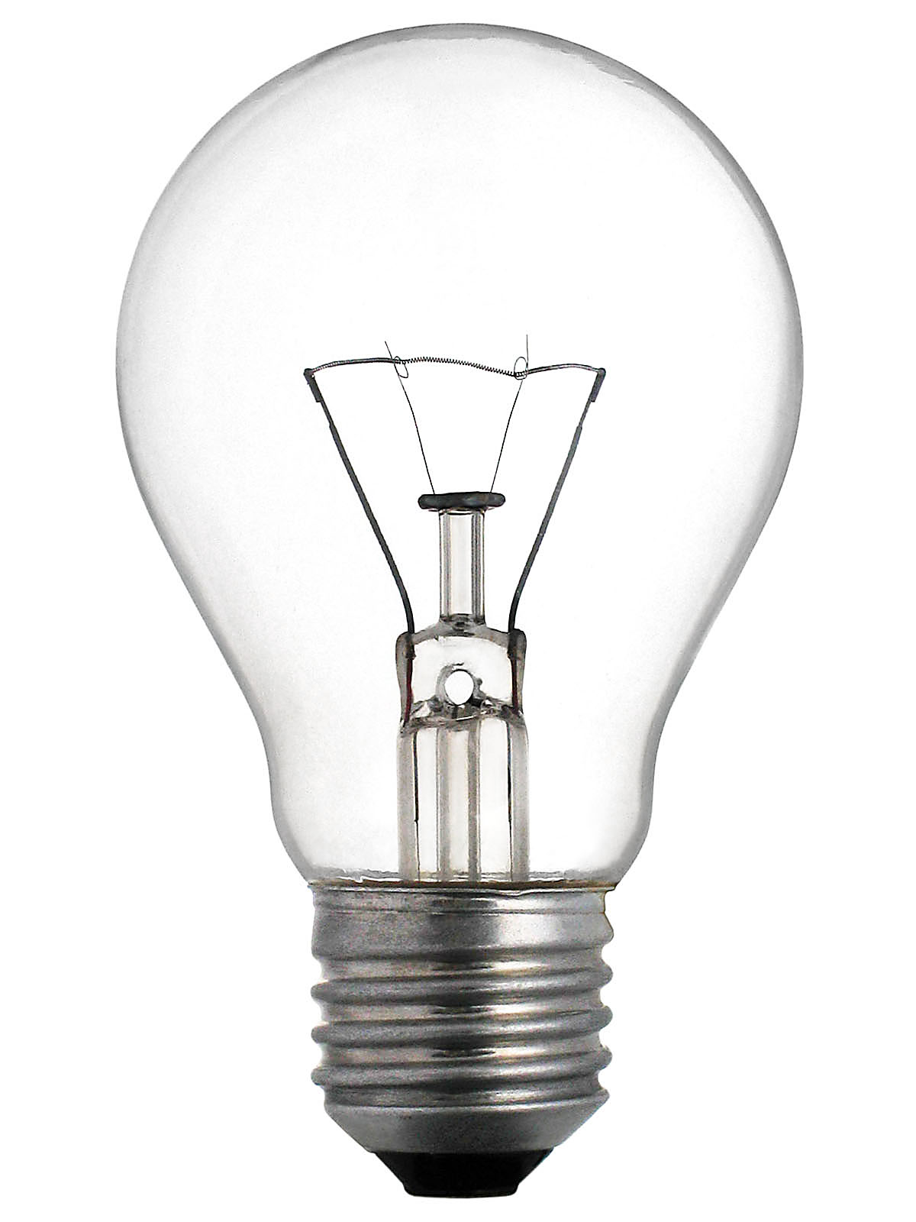
Light Bulb Challenge

Slide 12
Light Bulb Challenge

Slide 13
Reflection
Write a reflection sentence.
Here are some examples.
I felt I was successful using …..
I found it difficult using ….
An effective strategy I used today was ….
Today, it really helped me to use ….
I asked for help with question 2 because …
A top tip for (adding fractions) is …..
Perhaps it would have been easier if I had used/asked …

Slide 14
Maths Meetings
(15 minutes)
(Like this below, but less wonky!)
Column subtraction (up to 4 digits)
Go to the back of your book.
Split your page into four (look at the example).
In the THIRD section:
Today’s will use exchanging.
Let’s practise together.

