Slide 1
1 .3 . 2 2
6: Can I draw shapes accurately?
I can draw the correct perimeter.
I can use a ruler to measure the correct lengths.
I can use a protractor to measure the correct angles.
In focus task

Slide 2
In focus
Work out the perimeter of the rectangle.
5cm
1 cm

Slide 3
New learning
Draw a square with a perimeter of 12 cm
1 cm
12 $÷$ 4 $=$
1 cm
3

Slide 4
New learning
Draw a rectangle with a perimeter of 14 cm
1 cm
Have a think

Slide 5
New learning
Draw a rectangle with a perimeter of 24 cm
1 cm

Slide 6
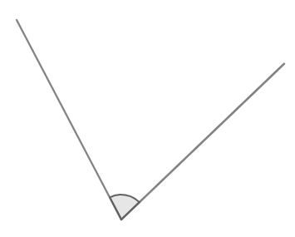
Develop learning
ON A WHITEBOARD:
Draw the diagram accurately
8 cm
63$°$
4 cm

Slide 7
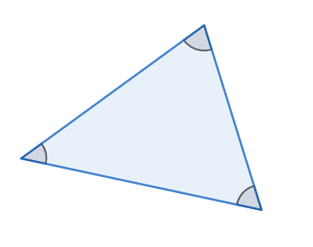
Develop learning
ON A WHITEBOARD:
Draw the triangle accurately
25$°$
75$°$
9 cm
Have a think

Slide 8
Light bulb challenge

