Slide 1
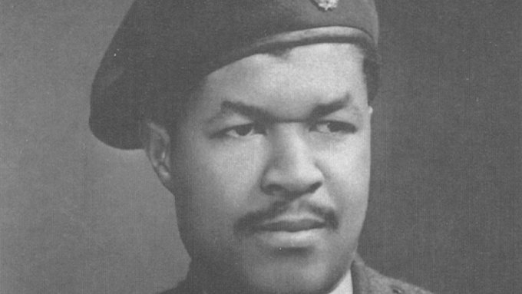
Who is Sam Beaver King?
LI: To understand why an individual is significant

Slide 2
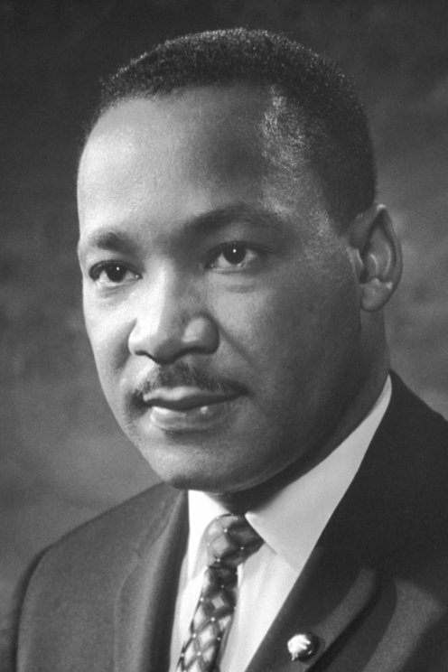
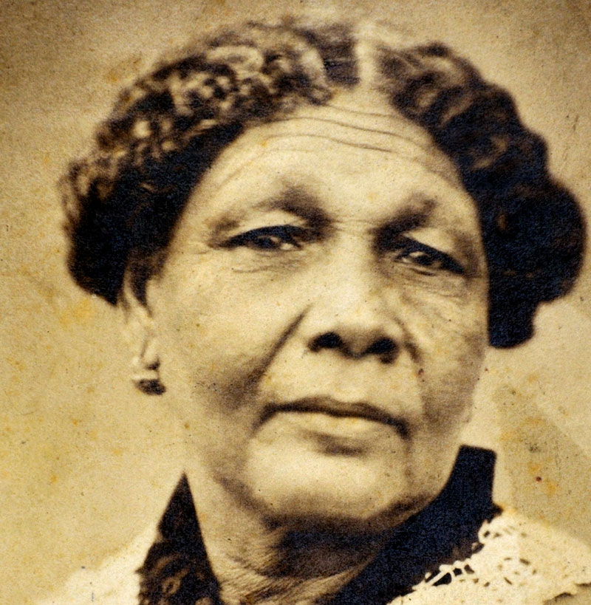
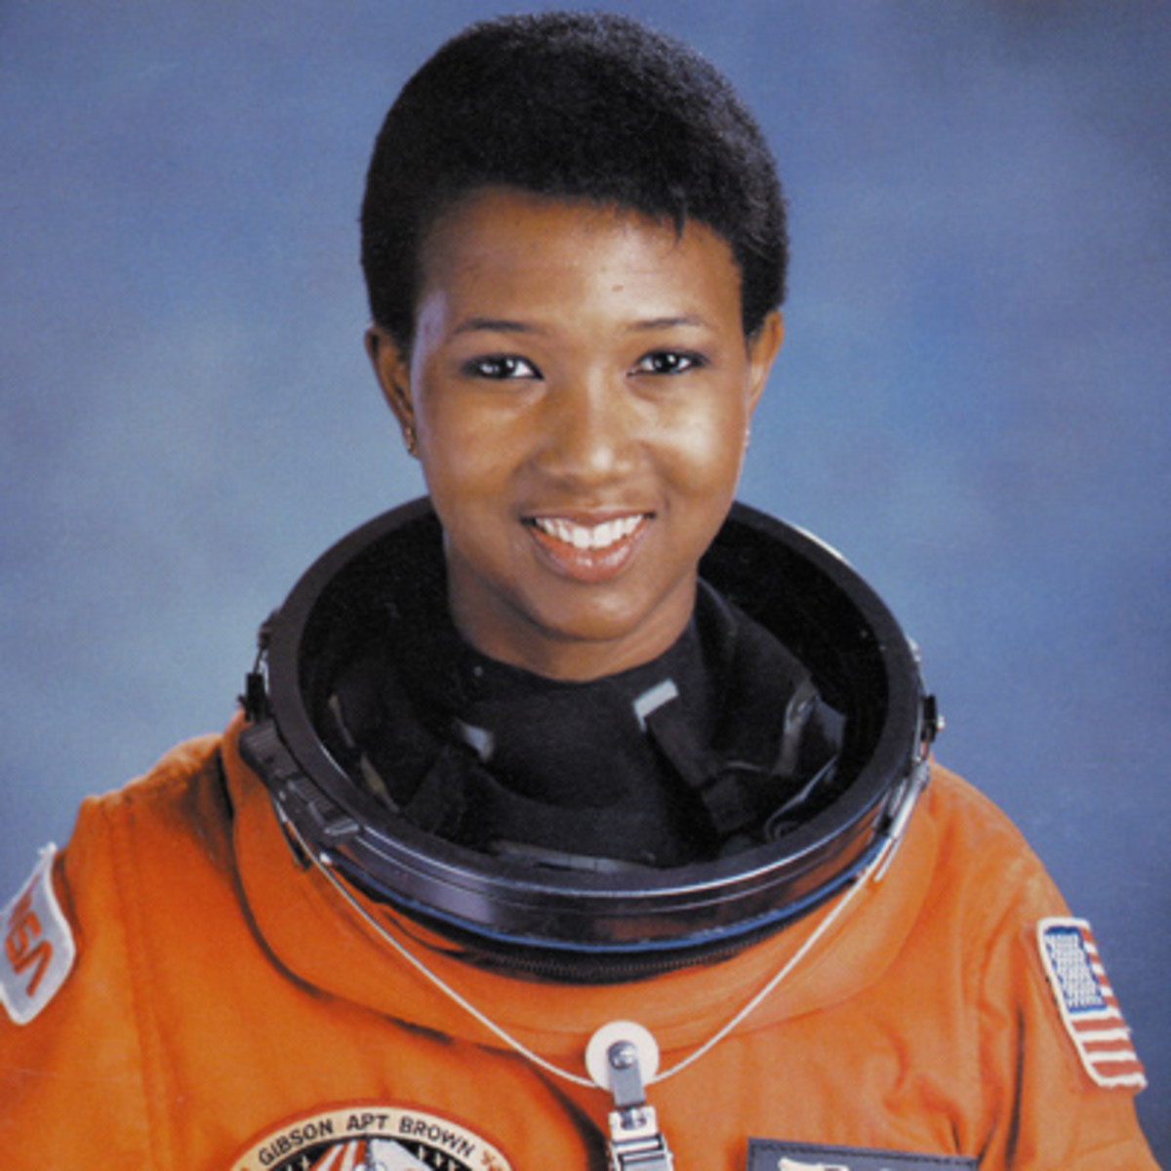
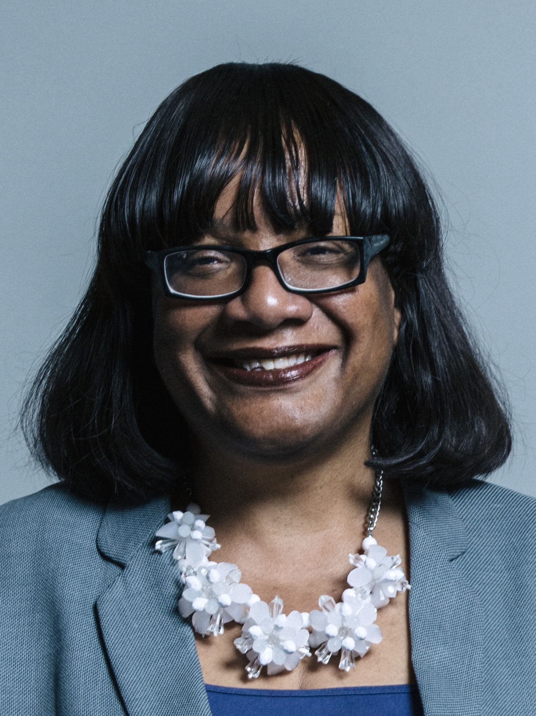
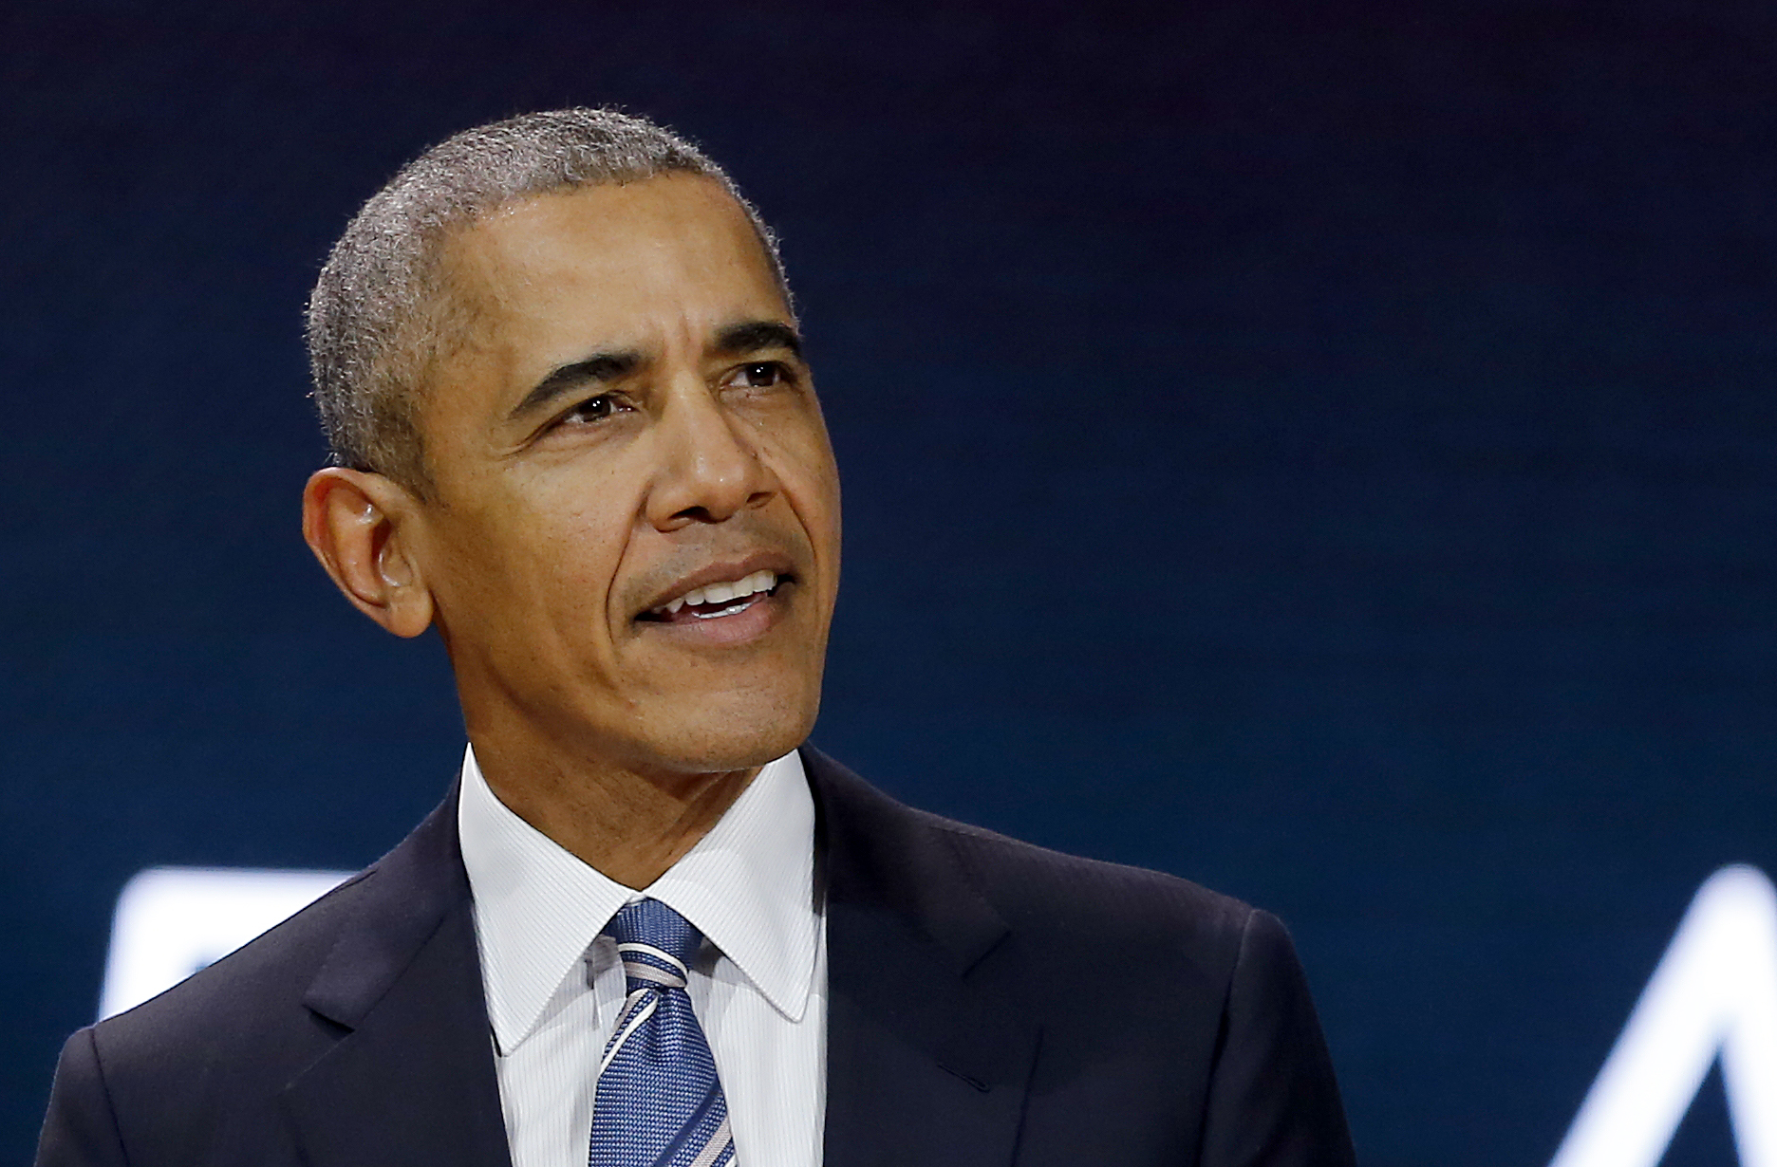
Starter
Who are these people? Do you recognise anyone?
Notes:
Books to support:
Vashti Harrison – Little Leaders
Vashti Harrison – Little Legends

Slide 3
What does significant mean?
Look at the reasons for a person being significant.
With your partner discuss someone you see as significant.
Notes:
Image source: https://www.teachwire.net/teaching-resources/significant-people
Teacher notes:
Ask children ‘How would you identify someone as significant?’

Slide 4
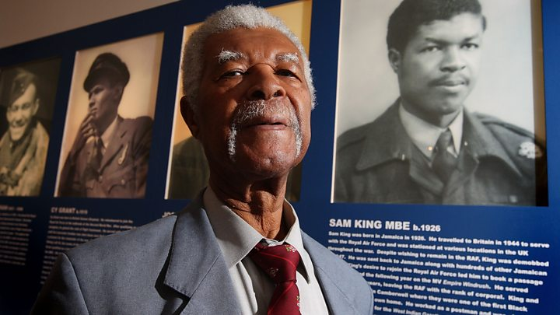
Sam Beaver King
Sam King was born in Jamaica and had served in the Royal Air Force during the Second World War.
He was on Empire Windrush and after serving in the Royal Air Force he settled in Southwark.
Notes:
Teacher notes:
Children can listen to oral story of Sam explaining his journey on Empire Windrush:
https://www.museumoflondon.org.uk/discover/how-did-empire-windrush-change-london-docklands

Slide 5
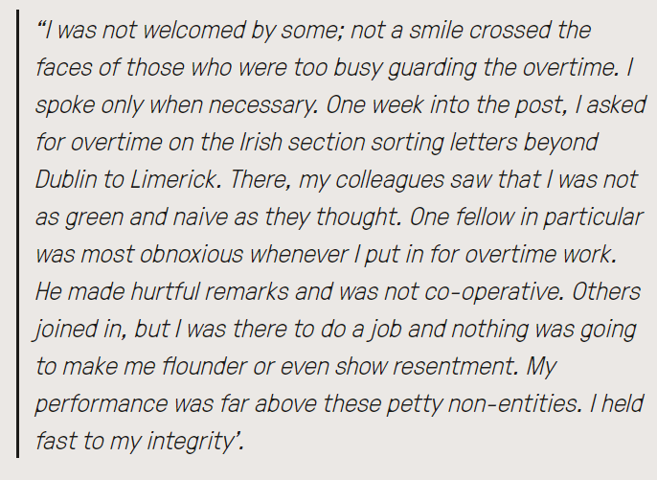
Racism at work
Sam worked in the Post Office for over 30 years, and unfortunately he faced racism at work:
Sam had helped Britain in WWII, do you think the way he was treated was fair?
Notes:
Teacher notes:
Extract from King’s autobiography. Can listen to oral story from King: https://www.postalmuseum.org/blog/sam-king-a-postal-worker-of-the-windrush-generation/

Slide 6
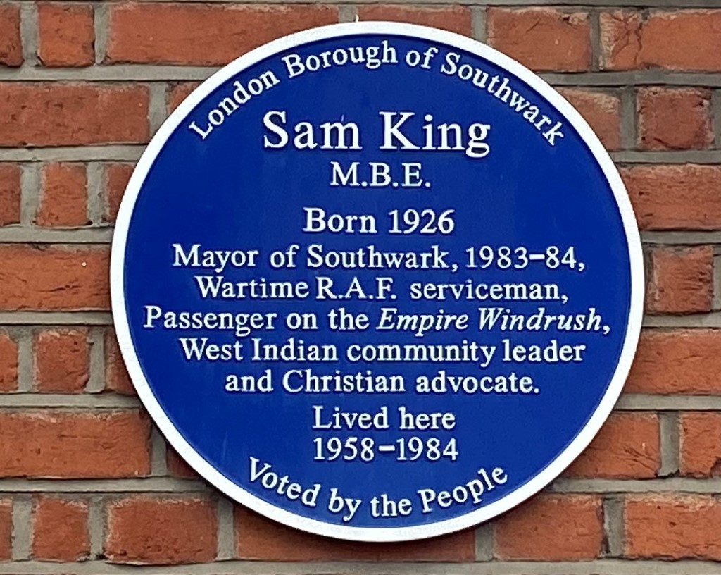
His work
Sam helped to support the West Indian community in the Southwark area. He was the first Black Mayor of the borough, and the only black Mayor in London at the time.
He set up the Windrush Foundation to help preserve the memories of the Windrush Generation, and also campaign for the West Indian community.
Despite facing racism in London, Sam supported the West Indian community. What does this tell us about Sam?

Slide 7
Activity
Think about Sam King – why is he significant?
You are going to retell the story of Sam King, including his work to support the West Indian community.
You can retell his story by:
Writing a fact sheet
Drama with a group
Create an art piece to tell his story
Presentation
Notes:
Teacher notes:
Additional activity – children can create a postal stamp to commemorate the work of Sam King.

Slide 8
Further Research
Further reading about Sam Beaver King:
https://www.postalmuseum.org/blog/sam-king-a-postal-worker-of-the-windrush-generation/
https://www.museumoflondon.org.uk/discover/how-did-empire-windrush-change-london-docklands

