Slide 1
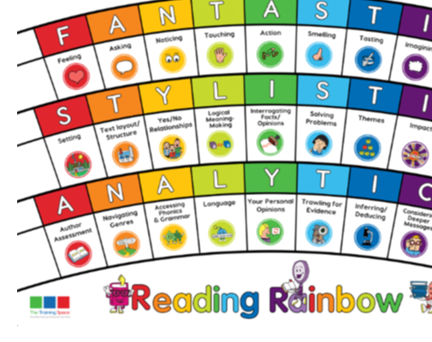
Our LI for the week: Band 3/4: Read with an awareness of the audience by selecting a range of appropriate techniques when reading aloud Band 5: Can I identify and discuss themes and impact of layout, paragraphing, grammar - usage, punctuation, and spelling. Band 5: Read and discuss an increasingly wide range of fiction, poetry, plays, non-fiction and reference books or textbooks.

Slide 2
Michael Morpurgo: Reading for Pleasure
Jacqueline Wilson: The Giants: SATs paper
Roald Dahl: Enable: All Aboard the Empire Windrush

Slide 3
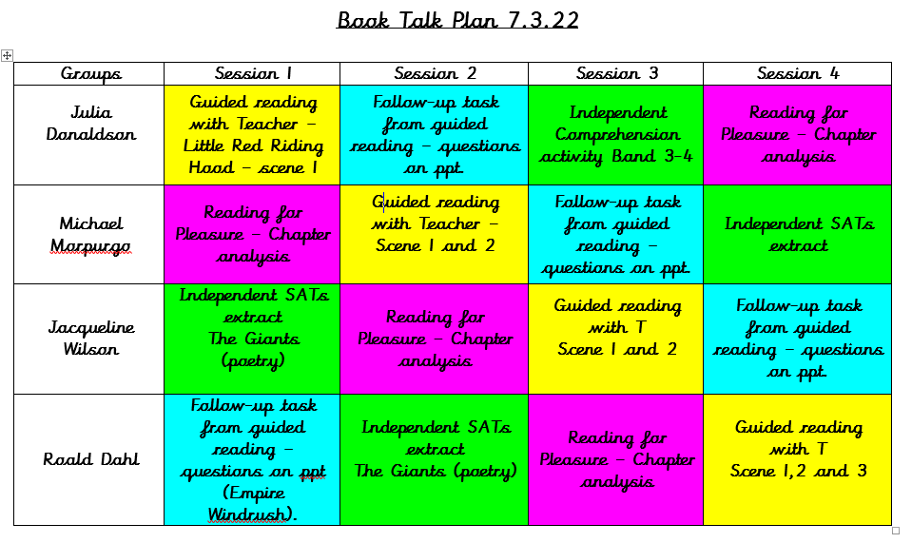
Tuesday
Wednesday
Thursday
Friday

Slide 4
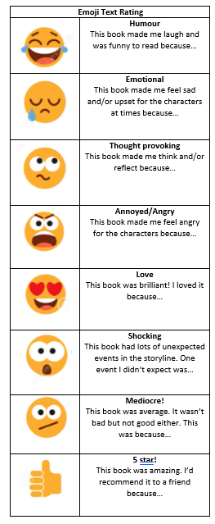
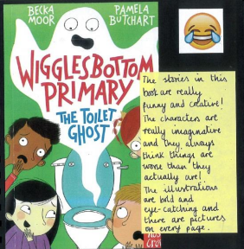

Slide 5
Questions for Roald Dahl: Tuesday

Slide 6
Julia Donaldson Group – Enable
Read the first scene of Little Red Riding Hood
Why is there a list of the characters on the first page of the playscript?
Why are parts of the text written in italics e.g. ‘Lights up. The narrators, Big Rabbit and Little Rabbit, stand downstage.
Brackets are used in some of the lines when the characters are speaking, why do you think these words are in brackets?
How do the actions of the characters e.g ‘Mother looks up at the clock (it’s noon) and taps her foot angrily’ have an impact on how the actors or actresses perform in the play?

Slide 7
Lenses:
Text Layout/Structure
Impact
Sentence Starters as reminders:
Text Layout/Structure
The feature… has been used to…
Impact
The use of the feature… has been used to have a… impact on the reader.

Slide 8
Michael Morpurgo Group – Enable
Read the first and second scenes of Little Red Riding Hood
What is the purpose in having a list of characters at the front of the playscript?
What is the purpose of italics in parts of the script? e.g. ‘Lights up. The narrators, Big Rabbit and Little Rabbit, stand downstage.
What impact do the actions of the characters have on you, the reader? Examples of this include: ‘tugs at the cape around her neck’, ‘sighing with relief’ and ‘waving a claw in the air’?
What impact would the narrator describing the scene that the characters are in have on the reader? How will it help person reading the playscript?

Slide 9
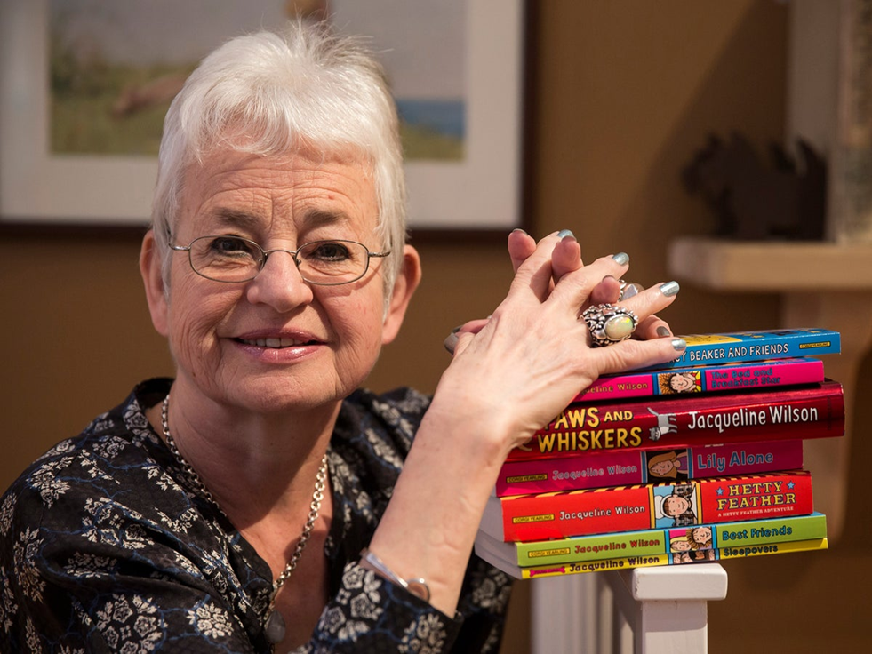
Lenses:
Text Layout/Structure
Impact
Sentence Starters:
Text Layout/Structure
The feature… has been used to…
Impact
The use of the feature… has been used to have a… impact on the reader.

Slide 10
Jacqueline Wilson Group – Enable
Read the whole script of Little Red Riding Hood
What is the purpose of italics in parts of the script? e.g. ‘Lights up. The narrators, Big Rabbit and Little Rabbit, stand downstage.
What impact do the actions of the characters have on you, the reader? Examples of this include: ‘tugs at the cape around her neck’, ‘sighing with relief’ and ‘waving a claw in the air’?
What impact would the narrator describing how the wolf is the ‘Big Bad Wolf’ have on the reader? How would an audience react if they were watching this in a theatre?
Why is it important that the most appropriate action be used for when a character speaks in the script? For example ‘(croaking) all the better to see you with my dear’.

Slide 11
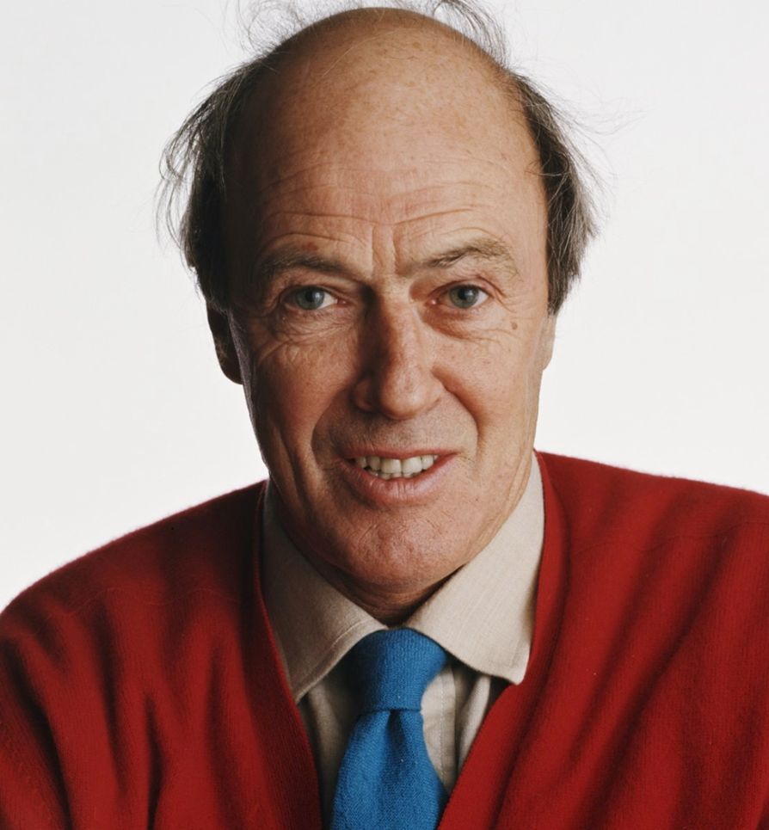
Lenses:
Text Layout/Structure
Impact
Sentence Starters:
Text Layout/Structure
The feature… has been used to…
Impact
The use of the feature… has been used to have a… impact on the reader.

Slide 12
Roald Dahl Group – Enable
Read the whole script of Little Red Riding Hood
What is the purpose of italics in parts of the script? e.g. ‘Lights up. The narrators, Big Rabbit and Little Rabbit, stand downstage.
What impact do the actions of the characters have on you, the reader? Examples of this include: ‘tugs at the cape around her neck’, ‘sighing with relief’ and ‘waving a claw in the air’?
What impact would the narrator describing how the wolf is the ‘Big Bad Wolf’ have on the reader? How would an audience react if they were watching this in a theatre?
Why is it important that the most appropriate action be used for when a character speaks in the script? For example ‘(croaking) all the better to see you with my dear’.

