Slide 1
In Focus
Complete the table by identifying the value of the underlined digits.
60,534
41,956
134,675
534,783
674,783

Slide 2
In Focus
Complete the table by identifying the value of the underlined digits.
60,534 | 500
41,956 | 50
134,675 | 4,000
534,783 | 30,000
674,783 | 600,000

Slide 3
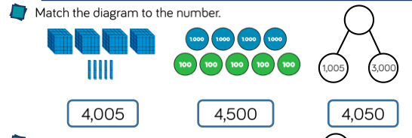

Slide 5
Complete the table by adding to the starting number.
 | Add 10 | Add 100 | Add 1000
2,506
7,675
6,495
 | 7,450

Slide 6
Check your answers
 | Add 10 | Add 100 | Add 1000
2,506 | 2,516 | 2,606 | 3,506
7,675 | 7,685 | 7,775 | 8,575
6,495 | 6,505 | 6,595 | 6,595
7,440 | 7,450 | 7,540 | 8,440

Slide 7
Complete the bar model

Slide 8
Check your answers

Slide 9
Hannah is counting in 100s from the number represented below. What number is it? What numbe will she say next? What number will she say fifth?

Slide 10
Hannah is counting in 100s from the number represented below. What number is it? What numbe will she say next? What number will she say fifth?
31,625
Next 31,225
Fifth 32,125

