Slide 1
LI To compare and order fractions that are greater than 1
Number: Fractions
Lesson 6
Spr2

Slide 2
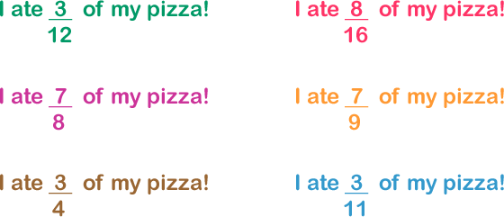
In focus:
Success Criteria: I can compare and order improper fractions and mixed numbers I can use what I know about common denominators to help me
Who ate most pizza?
Explain your answer.

Slide 3
In focus:
Success Criteria: I can compare and order improper fractions and mixed numbers I can use what I know about common denominators to help me
Who ate most pizza?
Explain your answer.
7/8 is the largest fraction. Both 3/11 and 3/12 are less than half. 8/16 is equal to
half. Out of 7/9 and 7/8, 7/8 is the larger fraction because the 7 parts are larger (the denominator is smaller). 7/8 is more than 3/4 too, so it is the largest fraction.

Slide 4
Talking time:
5 .
3_
6 .
4_
Use bar models to compare with .
5 .
3_
6 .
4_
6 .
4_
5 .
3_

Slide 5
Talking time:
5 .
3_
6 .
4_
Use bar models to compare with .
5 .
3_
6 .
4_
>
6 .
4_
<
5 .
3_

Slide 6
Talking time:
5 .
2_
10.
4_
Use bar models to compare with .
5 .
2_
10
4_
10
4_
5 .
2_

Slide 7
Talking time:
5 .
2_
10.
4_
Use bar models to compare with .
5 .
2_
10
4_
=
10
4_
=
5 .
2_

Slide 8
Activity 1:
Draw bar models to compare these fraction pairs.
9 .
3_
13
4
6 .
5_
4
3_
4 .
2_
10
5_
5
3_
3 .
2_

Slide 9
Activity 1:
Draw bar models to compare these fraction pairs.
9 .
3_
13
4
<
6 .
5_
4
3_
<
4 .
2_
10
5_
=
5
3_
>
3 .
2_

Slide 10
Talking time:
1 .
4_
1 .
5_
Use bar models to compare 1 with 1 .
1 .
4_
1 .
5_
1
1

Slide 11
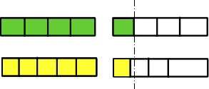
Talking time:
1 .
4_
1 .
5_
Use bar models to compare 1 with 1 .
1 .
4_
1 .
5_
1
>
1

Slide 12
Activity 2:
Draw bar models to compare these mixed numbers.

Slide 13
Activity 2:
Draw bar models to compare these mixed numbers.

Slide 14
Talking time:
Explain how to order these fractions from smallest to greatest.

Slide 15
Talking time:
Explain how to order these fractions from smallest to greatest.
8/5 is the same as 1 3/5. This is the only fraction that is more than 1, so it is the greatest.
10/20 is the same as 1/2.
14/15 is nearly 1 whole (and so is more than 1/2).

Slide 16
Activity 3:
Put these fractions in order from smallest to greatest. .

Slide 17
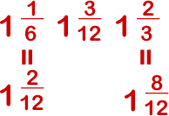
Activity 3:
Put these fractions in order from smallest to greatest. .

Slide 18
Success Criteria: I can compare and order improper fractions and mixed numbers I can use what I know about common denominators to help me
Light bulb challenge:
True or False?
In order from smallest to greatest: five halves, twelve quarters and ten thirds.

Slide 19
Light bulb challenge:
Success Criteria: I can compare and order improper fractions and mixed numbers I can use what I know about common denominators to help me
True or False?
FALSE
FALSE
TRUE
In order from smallest to greatest: five halves, twelve quarters and ten thirds. TRUE

