Slide 1
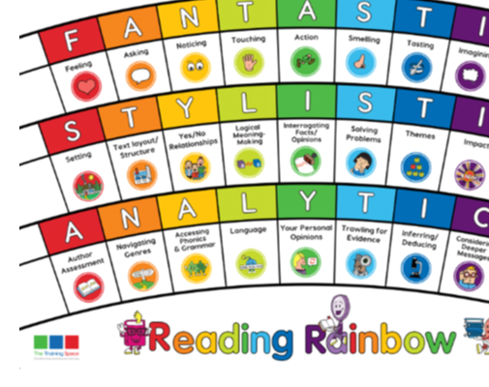
Monday 7th December
Lesson 1:
BOOK TALK – Write in books.

Slide 2
Our LI’s for the week: - I can infer characters feelings from their actions. -I can predict what might happen from details implied.

Slide 3
Lesson 1 - Book Talk
Using the extract from ‘A Christmas Carol’ we are focusing on these 3 lenses:
Touching
Yes/No Relationships
Predictions
A Christmas Carol is a well-known book written by Charles Dickens during the Victorian times.

Slide 4
In your books, write down the following sentence starters for each of the lenses. These will help us when we write our answers this week.

Slide 5
Sentence starters:
Touching:
There are positive moments of ‘touch’ when…
In addition, there are negative moments of ‘touch’
when…
Yes/No Relationships:
The relationship between the two characters seems positive because…
Predictions:
In line with other stories about ghosts, the clues tell us that this one is…

Slide 6
Touching
What would you describe as positive or negative moments of touch between the characters in this extract?
There are positive moments of ‘touch’ when…
In addition, there are negative moments of ‘touch’
when…
Can you verbally answer the question using a sentence starter? (2 points)
Write down some actions.

Slide 7
Yes/No Relationships
How can you tell that the relationship between the little girl and the boy is a happy one?
The relationship between the two characters seems positive because…
Can you verbally answer the question using a sentence starter? (2 points)
Chot down the ‘positive’ vocabulary.

Slide 8
Predictions
Based on what you have read/heard about ghosts, do you predict that this ghost is a ‘good’ ghost or a villain?
In line with other stories about ghosts, the clues tell us that this one is…
Can you verbally answer the question using a sentence starter? (2 points)

Slide 9
Tuesday 8th December
Lesson 2:
MODEL – please write this in the margin.

Slide 10
Lesson 2 – Model
We are going to create some sentences together today using the same 3 lenses:
Touching
Yes/No Relationships
Predictions
We will write the answers together, but you can add in extra information if you would like to.

Slide 11
Touching
What would you describe as positive or negative moments of touch between the characters in this extract?
There are positive moments of ‘touch’ when…
In addition, there are negative moments of ‘touch’
when…
2) Yes/No relationships
How can you tell that the relationship between the little girl and the boy is a happy one?
The relationship between the two characters seems positive because…
3) Predictions
Based on what you have read/heard about ghosts, do you predict that this ghost is a ‘good’ ghost or a villain?
In line with other stories about ghosts, the clues tell us that this one is…

Slide 12
Thursday 10th December
Lesson 3:
ENABLE – please write this in the margin.

Slide 13
Lesson 3 – Enable
Today is your turn to answer questions on your own.
Please use the sentence starters from this week to help you.
Touching
Yes/No Relationships
Predictions

Slide 14
Session 3 – Enable (Independent comprehension)
Year 5
Bonus question
4) Fan, Scrooge’s little sister, obviously loves her brother. How is this shown in the text?
Fan’s love for Scrooge is shown in the text where it says…
Year 6
3) Fan, Scrooge’s little sister, obviously loves her brother. How is this shown in the text?
Fan’s love for Scrooge is shown in the text where it says…

Slide 15
Friday 11th December
Lesson 4:
COMPREHENSION

