Slide 1
STARTER:
Place the shapes in the correct place in the Carroll Diagram.

Slide 2
STARTER:
Place the shapes in the correct place in the Carroll Diagram.

Slide 4
1, 3, 4
2 (pentagon) and 5 (quadrilateral)

Slide 5
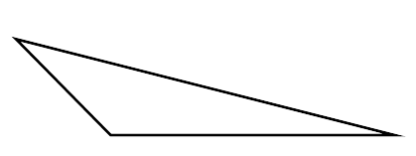
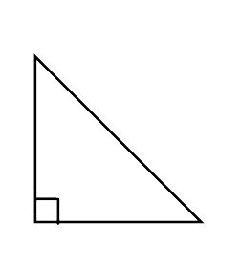
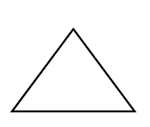
TALKING TIME:
Look at the triangles below.
What similarities do they have and what differences?

Slide 6
TALKING TIME:
Look at the triangles below.
What similarities do they have and what differences?
They all have 3 sides. They are all triangles. They all have 3 angles.
The right angled triangle has a right angle for one of its angles.

Slide 7
ACTIVITY 1:
Use a ruler to measure the sides of these different triangles.
What do you notice? What could the properties of each type be? Write them down.
Isosceles right-angled equilateral
scalene isosceles

Slide 8
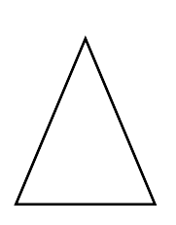
LEARNING TIME:
This is an isosceles triangle.
It has two sides the same length.
It has two angles the same size.
Here is a scalene triangle.
It has 3 sides that are all different lengths.
It has 3 angles that are all different sizes.
This is an equilateral triangle.
It has three sides that are the same length.
It has three angles that are the same size.

Slide 9
ACTIVITY 3:
Identify the scalene triangle, the isosceles triangle and the equilateral triangle.

Slide 10
ACTIVITY 4:
Sort these triangles into their correct groups.
Equilateral | Scalene | Right-angled | Isosceles
Draw one more triangle to go in each column.

Slide 11
ACTIVITY 4:
Sort these triangles into their correct groups.
Equilateral | Scalene | Right- angled | Isosceles
Draw one more triangle to go in each column.

Slide 12
TALKING TIME:
John drew an isosceles triangle.
What has gone wrong?

Slide 13
TALKING TIME:
John drew an isosceles triangle.
What has gone wrong?
An isosceles triangle has two sides and two angels the same size which John’s triangle does not have.

Slide 14
ACTIVITY 3:
Draw three different isosceles triangles.

Slide 15
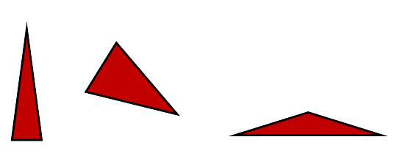
ACTIVITY 5:
Draw three different isosceles triangles.
Responses will vary.

Slide 16
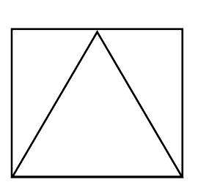
LIGHTBULB CHALLENGE:
Look at the diagram below.
Calculate the perimeter of the triangle.
16cm

Slide 17
LIGHTBULB CHALLENGE:
Look at the diagram below.
Calculate the perimeter of the triangle.
The equilateral triangle inside the square has the same sized sides as the square. Perimeter = 16cm + 16cm + 16cm = 48cm
16cm

