Slide 1
Introduction
What steps do you need to count in on these scales?
We call these increments
0 |  |  |  |  | 10 |  |  |  |  | 20
0 |  |  |  |  |  |  |  |  |  | 100
0 |  |  |  |  | 25 |  |  |  |  | 50
0 |  |  |  |  | 20 |  |  |  |  | 40
© Classroom Secrets Limited 2019

Slide 2
Introduction
What steps do you need to count in on these scales?
We call these increments
0 | 2 | 4 | 6 | 8 | 10 | 12 | 14 | 16 | 18 | 20
0 | 10 | 20 | 30 | 40 | 50 | 60 | 70 | 80 | 90 | 100
0 | 5 | 10 | 15 | 20 | 25 | 30 | 35 | 40 | 45 | 50
0 | 4 | 8 | 12 | 16 | 20 | 24 | 28 | 32 | 36 | 40
© Classroom Secrets Limited 2019

Slide 3
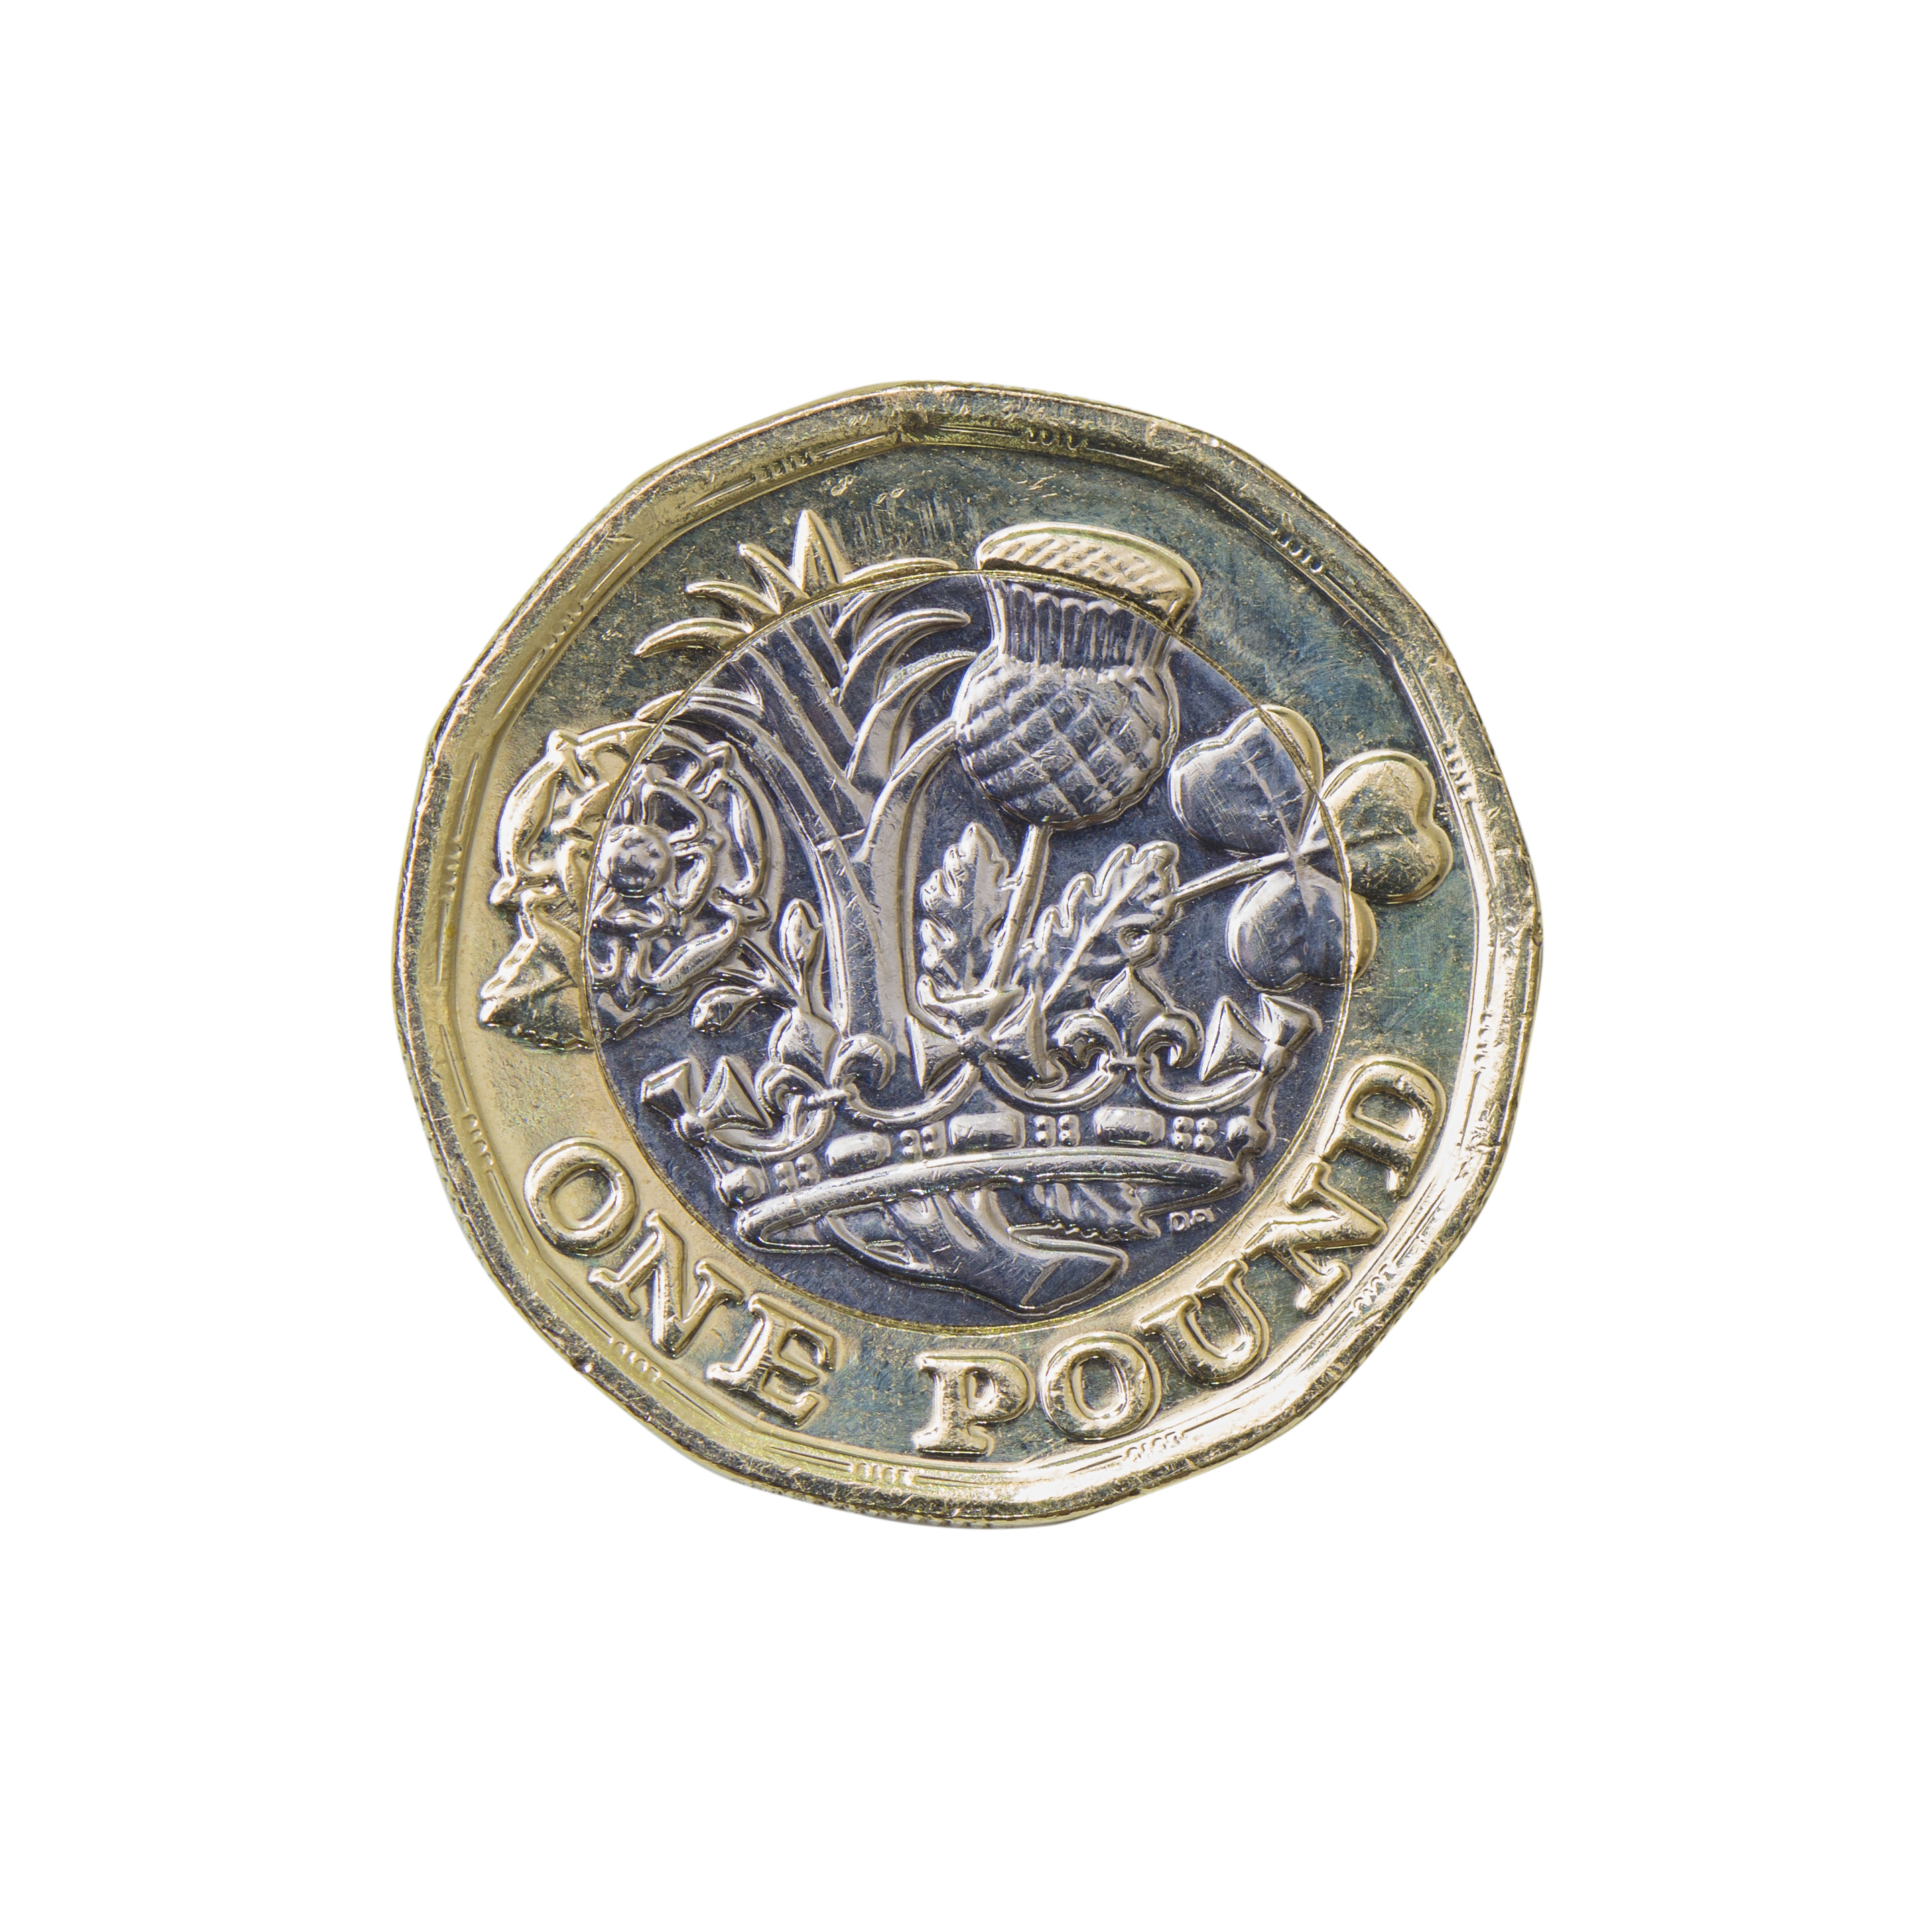
Varied Fluency 1
Look at this pictogram.
Fill in the blanks in the table.
Pocket Money
< £5 | £6 - £10 | £11 - £15 | £16 - £20
each image = 5 children
< £5 | £6 – £10 | £11 – £15 | £16 – £20
 |  | 10
© Classroom Secrets Limited 2019

Slide 4
Varied Fluency 1
Look at this pictogram.
Fill in the blanks in the table.
Pocket Money
< £5 | £6 - £10 | £11 - £15 | £16 - £20
each image = 5 children
< £5 | £6 – £10 | £11 – £15 | £16 – £20
15 | 15 | 10 | 5
© Classroom Secrets Limited 2019

Slide 5
Varied Fluency 2
Think of one question to ask about the information in this tally chart:
Holiday Destinations
UK
Europe
Rest of the World
© Classroom Secrets Limited 2019

Slide 6
Varied Fluency 2
Think of one question to ask about the information in this tally chart:
Various answers, for example:
How many people stayed in the UK for their holiday?
Which is the least popular destination?
How many people were asked in total?
How many more people stayed in the UK than travelled to Europe?
Holiday Destinations
UK
Europe
Rest of the World
© Classroom Secrets Limited 2019

Slide 7
Varied Fluency 3
Use the information in the table to create a bar chart.
Colour of Cars Passing the School
Silver | 35
Red | 40
Blue | 55
 | Silver |  | Red |  | Blue
© Classroom Secrets Limited 2019

Slide 8
Varied Fluency 3
Use the information in the table to create a bar chart.
Colour of Cars Passing the School
Silver | 35
Red | 40
Blue | 55
 | Silver |  | Red |  | Blue
Discuss which scale to use: 1s, 2s, 5s, 10s, 20s
How will you
show 35? 55?
© Classroom Secrets Limited 2019

Slide 9
Varied Fluency 3
Use the information in the table to create a bar chart.
Silver | 35
Red | 40
Blue | 55
Colour of Cars Passing the School
60
40
20
0
 | Silver |  | Red |  | Blue
Number of Cars
Colour
© Classroom Secrets Limited 2019

Slide 10
Varied Fluency 4
Use the bar chart to answer the questions.
60
45
30
15
0
Cake Sales
How many cakes were sold on Monday?
What is the most cakes sold in one day?
On which day were the least amount of cakes sold?
Mon | Tues | Wed | Thurs | Fri
© Classroom Secrets Limited 2019

Slide 11
Varied Fluency 4
Use the bar chart to answer the questions.
60
45
30
15
0
Cake Sales
How many cakes were sold on Monday? 45
What is the most cakes sold in one day? 60 on Wednesday
On which day were the least amount of cakes sold? Tuesday and Thursday
Mon | Tues | Wed | Thurs | Fri
© Classroom Secrets Limited 2019

Slide 12
Reasoning 1
The school kitchen are collecting ideas for recipes by asking the children their favourite food.
Who do you agree with and why?
I want to use a pictogram to draw each meal.
Jayden
I think a choice of 4 meals and a bar chart would work best.
Hakeem
© Classroom Secrets Limited 2019

Slide 13
Reasoning 1
The school kitchen are collecting ideas for recipes by asking the children their favourite food.
Who do you agree with and why?
Hakeem has the best idea because…
I want to use a pictogram to draw each meal.
Jayden
I think a choice of 4 meals and a bar chart would work best.
Hakeem
© Classroom Secrets Limited 2019

Slide 14
Reasoning 1
The school kitchen are collecting ideas for recipes by asking the children their favourite food.
Who do you agree with and why?
Hakeem has the best idea; it will be quick and simple to collect the data and make people’s decision making much easier.
I want to use a pictogram to draw each meal.
Jayden
I think a choice of 4 meals and a bar chart would work best.
Hakeem
© Classroom Secrets Limited 2019

Slide 15
Reasoning 2
True or false?
Explain your answer.
The lines on a chart are called axels.
© Classroom Secrets Limited 2019

Slide 16
Reasoning 2
True or false?
Explain your answer.
False, the lines are called the y-axis and the x-axis
(or axes).
The lines on a chart are called axels.
y-axis
x-axis
© Classroom Secrets Limited 2019

Slide 17
Problem Solving 1
Mr Thompson says this tally chart is not easy to interpret.
Find 2 ways in which you could make the chart easier to interpret.
Height of Pupils in Oak Class
< 1 metre
> 1 metre
© Classroom Secrets Limited 2019

Slide 18
Problem Solving 1
Mr Thompson says this tally chart is not easy to interpret.
Find 2 ways in which you could make the chart easier to interpret.
The tally should be 5 strokes so counting is easier.
The options could be broken into smaller steps e.g. 90cm to 1m, 1m to 1.5m, 1.5 to 2m as the data is not very useful with such a large range.
Height of Pupils in Oak Class
< 1 metre
> 1 metre
© Classroom Secrets Limited 2019

