Slide 1
Worries
Grown-ups sometimes call worries, anxiety or stress. So what is a worry?
I think of it as a bad thought that gets stuck in your head. You might not know exactly what it is, but it’s just bothering you.

Slide 2
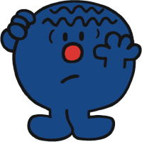
What do you worry about?
You can worry about almost anything. It’s normal to think about things.
It helps us to keep safe and manage dangers.
Worries can help us think about things so we can make sensible choices and decisions.
But sometimes worries can get stuck and they are all we think about.

Slide 3
What is anxiety?
https://www.youtube.com/watch?v=pvM_TtQi9DU
Are you scared of anything?

Slide 4
Overcoming fear
https://www.youtube.com/watch?v=8dsLxF6VoXM
Relax
Talk
Eat healthily
Exercise
Breath slowly
Choose a special memory

