Slide 1
ACTIVITY 1:
Jenna has £44.
She spends one third of her money. How much does she have left?
How can we use the bar model to help us?
Create your own bar model problem.

Slide 2
ACTIVITY 1:
Jenna has £44.
She spends one third of her money. How much does she have left?
£44 ÷ 4 = £11
£11 x 3 = £33
£44
£11
£11
£11
£11

Slide 3
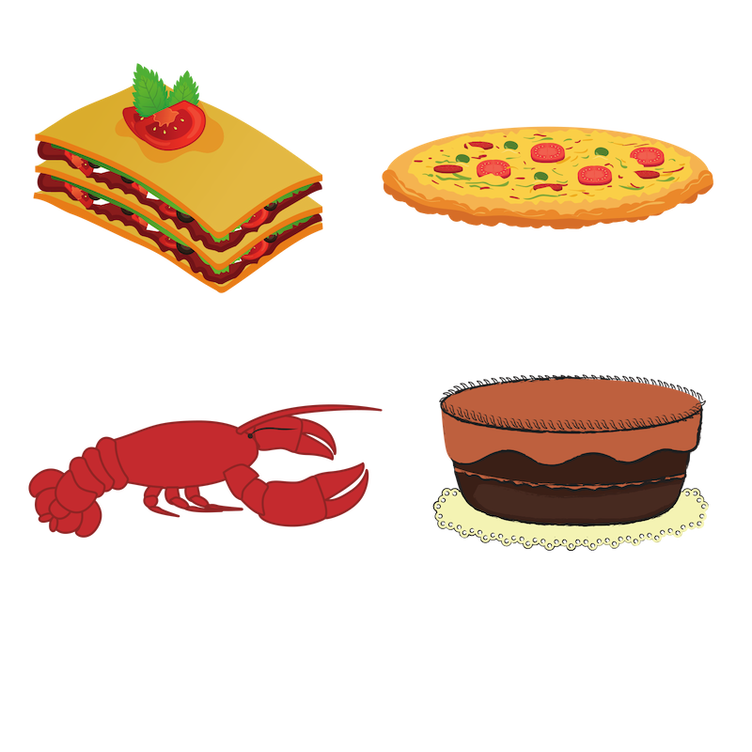
ACTIVITY 2:
On Wednesdays, Prizzi Ristorante offers its menu at half price.
Lasagna £5.50
Pizza £6
Lobster £16
Tiramisu £3.50
How much do the menu items cost full price?
How much would you pay for all four items full price?
How much would you pay on a Wednesday? How much money is saved eating on a Wednesday?
Write your own word problem.

Slide 4
ACTIVITY 2:
On Wednesdays, Prizzi Ristorante offers its menu at half price.
Lasagna £5.50
Pizza £6
Lobster £16
Tiramisu £3.50
How much do the menu items cost full price?
How much would you pay for all four items full price?
How much would you pay on a Wednesday? How much money is saved eating on a Wednesday?
£11, £12, £32 and £7
£11 + £12 + £32 + £7 = £62
£62 ÷ 2 = £31
So, £31 is saved by eating on a Wednesday!

Slide 5
ACTIVITY 3:
The Smith family are planning a train journey.
How much does it cost for 1 adult and 1 child off peak?
b) How much does it cost for 2 adults and 1 child at peak time?
Tickets | Peak | Off-peak
Adult | £9 | £6
Child | £3.60 | £2.40
Write your own word problems based on the table above.
Notes:
Children can use toy money as a means of support.

Slide 6
ACTIVITY 3:
The Smith family are planning a train journey.
How much does it cost for 1 adult and 1 child off peak? £6 + £2.40 = £8.40
b) How much does it cost for 2 adults and 1 child at peak time?
(£9 x 2) + £3.60 £18 + £3.60 = £21.60
Tickets | Peak | Off-peak
Adult | £9 | £6
Child | £3.60 | £2.40

Slide 7
ACTIVITY 4:
A sports club has £50 to spend on new kit.
Kit prices:
Shorts = £3
Shirts = £7
How many pieces of kit can they buy with £50?
Can you find more than one way for the club to spend their kit money?

Slide 8
ACTIVITY 4:
A sports club has £50 to spend on new kit.
Kit prices:
Shorts = £3
Shirts = £7
How many pieces of kit can they buy with £50?
Various responses…
The most pieces of kit they could buy would be 16 pairs of shorts at £48.
The least pieces of kit they could buy would by 7 shirts for £49.
They could buy five sets of matching shirts and shorts.

Slide 9
ACTIVITY 5:
Sharon bought a big bag of crisps and a lollipop.
The cost of each is somewhere in the table below.
Use the clues to figure out how much each item cost.
You need 3 or more coins to make each amount.
If Sharon paid using a £2 coin, she’d get change.
The lollipop cost less than £1.
You would need copper coins to pay for both items individually.
The crisps cost twice as much as the lollipop.
£1.75 | 85p | £1.23 | 97p
£1.63 | £2.40 | 80p | £1.15
85p | £1.24 | 99p | £2.00
£1.01 | 76p | £1.36 | 62p
Create your own question!

Slide 10
ACTIVITY 5:
Sharon bought a big bag of crisps and a lollipop.
The cost of each is somewhere in the table below.
Use the clues to figure out how much each item cost.
You need 3 or more coins to make each amount.
If Sharon paid using a £2 coin, she’d get change.
The lollipop cost less than £1.
You would need copper coins to pay for both items individually.
The crisps cost twice as much as the lollipop.
crisps
£1.75 | 85p | £1.23 | 97p
£1.63 | £2.40 | 80p | £1.15
85p | £1.24 | 99p | £2.00
£1.01 | 76p | £1.36 | 62p
lollipop

Slide 11
LIGHTBULB CHALLENGE:
Ellie goes to the shops. She buys a doll for £7.00, a puzzle for £3.50, a computer game for £6.50 and a bag of sweets for £3.
She has two vouchers. One gets her £10 off her bill; the other is a half off voucher.
Which voucher offers the best savings?
Explain your answer.

Slide 12
LIGHTBULB CHALLENGE:
Ellie goes to the shops. She buys a doll for £7.00, a puzzle for £3.50, a computer game for £6.50 and a bag of sweets for £3.
She has two vouchers. One gets her £10 off her bill; the other is a half off voucher.
Which voucher offers the best savings?
Explain your answer.
£7 + £3.50 + £6.50 + £3 means her total spend would be £20
If she uses the half off voucher or the £10 off voucher, she will save the same amount of money.
Therefore, it doesn’t matter which voucher she uses!

