Slide 1
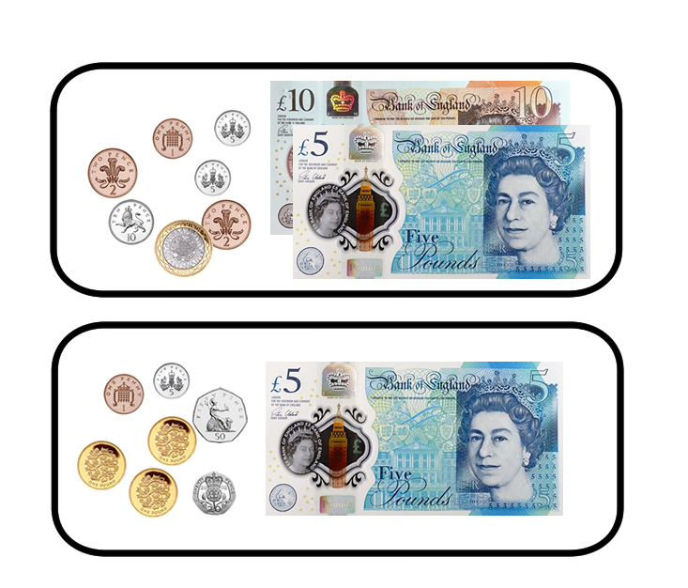
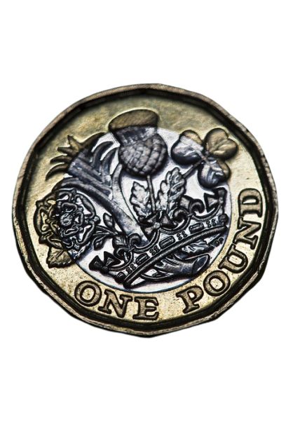
ACTIVITY 1:
How much money is in the trays below?

Slide 2
ACTIVITY 1:
How much money is in the trays below?
This tray has £17.25.
This tray has £8.76
Think about what helped you to know how much was in each tray? What did you compare first?

Slide 3
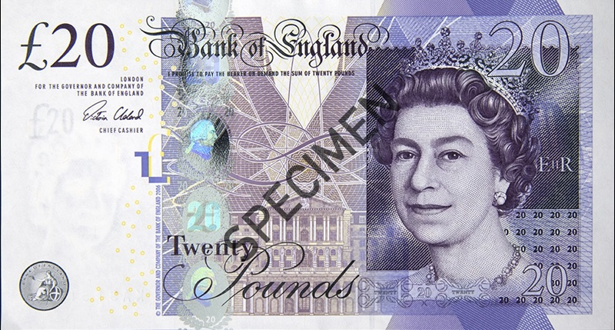
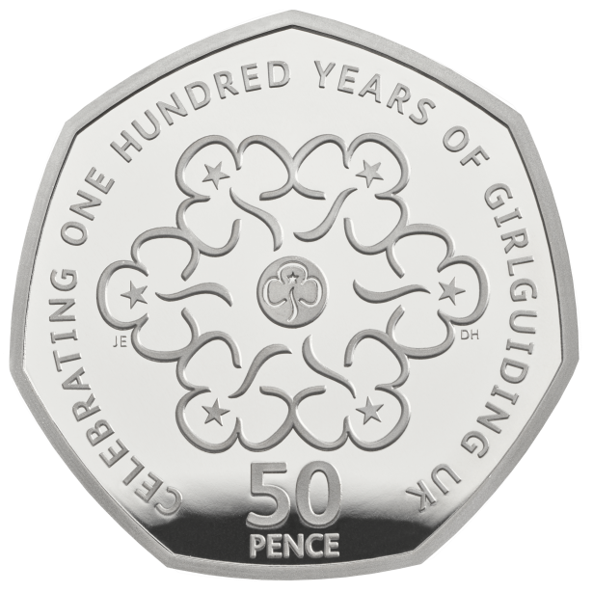
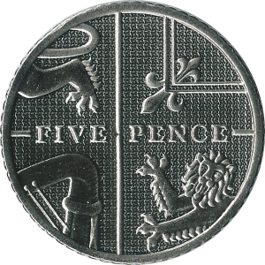
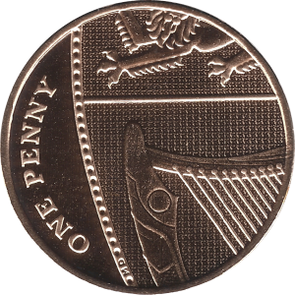
ACTIVITY 2:
Complete the part-whole models to show how many pounds and pence there are or what the total is...
£21
£12
18p
£21.56

Slide 4
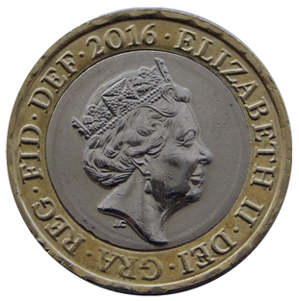
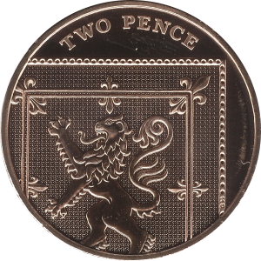
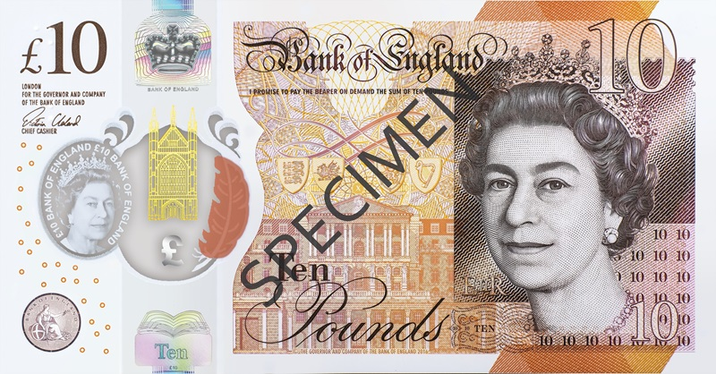
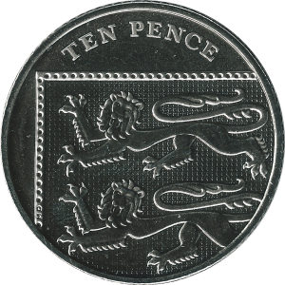
ACTIVITY 2:
Complete the part-whole models to show how many pounds and pence there are or what the total is...
£21
56p
£12
18p
£21.56
£12.18

Slide 5
ACTIVITY 3:
Can you convert the amounts below into pounds and pence?
567p
507p
57p
560p

Slide 6
ACTIVITY 3:
Can you convert the amounts below into pounds and pence?
567p = £5.67
507p = £5.07
57p = £0.57
560p = £5.60

Slide 7
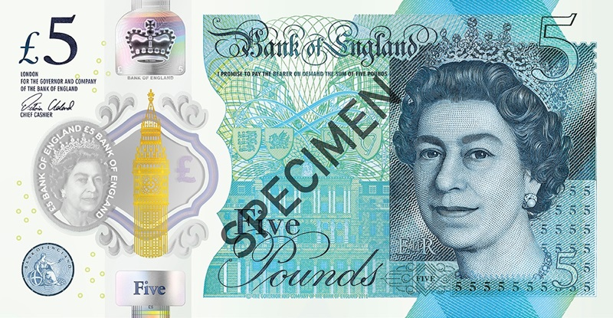
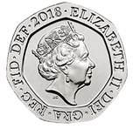
ACTIVITY 4:
Hamira has the following coins and note:
She chooses three items each time.
Are the following statements always, sometimes or never true?
She can make an even total.
She can make an amount more than £16.
She can make an amount which ends in 5.
She can make a total which is less than £5.

Slide 8
ACTIVITY 4:
Hamira has the following coins and note:
She chooses three items each time.
Are the following statements always, sometimes or never true?
Sometimes – as long as her final piece is £1, 20p or 2p.
Never - £16 is the greatest possible amount.
Sometimes – when the 5p piece as her smallest piece.
Sometimes –if she uses the coins and no notes.

Slide 9
EVALUATION:
Miss Apple’s class are converting between pounds and pence.
Are the children correct or incorrect? Explain your answer.
Jim says, “2,650p is the same as £2.65.”
Ahmed says, “75p can be written as £0.75.”
Destiny says, “550p equals £5.55.”
Chen says, “£4.40 is equivalent to 404p.”

Slide 10
EVALUATION:
Miss Apple’s class are converting between pounds and pence.
Are the children correct or incorrect? Explain your answer.
Jim says, “2,650p is the same as £2.65.” Jim is wrong, 2,650p is the same as £26.50.
Ahmed says, “75p can be written as £0.75.” Ahmed is correct £0.75 is decimal notation for 75 pence.
Destiny says, “550p equals £5.55.” Destiny is incorrect, £5.55 equals 555p, not 550p.
Chen says, “£4.40 is equivalent to 404p.” Chen has made a place value error, he has confused the digit 4 in the tenths column with the value of a digit 4 in the hundredths column, so £4.40 correctly equals 440p.

