Slide 1
Year 4 – Summer Block 1 – Decimals
Step 3: Compare Decimals
© Classroom Secrets Limited 2018

Slide 2
Year 4 – Summer Block 1 – Decimals – Compare Decimals
About This Resource:
This PowerPoint has been designed to support your teaching of this small step. It includes a starter activity and an example of each question from the Varied Fluency and Reasoning and Problem Solving resources also provided in this pack. You can choose to work through all examples provided or a selection of them depending on the needs of your class.
National Curriculum Objectives:
Mathematics Year 4: (4F8) Compare numbers with the same number of decimal places up to two decimal places
Mathematics Year 4: (4F10b) Solve simple measure and money problems involving fractions and decimals to two decimal places
More Year 4 Decimals resources.
Did you like this resource? Don’t forget to review it on our website.
© Classroom Secrets Limited 2018

Slide 3
Introduction
Find 6 complements of 1 on the grid below.
0.7 | 0.4 | 0.6 | 0.11 | 0.08
0.59 | 0.1 | 0.22 | 0.73 | 0.27
0.55 | 0.1 | 0.8 | 0.98 | 0.5
0.45 | 0.09 | 0.1 | 0.2 | 0.64
0.44 | 0.9 | 0.23 | 0.7 | 0.36
© Classroom Secrets Limited 2018

Slide 4
Introduction
Find 6 complements of 1 on the grid below.
0.7 | 0.4 | 0.6 | 0.11 | 0.08
0.59 | 0.1 | 0.22 | 0.73 | 0.27
0.55 | 0.1 | 0.8 | 0.98 | 0.5
0.45 | 0.09 | 0.1 | 0.2 | 0.64
0.44 | 0.9 | 0.23 | 0.7 | 0.36
© Classroom Secrets Limited 2018

Slide 5
Varied Fluency 1
Write down and compare these decimal numbers using >, < or =.
0.01
0.01
0.01
0.1
0.01
0.1
0.01
1
0.1
0.1
0.01
1
1
© Classroom Secrets Limited 2018

Slide 6
Varied Fluency 1
Write down and compare these decimal numbers using >, < or =.
0.01
0.01
0.01
0.1
>
0.1
0.01
0.01
1
0.1
0.1
0.01
1
1
2.23
1.23
© Classroom Secrets Limited 2018

Slide 7
Varied Fluency 2
Use >, < or = to compare these decimal numbers.
1 | 0.1 | 0.01
1 | 0.1 | 0.01
© Classroom Secrets Limited 2018

Slide 8
Varied Fluency 2
Use >, < or = to compare these decimal numbers.
1 | 0.1 | 0.01
1 | 0.1 | 0.01
<
2.34
3.05
© Classroom Secrets Limited 2018

Slide 9
Varied Fluency 3
Use > or < to compare these decimal numbers.
5.63 |  | 5.36
1.04 |  | 1.4
7.8 |  | 7.79
© Classroom Secrets Limited 2018

Slide 10
Varied Fluency 3
Use > or < to compare these decimal numbers.
5.63 | > | 5.36
1.04 | < | 1.4
7.8 | > | 7.79
© Classroom Secrets Limited 2018

Slide 11
Varied Fluency 4
Using digits from 1 to 9, make these statements correct.
0.54 > 0.5
0.1 < 0.18
0.72 = 0. 2
© Classroom Secrets Limited 2018

Slide 12
Varied Fluency 4
Using digits from 1 to 9, make these statements correct.
Various possible answers, for example:
3
0.54 > 0.5
0.1 < 0.18
0.72 = 0. 2
7
7
© Classroom Secrets Limited 2018

Slide 13
Problem Solving 1
Travel vertically or horizontally through the maze
by moving from smaller to larger decimal numbers.
Start
6.23 | 6.45 | 6.81 | 6.41
6.19 | 6.28 | 6.93 | 6.49
6.48 | 6.59 | 7.02 | 7.56
7.86 | 7.99 | 6.61 | 8.01
Finish
© Classroom Secrets Limited 2018

Slide 14
Problem Solving 1
Travel vertically or horizontally through the maze
by moving from smaller to larger decimal numbers.
Start
6.23 | 6.45 | 6.81 | 6.41
6.19 | 6.28 | 6.93 | 6.49
6.48 | 6.59 | 7.02 | 7.56
7.86 | 7.99 | 6.61 | 8.01
Finish
© Classroom Secrets Limited 2018

Slide 15
Problem Solving 2
Use >, < and = to compare the partitioned decimal numbers.
0.6 + 0.02 0.3 + 0.3
0.04 + 0.05 0.4 + 0.05
© Classroom Secrets Limited 2018

Slide 16
Problem Solving 2
Use >, < and = to compare the partitioned decimal numbers.
0.6 + 0.02 0.3 + 0.3
0.04 + 0.05 0.4 + 0.05
>
<
© Classroom Secrets Limited 2018

Slide 17
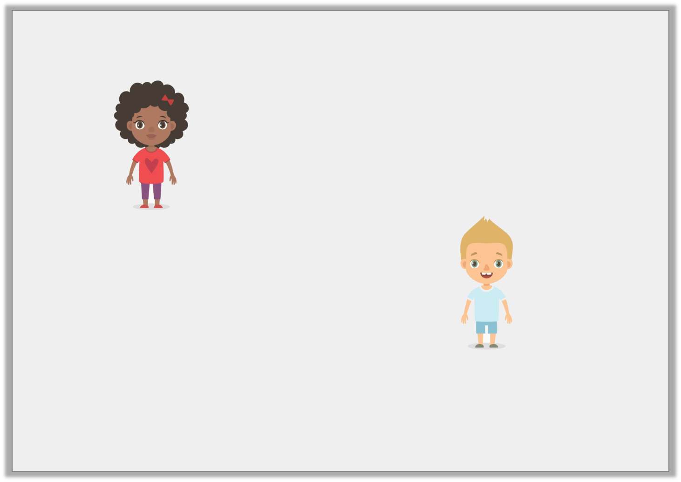
Reasoning 1
Agatha says:
Oscar says:
Who is correct? Explain why.
I have made the longest train track because it is 1.2m long.
I have made the longest train track because it is 0.21m long.
© Classroom Secrets Limited 2018

Slide 18
Reasoning 1
Agatha says:
Oscar says:
Who is correct? Explain why.
Agatha is correct because…
I have made the longest train track because it is 1.2m long.
I have made the longest train track because it is 0.21m long.
© Classroom Secrets Limited 2018

Slide 19
Reasoning 1
Agatha says:
Oscar says:
Who is correct? Explain why.
Agatha is correct because 1.2m is longer than 0.21m.
I have made the longest train track because it is 1.2m long.
I have made the longest train track because it is 0.21m long.
© Classroom Secrets Limited 2018

