Slide 1
Year 4 – Spring Block 4 – Suffixes – Words Ending in ‘-sure’, ‘-ture’ or ‘-cher’
About This Resource:
This PowerPoint has been designed to support your teaching of this small step. It includes a starter activity and an example of each question from the Varied Fluency and Application and Reasoning resources also provided in this pack. You can choose to work through all examples provided or a selection of them depending on the needs of your class.
National Curriculum Objectives:
Spell words with endings sounding like /ʒə/ or /tʃə/
More resources from our Grammar, Punctuation and Spelling scheme of work.
Did you like this resource? Don’t forget to review it on our website.
© Classroom Secrets Limited 2019

Slide 2
Year 4 – Spring Block 4 – Suffixes – Words Ending in ‘-sure’, ‘-ture’ or ‘-cher’
Notes and Guidance:
Having recapped word families and root words in the previous step, children can now begin selecting the correct endings to match root words.
In this step, children will focus upon spelling ‘-sure’, ‘-ture’ or ‘-cher’.
They will begin to recognise the correct spelling for words with endings sounding like /ʒə/ or /tʃə/ and use them in their own writing, in addition to identifying where the sounds have been spelt incorrectly (for example, teacher and teature).
Focused Questions
Which spelling of the sound /tʃə/ should be used in the following words?
Change the words by adding the correct endings.
© Classroom Secrets Limited 2019

Slide 3
Year 4 – Spring Block 4 – Suffixes
Step 2: Words Ending in
‘-sure’, ‘-ture’ or ‘-cher’
© Classroom Secrets Limited 2019

Slide 4
Introduction
Find all the words that form a family of words based on the same root word.
gleeful
joyful
joyfully
gladdest
happiest
joyfulness
© Classroom Secrets Limited 2019

Slide 5
Introduction
Find all the words that form a family of words based on the same root word.
gleeful
joyful
joyfully
gladdest
happiest
joyfulness
© Classroom Secrets Limited 2019

Slide 6
Introduction
Find all the words that form a family of words based on the same root word.
joyful joyfully joyous joyfulness
Now do the same for these words
Joy
glee
glad
happy
© Classroom Secrets Limited 2019

Slide 7
Varied Fluency 1
Which sentence has the correct spelling of the underlined word?
The x-ray showed that I had a nasty fracture at the top of my arm.
The x-ray showed that I had a nasty fraccher at the top of my arm.
© Classroom Secrets Limited 2019

Slide 8
Varied Fluency 1
Which sentence has the correct spelling of the underlined word?
The x-ray showed that I had a nasty fracture at the top of my arm.
The x-ray showed that I had a nasty fraccher at the top of my arm.
© Classroom Secrets Limited 2019

Slide 9
Varied Fluency 2
Match the start of each word to the correct spelling of the full word.
Start |  | Full Word
in |  | inture
 |  | insure
fu |  | future
 |  | fucher
pres |  | pressure
 |  | presture
© Classroom Secrets Limited 2019

Slide 10
Varied Fluency 2
Match the start of each word to the correct spelling of the full word.
Start |  | Full Word
in |  | inture
 |  | insure
fu |  | future
 |  | fucher
pres |  | pressure
 |  | presture
© Classroom Secrets Limited 2019

Slide 11
Varied Fluency 3
Complete the sentence using the correct word from the word bank below.
I am always very pleased when someone gives me a ______________________ as a present, because then I can go shopping and buy whatever I would like with it.
voucher
vouture
© Classroom Secrets Limited 2019

Slide 12
Varied Fluency 3
Complete the sentence using the correct word from the word bank below.
I am always very pleased when someone gives me a ______________________ as a present, because then I can go shopping and buy whatever I would like with it.
voucher
voucher
vouture
© Classroom Secrets Limited 2019

Slide 13
Application 1
Rewrite the sentence below and correct the spelling mistakes.
It gave the scientific researchture enormous pleature to announce that she had made a breakthrough in the quest to find a cure for the deadly disease.
© Classroom Secrets Limited 2019

Slide 14
Application 1
Rewrite the sentence below and correct the spelling mistakes.
It gave the scientific researchture enormous pleature to announce that she had made a breakthrough in the quest to find a cure for the deadly disease.
It gave the scientific researcher enormous pleasure to announce that she had made a breakthrough in the quest to find a cure for the deadly disease.
© Classroom Secrets Limited 2019

Slide 15
Application 2
Create your own multi-clause sentence using one word from each column in the word bank. Include at least two adjectives in your sentence.
Hint: Some of the words in the word bank are spelt incorrectly!
furnicher | pressure
picture | culsure
© Classroom Secrets Limited 2019

Slide 16
Application 2
Create your own multi-clause sentence using one word from each column in the word bank. Include at least two adjectives in your sentence.
Hint: Some of the words in the word bank are spelt incorrectly!
Various answers, for example: I could tell by the look of the antique furniture that it must have been created by people from a different culture, due to the high quality and detail of their work.
furnicher | pressure
picture | culsure
© Classroom Secrets Limited 2019

Slide 17
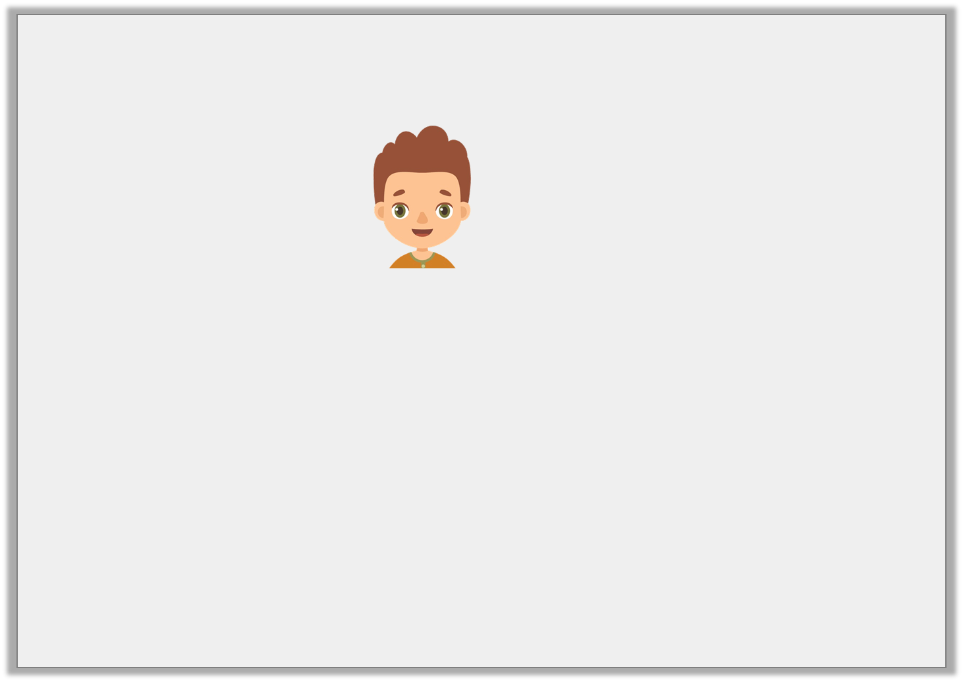
Reasoning 1
Kristian thinks he has written his sentence correctly.
I am very excited about seeing the new superhero advencher film, as my friends say it is really good.
Is he correct? How do you know?
Kristian
© Classroom Secrets Limited 2019

Slide 18
Reasoning 1
Kristian thinks he has written his sentence correctly.
I am very excited about seeing the new superhero advencher film, as my friends say it is really good.
Is he correct? How do you know?
No because…
Kristian
© Classroom Secrets Limited 2019

Slide 19
Reasoning 1
Kristian thinks he has written his sentence correctly.
I am very excited about seeing the new superhero advencher film, as my friends say it is really good.
Is he correct? How do you know?
No because there is a spelling mistake. It should be ‘adventure’, not ‘advencher’.
Kristian
© Classroom Secrets Limited 2019

