Slide 1
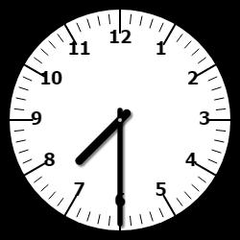
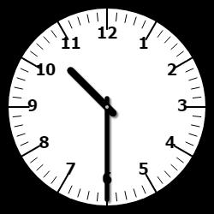
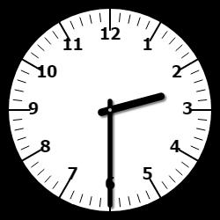
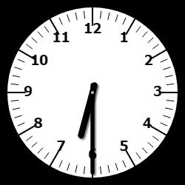
ACTIVITY 1:
Write the times these clocks show in three different ways.
b. evening b. morning
c. morning d. evening

Slide 2
ACTIVITY 1:
30 minutes past 7 o’clock
half past 7
07:30pm
b. 30 minutes past 10 o’clock
half past 10
10:30am
30 minutes past 2 o’clock
half past 2
02:30am
d. 30 minutes past 6 o’clock
half past 6
06:30pm

Slide 3
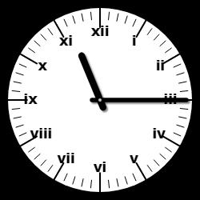
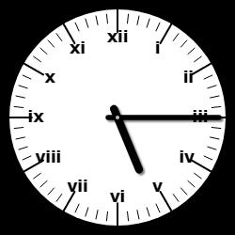
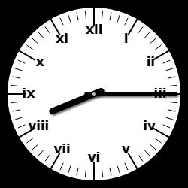
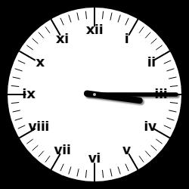
ACTIVITY 2:
Write the times shown on each of these clocks in three different
ways.
a. Morning b. Evening
c. Evening d. morning
For each clock above, how many minutes is it to the next hour? How do you know?

Slide 4
ACTIVITY 2:
15 minutes past 11
quarter past 11
11:15am
b. 15 minutes past 5
quarter past 5
05:15pm
15 minutes past 8
quarter past 8
08:15pm
15 minutes past 3
Quarter past 3
03:15am
For each clock above, how many minutes is it to the next hour? How do you know? 45 minutes because 15 + 45 = 60

Slide 5
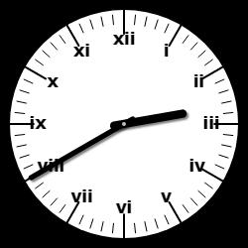
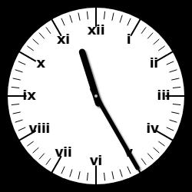
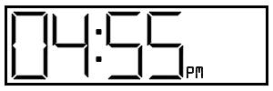
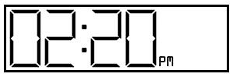
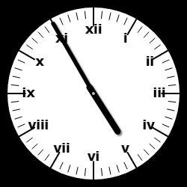
ACTIVITY 3:
Match the written times to the analogue and/or digital clocks.
40 minutes past 2
25 minutes past 12
5 minutes to 5

Slide 6
ACTIVITY 3:
Match the written times to the analogue and/or digital clocks.
40 minutes past 2
25 minutes past 12
5 minutes to 5

Slide 7
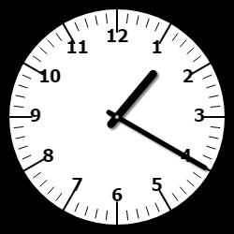
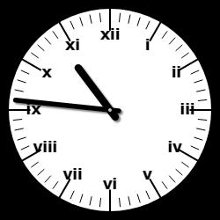
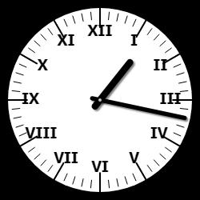
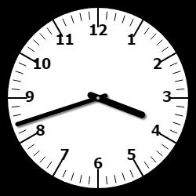
ACTIVITY 4:
Write the times shown on the analogue clocks in digital format.
a. b.
c. d.

Slide 8
ACTIVITY 4:
Write the times shown on the analogue clocks in digital format.
a. b.
01:20 10:46
d. d.
01:17 03:42

Slide 9
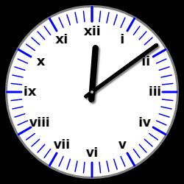
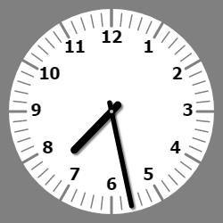
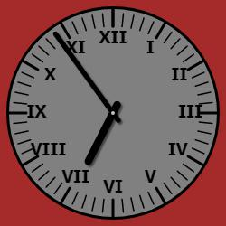
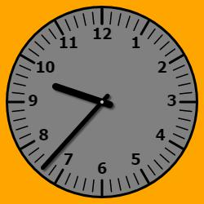
ACTIVITY 4:
Write the times shown on the analogue clocks in digital format.
a. b.
c. d.

Slide 10
ACTIVITY 4:
Write the times shown on the analogue clocks in digital format.
a. b.
12:09 07:28
c. d.
06:54 09:37

Slide 11
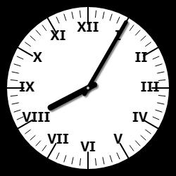
ACTIVITY 5:
Kalvin says,
It takes me 46 minutes to walk to school. School starts at 08:55am. If I leave home at the time shown, will I be late for school?
If Kalvin is not on time, how early or late is he?

Slide 12
ACTIVITY 5:
Kalvin says,
No. It is 08:05am now if you count on 46 minutes the time is 08:51am.
08:51am is earlier than 08:55am.
It takes me 46 minutes to walk to school. School starts at 08:55am. If I leave home at the time shown, will I be late for school?
If Kalvin is not on time, how early or late is he? 4 minutes early

Slide 13
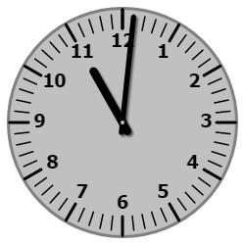
LIGHTBULB CHALLENGE:
Harvey converts the analogue time to digital format.
Here is his answer.
Do you agree? Explain your answer.

Slide 14
LIGHTBULB CHALLENGE:
Harvey converts the analogue time to digital format.
Here is his answer.
Do you agree? Explain your answer.
Harvey is incorrect. He has confused the minutes and hour hands. He should have written the time as either 11:01 or 23:01.

