Slide 1
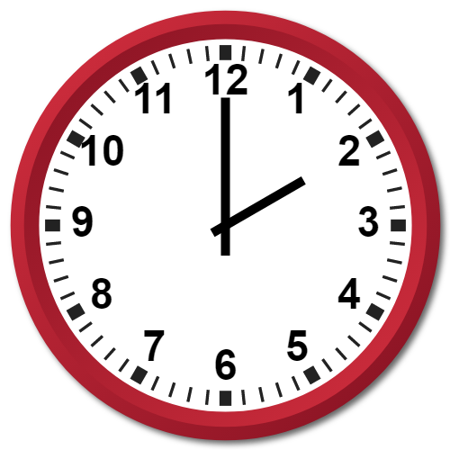
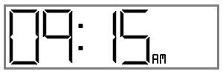
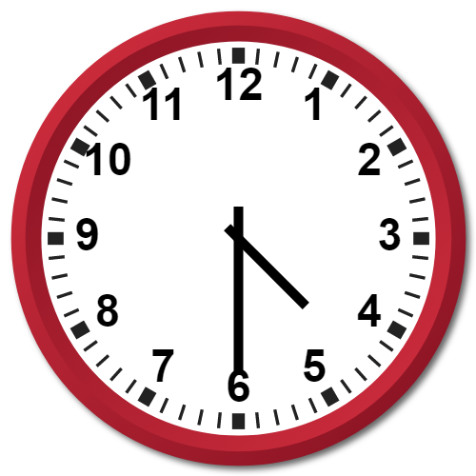
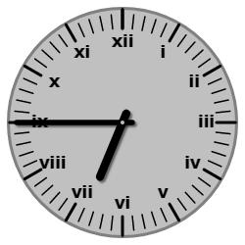
STARTER:
Starter Activity: What time do these clocks show?

Slide 2
STARTER:
Starter Activity: What time do these clocks show?
quarter past nine in the morning
2 o’clock
half past 4
quarter to 7

Slide 3
TALKING TIME:
Sort the activities based on the length of time they take to do.
One second
One minute
One hour
Put your shoes on
Football club
Run around the field
Maths lesson
Stamp your foot
Click your fingers

Slide 4
TALKING TIME:
Sort the activities based on the length of time they take to do.
One second – stamp your foot, click your fingers
One minute – put your shoes on, run around the field
One hour – maths lesson, football club
One second
One minute
One hour
Put your shoes on
Football club
Run around the field
Maths lesson
Stamp your foot
Click your fingers

Slide 5
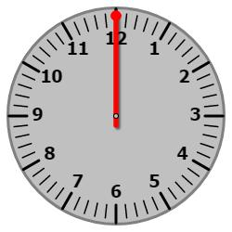
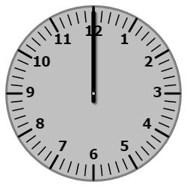
TALKING TIME:
How many seconds are there in a minute?
HINT: Use the clock to count them
How many minutes are there in an hour?
HINT: Use the clock to count them

Slide 6
TALKING TIME:
How many seconds are there in a minute?
HINT: Use the clock to count them
How many minutes are there in an hour?
HINT: Use the clock to count them
60 seconds in one minute
60 minutes in one hour

Slide 7
TALKING TIME:
Josh writes a paragraph in his book in 4 minutes and 26 seconds. Harry writes his paragraph in 315 seconds. Who writes their paragraph the quickest?

Slide 8
TALKING TIME:
Josh writes a paragraph in his book in 4 minutes and 26 seconds. Harry writes his paragraph in 315 seconds. Who writes their paragraph the quickest?
Josh because 4 minutes and 26 seconds is equivalent to 266 seconds which is quicker than Harry’s 315 seconds.

Slide 9
TALKING TIME:
Ellie says,
Is she correct? Can you explain why?
To convert minutes to seconds, I multiply the number of minutes by 60.

Slide 10
TALKING TIME:
Ellie says,
Is she correct? Can you explain why?
Yes because 1 minute = 60 seconds, 2 minutes = 120 seconds, 3 minutes = 180 seconds and the pattern would continue in the same way.
To convert minutes to seconds, I multiply the number of minutes by 60.

