Slide 1
Data logging
Computing Scheme of Work Unit 3.8 – Graphing
Introducing and using 2Graph
Notes:
RESOURCES
Unless otherwise stated, all resources can be found on the main unit 3.8 page. From here, click on the icon to set a resource as a 2Do for your class.
Example graph – Favourite Colours. This should be set as a 2Do.
2Graph tool which can be found in the Tools area of Purple Mash.

Slide 2
Aim
Slide 2
To enter data into a graph and answer questions.
Need more support? Contact us:
Tel: +44(0)208 203 1781 | Email: support@2simple.com | Twitter: @2simplesoftware
Notes:
Display slide 2 and outline the lesson objectives.

Slide 3
Success Criteria
Slide 3
Children can set up a graph with a given number of fields.
Children can enter data for a graph.
Children can produce and share graphs made on the computer.
Extension: Children can select most appropriate style of graph for their data and explain their reasoning.
Need more support? Contact us:
Tel: +44(0)208 203 1781 | Email: support@2simple.com | Twitter: @2simplesoftware
Notes:
Display slide 3 and outline the success criteria.
If appropriate, remind the children of their work using 2Count and 2Graph in Year 1 (Unit 1.4).

Slide 4
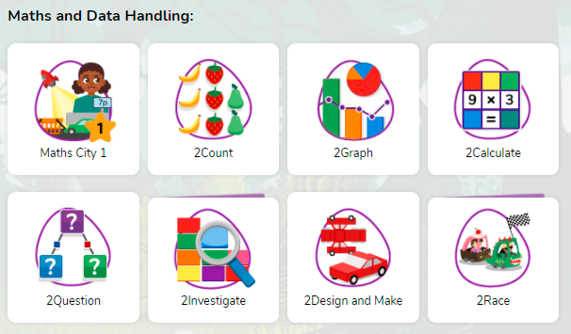
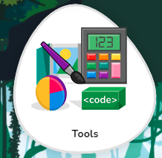
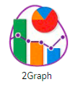
Opening 2Graph
Slide 4
Need more support? Contact us:
Tel: +44(0)208 203 1781 | Email: support@2simple.com | Twitter: @2simplesoftware
Notes:
Display slide 4. Show the children how to open 2Graph

Slide 5
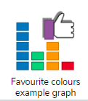
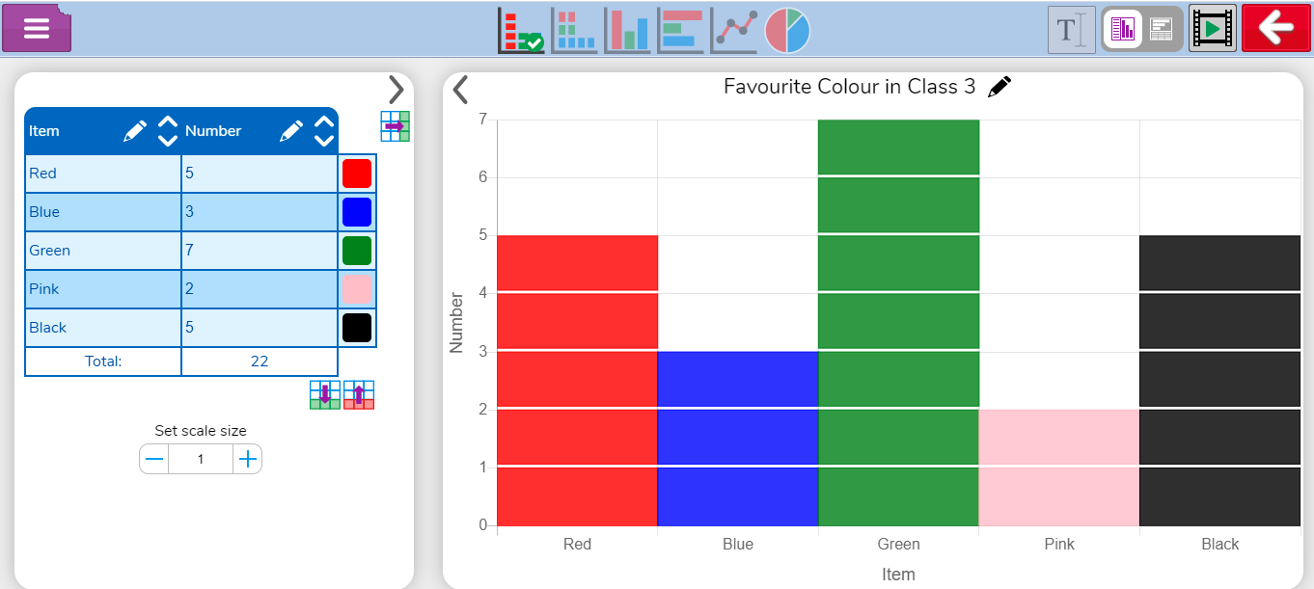
Favourite Colours
Slide 5
Need more support? Contact us:
Tel: +44(0)208 203 1781 | Email: support@2simple.com | Twitter: @2simplesoftware
Notes:
Display slide 5. Open the example graph ‘Favourite Colours’ which is found in the resource section for unit 3.8 on Purple Mash or by clicking on the link in the presentation. What information can the children find on the graph and associated table?

Slide 6
Features of 2Graph
Slide 6
Choose a graph style
Add / Delete table rows
Add a chart title
Axis labels
Click arrows to sort the data
Change the block size
Need more support? Contact us:
Tel: +44(0)208 203 1781 | Email: support@2simple.com | Twitter: @2simplesoftware
Notes:
Display slide 6. Look at the features of a 2Graph graph. Clicking highlights each feature.

Slide 7
Collecting Data
Slide 7
Colour | Frequency
RED
BLUE
PINK
GREEN
BLACK
ORANGE
YELLOW
Need more support? Contact us:
Tel: +44(0)208 203 1781 | Email: support@2simple.com | Twitter: @2simplesoftware
Notes:
Display slide 7. As a class complete the table to show what their favourite colours are.

Slide 8
Activity 1: Editing a Graph
Slide 8
Open the graph from your 2Dos.
Edit the graph to display the favourite colours in your class using the information collected in the previous slide.
Need more support? Contact us:
Tel: +44(0)208 203 1781 | Email: support@2simple.com | Twitter: @2simplesoftware
Notes:
Display slide 8. Instruct the children to open the same graph on their own computers from their 2Dos. The children should then spend time editing the graph using the data from their own class.

Slide 9
Checking the Work
Slide 9
Look at some finished examples.
Have your class mates amended the graphs correctly?
Need more support? Contact us:
Tel: +44(0)208 203 1781 | Email: support@2simple.com | Twitter: @2simplesoftware
Notes:
Display slide 9. Bring the class back together and then look at their finished graphs. Have the children edited their graphs correctly?

Slide 10
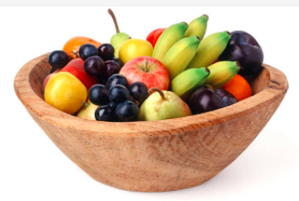
Choosing a Topic to Investigate
Slide 4
Think about what you would like to investigate.
Rolling a dice
Favourite fruit
Bedtimes
Need more support? Contact us:
Tel: +44(0)208 203 1781 | Email: support@2simple.com | Twitter: @2simplesoftware
Notes:
Display slide 4. Explain that the children will be undertaking an investigation and then inputting the results into a graph. If there are no appropriate curriculum links:
Roll some dice 30 times (link to Maths)
Consider the favourite fruits in the class (link to healthy eating)
Consider how the children travel to school (link to Walk to School Week)
Consider what time children go to bed (link to PSHE).
The children could come up with their own topic or the class could all complete the same one.

Slide 11
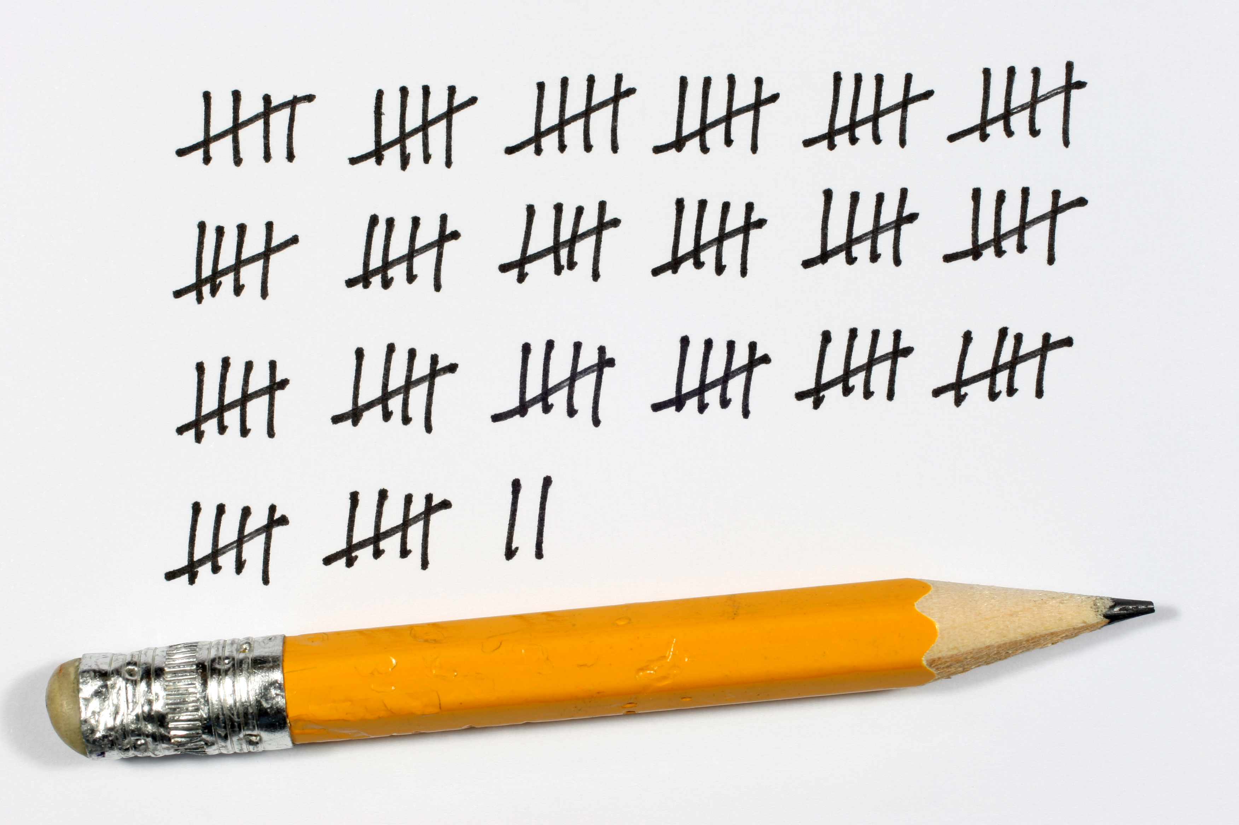
Collecting the Data
Slide 5
How will you collect your data?
Tally Chart
Using 2Email
By sending a survey using 2Survey
Need more support? Contact us:
Tel: +44(0)208 203 1781 | Email: support@2simple.com | Twitter: @2simplesoftware
Notes:
Display slide 5. The children need to consider how they will collect the date for their graph?

Slide 12
Completing the Graph
Slide 6
Need more support? Contact us:
Tel: +44(0)208 203 1781 | Email: support@2simple.com | Twitter: @2simplesoftware
Notes:
Display slide 6. Use 2Graph to complete the graph using the information they have collected. Remember to save the graph when they have finished.

Slide 13
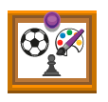
Sharing Graphs
Slide 7
Share your graph on the class display board
 |  | On a Display Board
Need more support? Contact us:
Tel: +44(0)208 203 1781 | Email: support@2simple.com | Twitter: @2simplesoftware
Notes:
Display slide 7. The children need share their graphs to a display board (you will need to set this up), via email or to a class blog (which will also need creating).

Slide 14
Review Success Criteria
Slide 14
I can set up a graph with a given number of fields.
I can enter data for a graph.
I can produce and share graphs made on the computer.
Extension: I can select most appropriate style of graph for my data and explain my reasoning.
Need more support? Contact us:
Tel: +44(0)208 203 1781 | Email: support@2simple.com | Twitter: @2simplesoftware
Notes:
Display slide 12. Review the success criteria from slide 3. Pupils could rate how well they achieved this using a show of hands.

