Slide 1
Theseus and the Minotaur

Slide 2
LI: I can edit and improve my myth

Slide 3
Success Criteria:
Read your work back
Check your spelling
Have you missed or need to add any additional words?
Is there any missing or incorrect punctuation?

Slide 4
The Rewrite
Are there any sentences that don’t make sense? Could they be restructured or generally improved? Could you improve the vocabulary chosen?

Slide 5
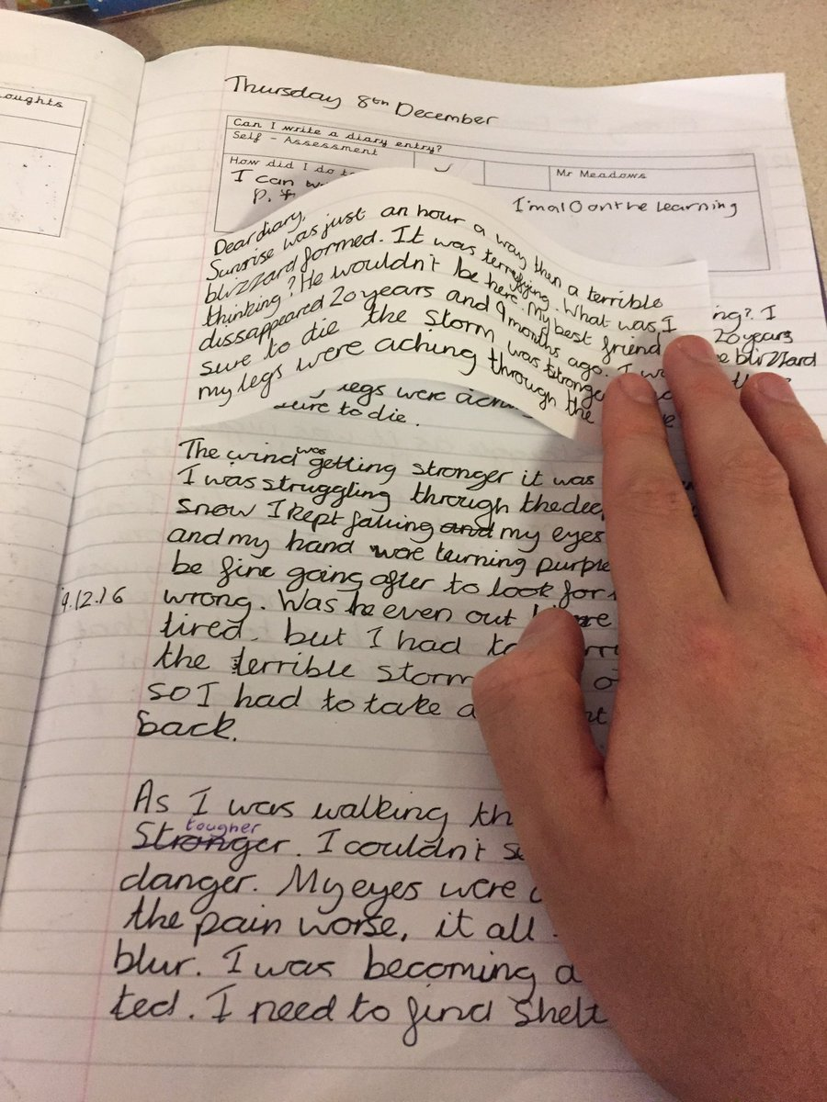
The Reimagine
Could you add any more sentences to develop an idea further?
Add these new sentences onto editing flaps

