Slide 1
Speech punctuation
Part 2

Slide 2
Speech punctuation
Do you remember the rules?
Tell your partner.

Slide 3
Punctuation for speech
Y3
Inverted commas go around the words of the speaker
Capital letter to start speech
Start on new line for each person talking
End the sentence with appropriate punctuation.
Except…
When you describe how a character is talking, then you end the sentence with a comma.
“It’s time to go to school. Hurry up,” shouted mum.
Y4

Slide 4
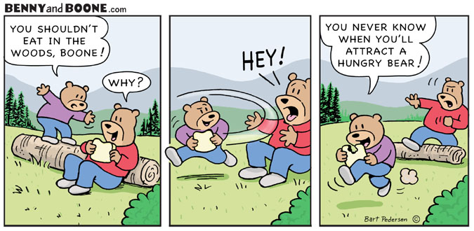
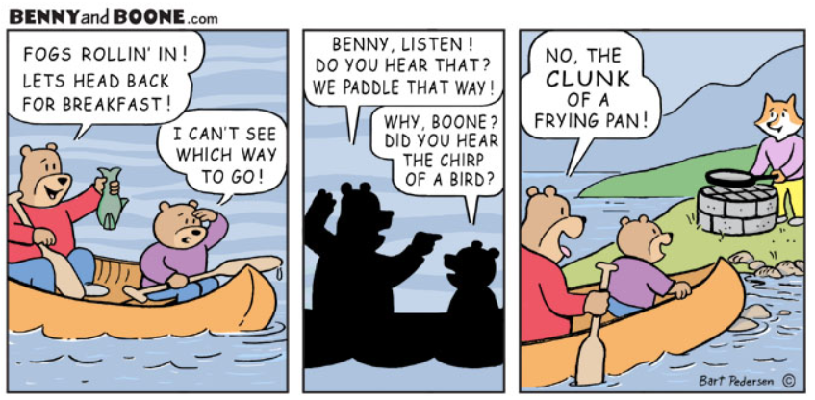
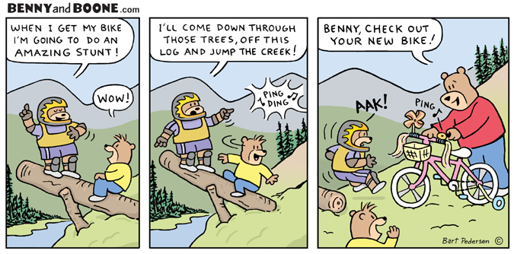
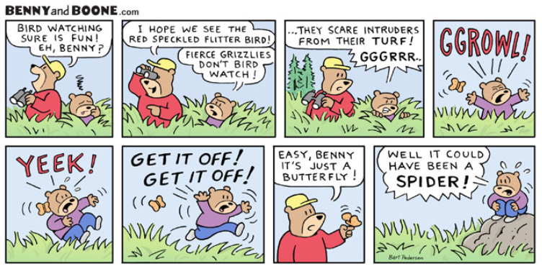
Print, cut up for pupils to use in books when writing dialogue.
Use the three lenses as modelled.

Slide 5
Can I use correct punctuation for dialogue?
We do - whiteboards

