Slide 1
Speech punctuation
Part 1

Slide 2
Can I use correct punctuation for dialogue?
Have a go – use the correct punctuation to show this is speech:
listen to me Harry this is the plan
are we there yet the children asked
all my books have gone gasped Hermione

Slide 3
Punctuation for speech
Y3
Inverted commas go around the words of the speaker
Capital letter to start speech
Start on new line for each person talking
End the sentence with appropriate punctuation.
Except…
When you describe how a character is talking, then you end the sentence with a comma.
“It’s time to go to school. Hurry up,” shouted mum.
Y4

Slide 4
Can I use correct punctuation for dialogue?
Now you know the rules, correct any mistakes you think you made.
“Listen to me Harry, this is the plan.”
“Are we there yet?” the children asked.
“All my books have gone,” gasped Hermione.

Slide 5
George’s Marvellous Medicine
George is talking with his grumpy grandmother. Can you work out when each person is talking?
You’re late she snapped. I don’t think I am, Grandma replied George. Don’t interrupt me in the middle of a sentence! she shouted. But you’d finished your sentence, Grandma replied George. There you go again! she cried. Always interrupting and arguing. You really are a tiresome little boy.

Slide 6
George’s Marvellous Medicine
Where should the inverted commas and any other punctuation go?
You’re late she snapped. I don’t think I am, Grandma replied George. Don’t interrupt me in the middle of a sentence! she shouted. But you’d finished your sentence, Grandma replied George. There you go again! she cried. Always interrupting and arguing. You really are a tiresome little boy.

Slide 7
George’s Marvellous Medicine
Mark your work
“You’re late,” she snapped. “I don’t think I am, Grandma,” replied George. “Don’t interrupt me in the middle of a sentence!” she shouted. “But you’d finished your sentence, Grandma,” replied George. “There you go again!” she cried. “Always interrupting and arguing. You really are a tiresome little boy.”

Slide 8
Speech punctuation
Part 2

Slide 9
Speech punctuation
Do you remember the rules?
Tell your partner.

Slide 10
Punctuation for speech
Y3
Inverted commas go around the words of the speaker
Capital letter to start speech
Start on new line for each person talking
End the sentence with appropriate punctuation.
Except…
When you describe how a character is talking, then you end the sentence with a comma.
“It’s time to go to school. Hurry up,” shouted mum.
Y4

Slide 11
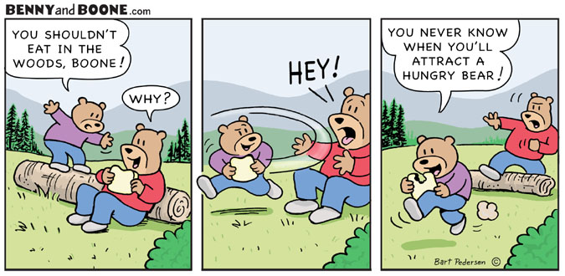
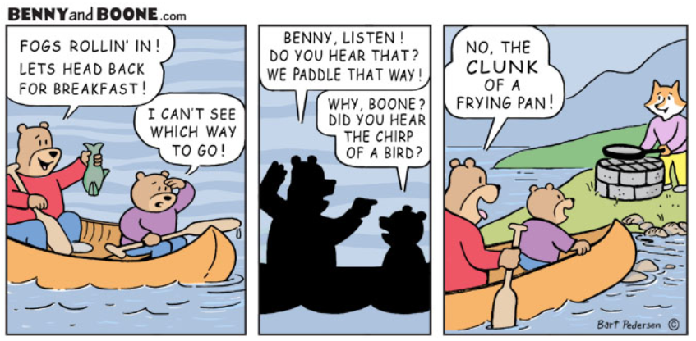
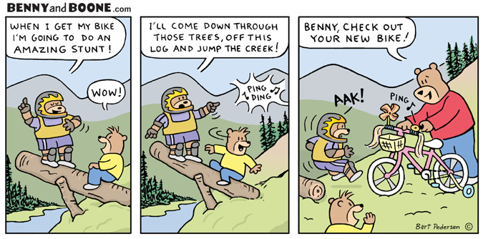
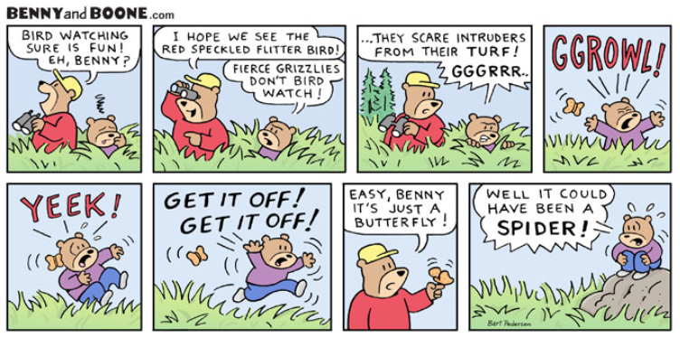
Print, cut up for pupils to use in books when writing dialogue.
Use the three lenses as modelled.

Slide 12
Can I use correct punctuation for dialogue?
We do - whiteboards

