Slide 1
Timetable for the week:
Groups | Session 1 | Session 2 | Session 3 | Session 4
Roald Dahl | Guided reading with T Initiate and Model Greek Myths | Follow-up task from guided reading Enable | Independent Comprehension | Independent reading for pleasure
Jacqueline Wilson | Independent reading for pleasure | Guided reading with T Initiate and Model Greek Myths | Follow-up task from guided reading Enable | Independent Comprehension
Julia Donaldson | Independent Comprehension | Independent reading for pleasure | Guided reading with T Initiate and Model | Follow-up task from guided reading Enable
Michael Morpurgo | Follow-up task from guided reading Enable | Independent Comprehension | Independent reading for pleasure | Guided reading with T Initiate and Model Greek Myths

Slide 2
Independent reading for pleasure
5 minutes before the end of BookTalk, you need to complete a post-it review of the book you have read.
Draw the emoji, then write down your opinion of the book, explaining why.

Slide 3
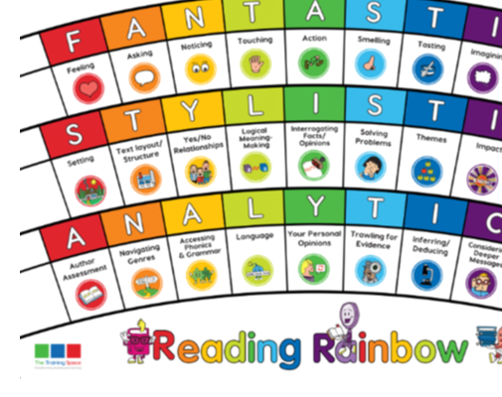
Our LI’s for the week: Band 3 Retrieve and record information from non-fiction using conventions such as indexes, contents pages and glossaries Band 4 – as band 3 … over a wide range of subjects identifying what the text is about, the type of text and discussing titles and subheadings. Band 3 - Read 110 words per minute and can talk about what they have just read to show understanding. Band 4 - Read 120 words per minute and can talk about what they have just read to show understanding.
Initiate/Model write this in your margin.

Slide 4
Meet the Ancient Greeks – James Davies
Lenses:
Text structure
Genres
Sentence Starters:
Text structure:
Information in this non-fiction text is made eye-catching by …
Genres:
There are particular clues in the text to show us we are reading…

Slide 5
Genres
What type of text are we reading?
Genres:
There are particular clues in the text to show us we are reading…
Together: find evidence that we are reading a fiction/non-fiction text.

Slide 6
Text structure
Text structure:
Information in this non-fiction text is made eye-catching by …
How does the author use titles, headings, index and glossary to help the reader?
Together find and chot down examples of titles, headings and discuss how to use the index and glossary to quickly find information.

Slide 7
ENABLE –
please write this in the margin.

Slide 8
Session – Enable (Independent follow-up task)
1) How do you know this is a non-fiction text?
There are particular clues in the text to show us we are reading …
2) Find two examples of titles and explain how they help the reader navigate the text.
_________ and ________ help me understand the text because …
Bonus question:
Use the glossary or contents page to find the page numbers on which you can find information about the following subjects:

