Slide 1
Book week

Slide 2
LI: Can I write a letter to an author?
Success Criteria:
I can set my letter out correctly
I can explain why I am writing
I can ask a question

Slide 3
Class discussion
Why do we write letters?

Slide 4
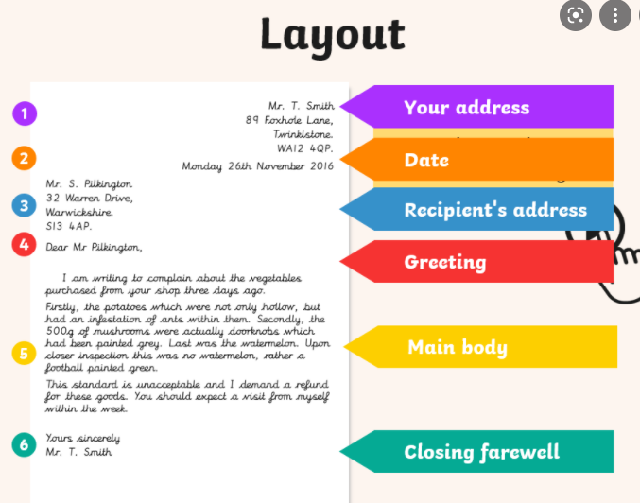
Look at letter layout
Would this be a good letter to write to Anthony Browne?

Slide 5
Class discussion
What might we include?
Chot down ideas as a class
Look at letter on next page

Slide 6
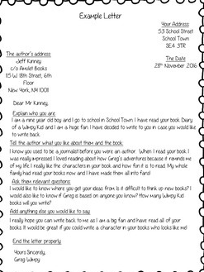
Explain who you are
Tell the author what you like about the books
Ask some relevant questions
Add anything else you’d like to say
Did we have any of these ideas?

Slide 7
Have a go…
Write the main body of your letter to Anthony Browne.
Dear Anthony Browne,
I am a…
Yours sincerely,
Bobby

Slide 8
LI: Can I write a letter to an author?
Success Criteria:
I can set my letter out correctly
I can explain why I am writing
I can ask a question

