Slide 2
Aim
To explore some of the key events during the ancient Greek period.
Success Criteria
order key events chronologically during a period in history.
discuss the terms ‘trade’, ‘empire’ and ‘civilisation’.
explore the effects of Alexander the Great’s empire on different people.

Slide 3
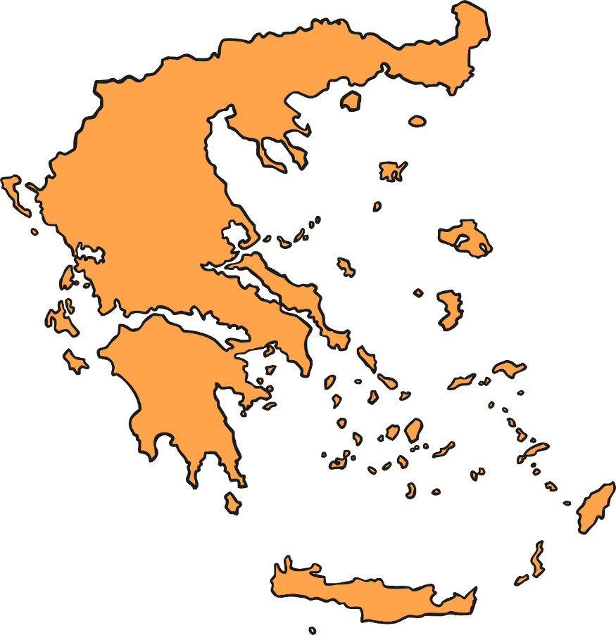
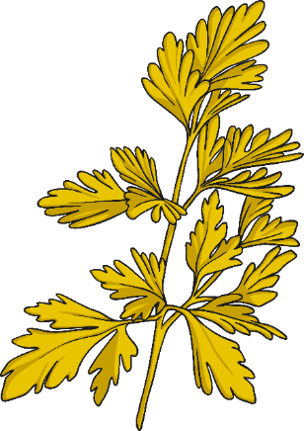
X
Where Is Modern Greece?
Click on the circle to zoom.
What do you know about Greece?
Tell your partner anything you know about modern Greece.

Slide 4
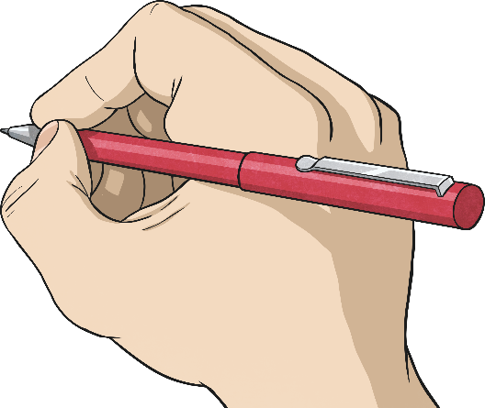
Where Is Modern Greece?
Can you answer these questions in your book?
Which continent is Greece in?
What do you think the weather is like in Greece and why?
What sea surrounds Greece?
What is special about Greece?
Athens

Slide 5
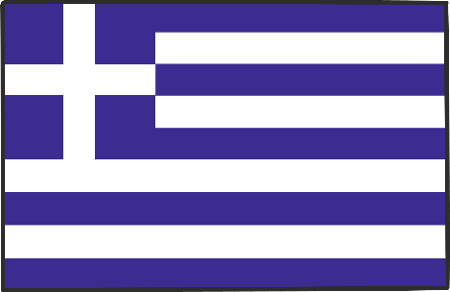
Where Is Modern Greece?
What things did you already know?
Greece has borders with Albania, Bulgaria, North Macedonia and Turkey.
Greece has the longest coastline in Europe and the mainland is mostly mountains.
Greece has over 1000 islands. The largest of these is Crete.
The warm climate and proximity to the coast help to make Greece a popular holiday destination.
Athens is the capital of Greece.
Athens
Crete

Slide 6
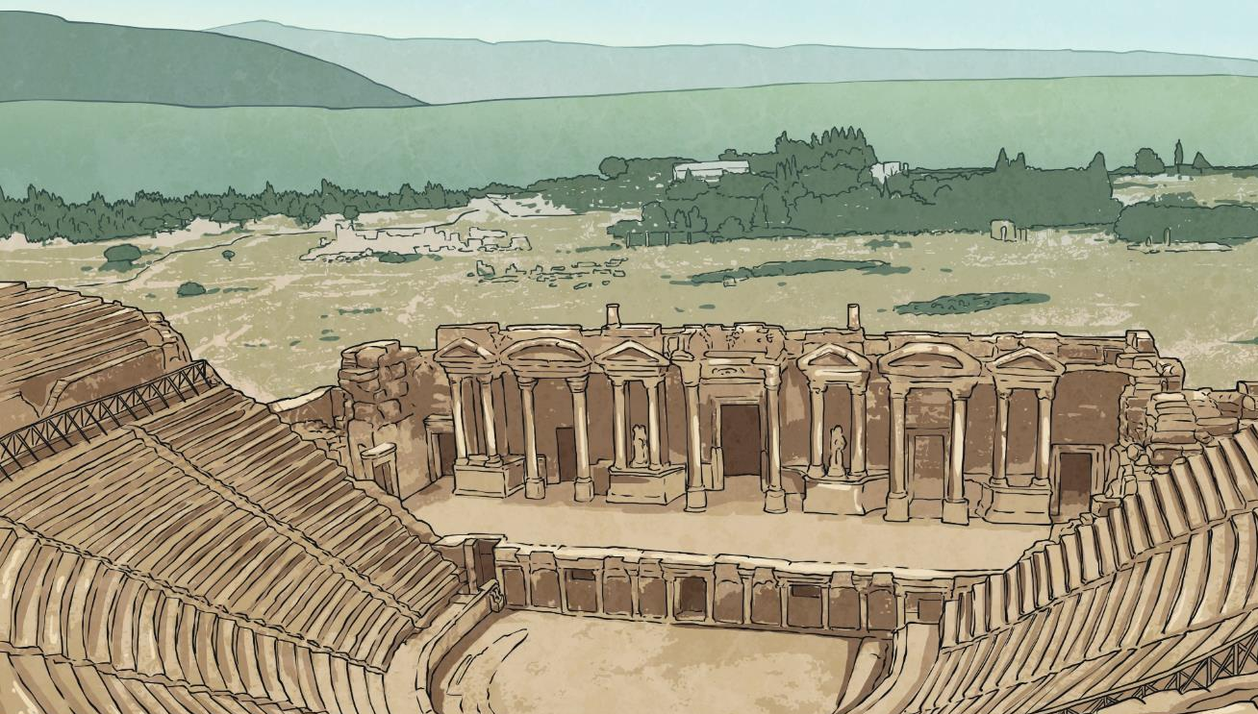
What Do We Know about Ancient Greece?
Ancient Greece is important historically because many things in culture today, especially in modern Europe, have been influenced by the ideas of the ancient Greek civilisation.
The sculptures, architecture, philosophy, politics and the scientific and mathematical ideas of ancient Greece are just some of the things that have had a significant impact on culture today.
In this context, the word ‘civilisation’ is used to describe a human society with well-developed rules and government, often where technology and the arts are considered important.
X
Can you write your own definition of ‘civilisation?’ Are we a ‘civilisation?’

Slide 7
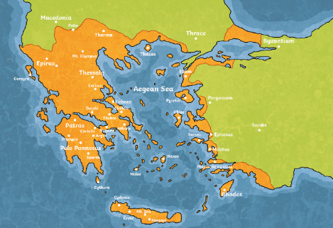
X
What Do We Know about Ancient Greece?
You may find it surprising to learn that ancient Greece was not a country.
It was made up of city states. Another way of saying city state is ‘polis’ which means city in Greek.
These city states made their own rules and lived alongside one another. Often there were battles between these city states but sometimes they would join together against a common enemy.
Important city states of ancient Greece included Athens, Corinth and Sparta.
Map showing ancient Greece around 750 BC
Click on the map to zoom!

Slide 8
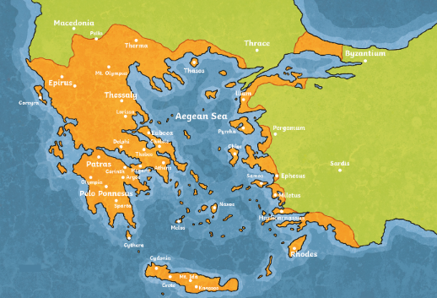
What Do We Know about Ancient Greece?
You will notice that many of the settlements in Greece - in modern times and in ancient times - are near the sea. Why do you think this might be?
A good source of food for the people.
The sea was also a means for people to travel and trade with other city states and countries.
To trade means to exchange (or to buy and sell) objects or services with others.

Slide 9
What Do We Know about Ancient Greece?
Items that the city states traded between one another and with other countries included:
wine
olives
grain
From around 600 BC, the ancient Greeks used coins to trade with.
cheese
pottery

Slide 10
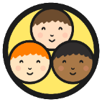
Ancient Greece in Time
The dates we will be learning about regarding ancient Greece all end in the letters BC.
Do you know what BC stands for?
BC stands for Before Christ and refers to any date before the year Christians believe Jesus was born. The Romans who introduced this calendar had no symbol for zero and the year that Jesus was born was called Year 1.
Some dates use BC and some use AD.
AD stands for Anno Domini and is a medieval Latin phrase that means, ‘In the year of our Lord’. AD is used for dates after the point Christians believe Jesus was born.

Slide 11
Ancient Greece in Time
Where does ancient Greece fit in with some of the other periods in history that you may have learnt about?
Timeline
3500 BC
AD 1
AD 1500
Ancient Egypt
Ancient Rome
Maya Civilisation
Ancient Greece
Celtic Britain
Anglo-Saxon Britain

Slide 12
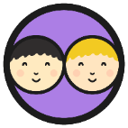
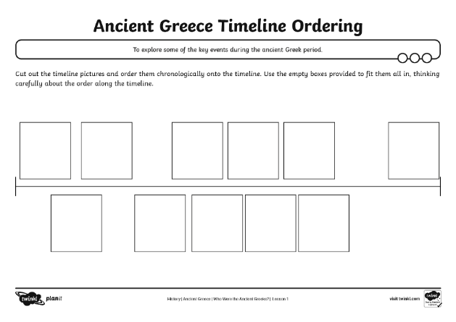
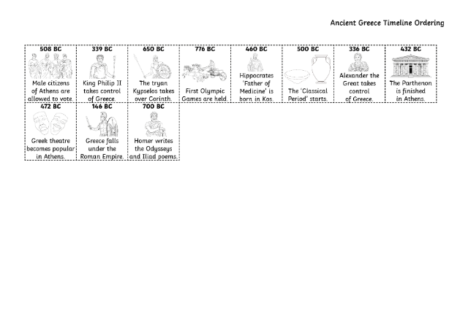
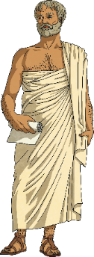
Ordering Events Chronologically
Work with a partner to chronologically order some important events from ancient Greek times using the Ancient Greece Timeline Ordering Activity Sheet.
Cut out the timeline pictures and order them chronologically onto the timeline.
Chronologically means the order in which the events happened.

Slide 13
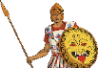
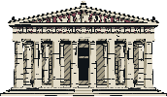
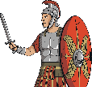
Ordering Events Chronologically
508 BC
339 BC
650 BC
776 BC
460 BC
500 BC
336 BC
432 BC
Hippocrates ‘Father of Medicine’ is born in Kos.
Alexander the Great takes control of Greece.
Male citizens of Athens are allowed to vote.
King Philip II takes control of Greece.
The tyrant Kypselos takes over Corinth.
The Parthenon is finished in Athens.
First Olympic Games are held.
The ‘Classical Period’ starts.
472 BC
146 BC
700 BC
X
Can you tell me one event that happened in ancient Greece before 500 BC and one event that happened after 500 BC?
Greek theatre becomes popular in Athens.
Greece falls under the Roman Empire.
Homer writes the Odyssey and Iliad poems.

Slide 14
What did the Greeks do for us?
How did the ancient Greeks change the world? - BBC Bitesize
Watch the video. Write down 3 things that we have learnt from the Greeks and now use in our society.

Slide 15
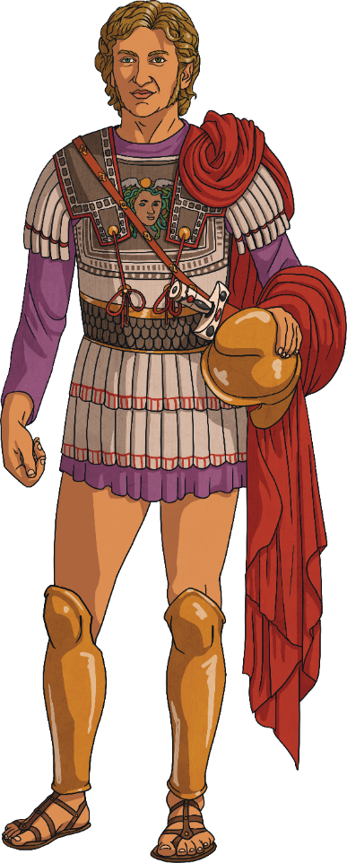
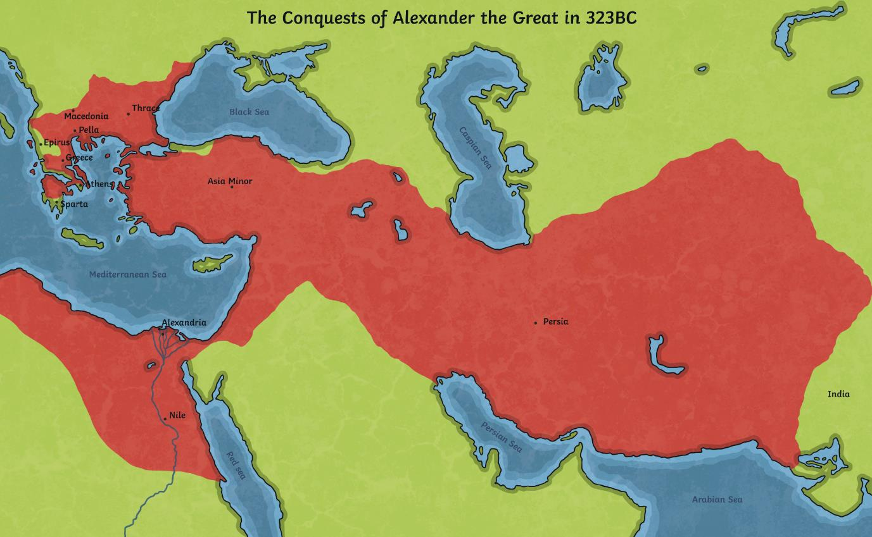
X
Alexander the Great’s Empire
We know that independent city states existed for most of the time in ancient Greece.
However, near the end of the ancient Greek period, King Philip II of Macedonia ruled over all of ancient Greece. Later, his son - Alexander the Great - took over the empire along with other lands that he conquered.
This was Alexander the Great’s empire.
Click on the map to zoom.

Slide 16
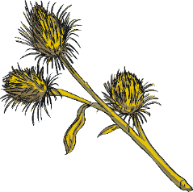
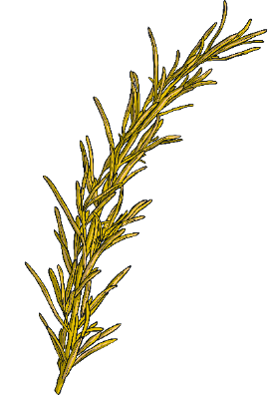
Alexander the Great’s Empire
An empire is a group of countries that is ruled by one ruler or country.
Empires are formed when a country takes over and rules other countries.
Alexander the Great was from Macedonia. With his armies, he conquered ancient Greece and many other countries to form an empire.

Slide 17
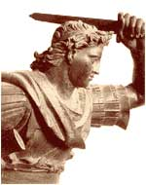
Alexander the Great
Ruler of the World

Slide 18
Why “the Great”?
In ten years, Alexander of Macedonia created the largest empire in the world up to that time.
Alexander spread Greek culture, ensuring cultural diffusion and the survival of the qualities of classical Greece.

Slide 19
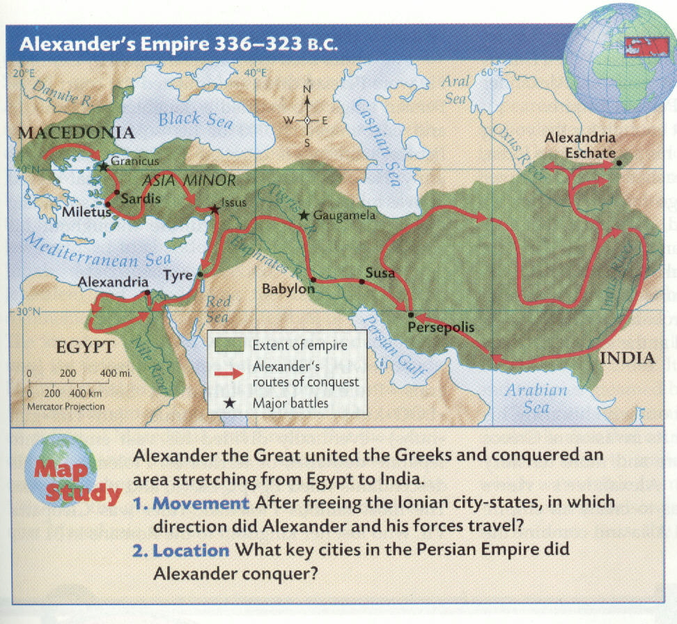
Alexander’s Empire

Slide 20
Securing his father’s empire
Alexander squelched rebellions in the northern regions to the Danube River
In the process of reconquering the Greek city states, his forces destroyed Thebes, massacring all, including women and children

Slide 21
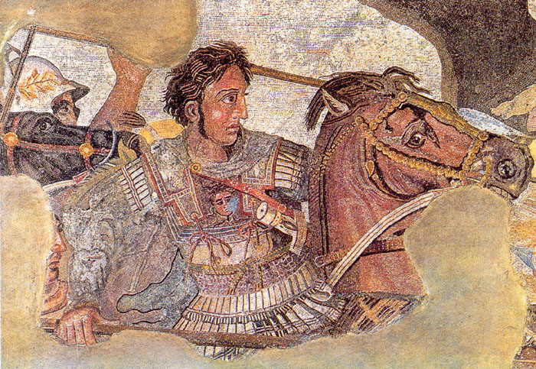
From Pompeii mosaic

Slide 22
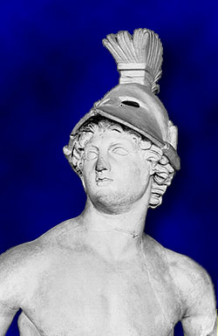
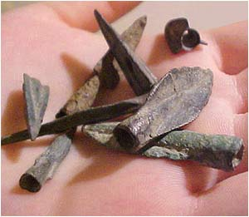
Expanding the Empire
Alexander’s forces of over 40,000 men crossed at the Dardanelles into Asia, where he declared that the whole of Asia would be won by the spear.

Slide 23
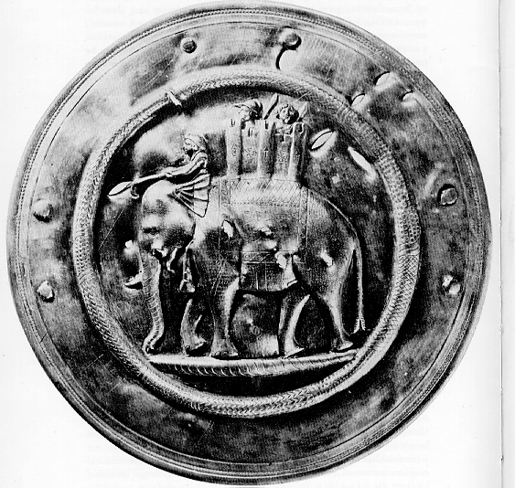
The limits of expansion
In the spring of 327 BC, Alexander and his army marched into India.
As he conquered regions he allowed rulers to continue to govern in his name.

Slide 24
Why was Alexander called ‘great?’
Brainstorm with your table, what made Alexander so successful when conquering new lands.
What type of man was he?
Mind map your ideas
Fearless
Brutal

