Slide 1
L.I – Can I understand what a part of a whole is?
Steps to success
What is the whole amount?
What is a part of the whole?
Equal and unequal parts.
Challenge: True or False

Slide 2
In Focus Task
What is a fraction? Explain.
½ - how can you represent this?

Slide 3
New Learning The part–whole relationship
Notes:
If the journey from Sunny’s house to Kofi’s house is the whole, then the journey from Sunny’s house to Alfie’s house is part of the whole.
The part is smaller than the whole.

Slide 4
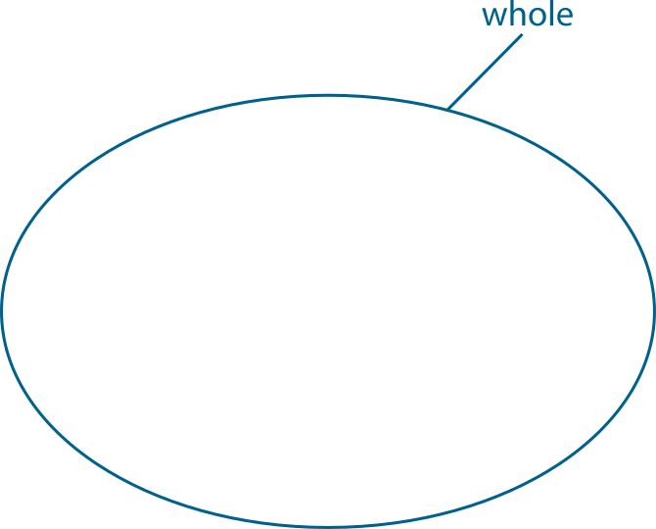
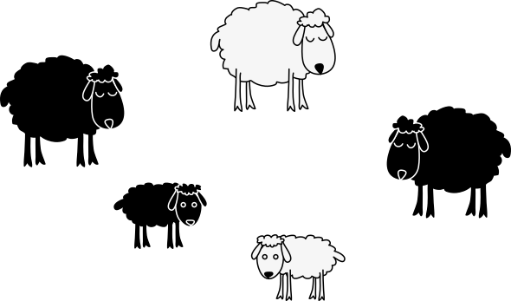
The part–whole relationship
Notes:
If the group of sheep is the whole, then the lambs are part of the whole.
The part is smaller than the whole.

Slide 5
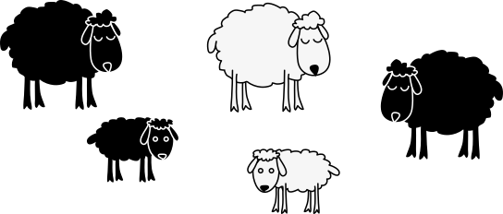
The part–whole relationship
Notes:
Look at our original group of sheep. Extend the group of sheep.
If all the sheep is the whole, then the sheep in the pen are part of the whole.
If the sheep in the pen are the whole, then the white sheep in the pen are part of the whole.
If the black sheep are the whole, then the black lamb is part of the whole.

Slide 6
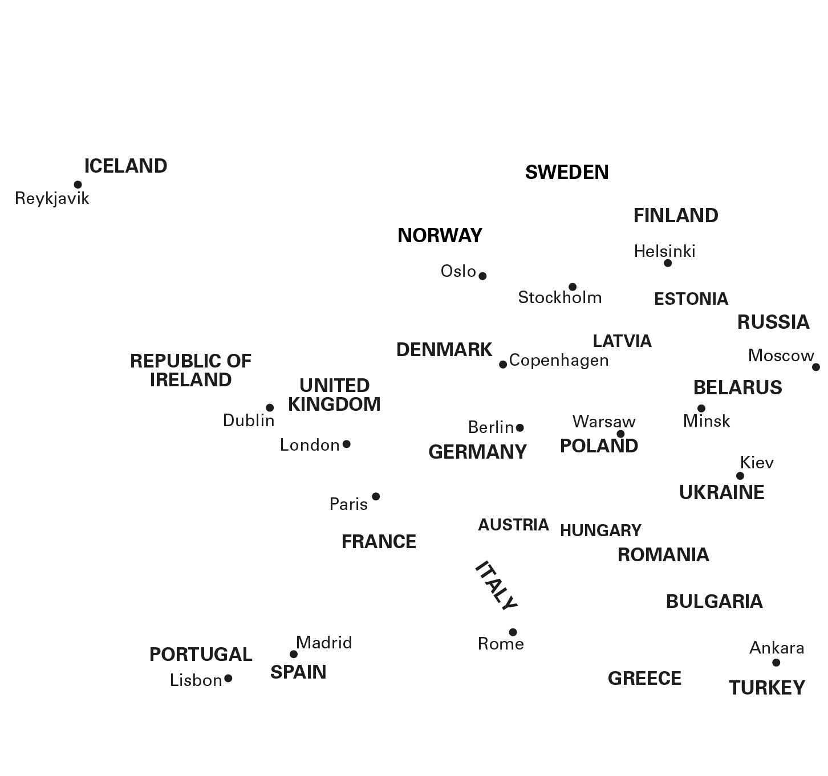
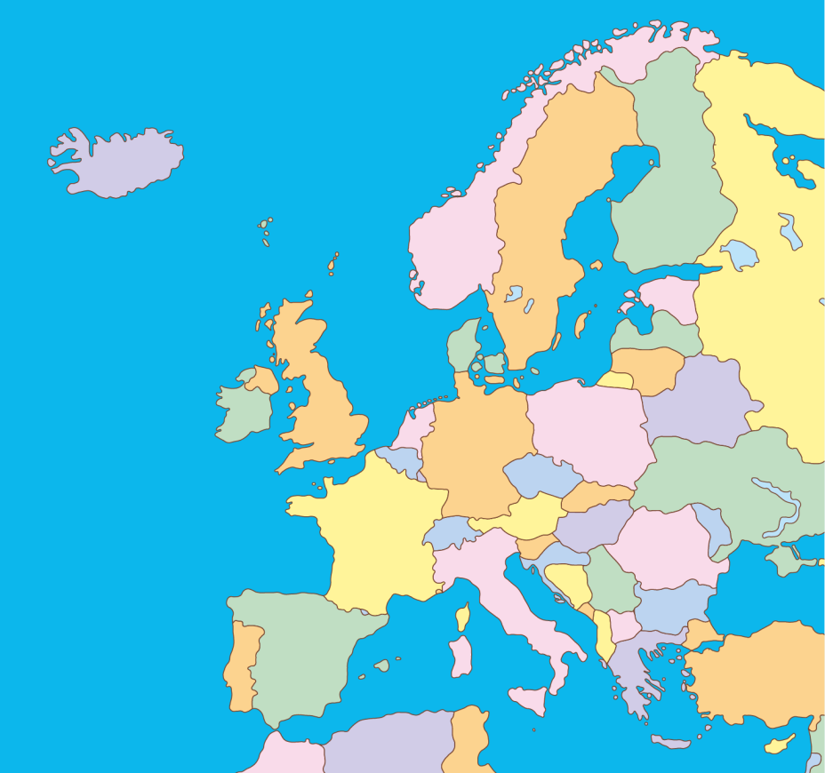
The part–whole relationship
If the UK is the whole,
✗
✓
then Italy is not part of the whole.
then Italy is part of the whole.

Slide 7
The part–whole relationship

Slide 8
The part–whole relationship
Equal or unequal parts?
Notes:
Explain to children that these are three equal-sized squares.

Slide 9
3.1 The part–whole relationship Step 2:2
Equal or unequal parts?

Slide 10
3.1 The part–whole relationship Step 2:2
Equal or unequal parts?

Slide 11
3.1 The part–whole relationship Step 2:3
Notes:
It is only possible to divide a whole into parts using straight lines.
Do you agree with this statement?

Slide 12
The part–whole relationship
4 equal parts
4 unequal parts

Slide 13
The part–whole relationship
Are all the parts of equal size?

Slide 14
The part–whole relationship
Odd one out?
Notes:
Three children have folded their paper strips in different ways.
Which strip is the odd one out?
Can you find a way to make each of the strips the odd one out?

Slide 15
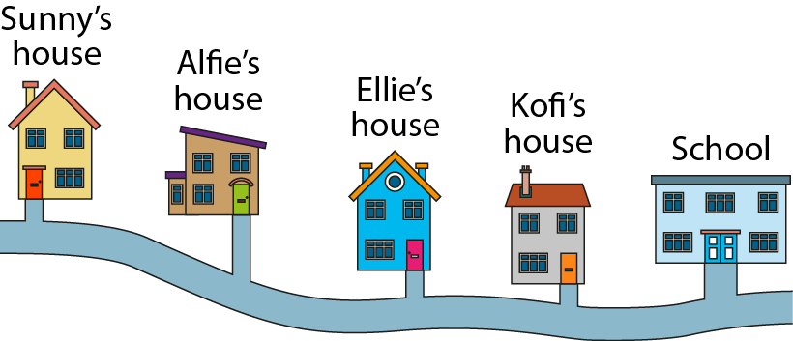
Independent learning
Complete the sentence
If the journey from ______ house to ______ house is the whole, then the journey from ________ house to _______ house is part of the whole.
Notes:
If the journey from Sunny’s house to Kofi’s house is the whole, then the journey from Sunny’s house to Alfie’s house is part of the whole.
If the journey from Sunny’s house to school is the whole, then the journey from Sunny’s house to Kofi’s house is part of the whole.
If the journey from Sunny’s house to school is the whole, then the journey from Sunny’s house to Alfie’s house is part of the whole.

Slide 16
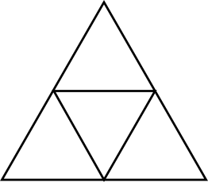
Independent learning
Equal parts
Unequal parts

Slide 17
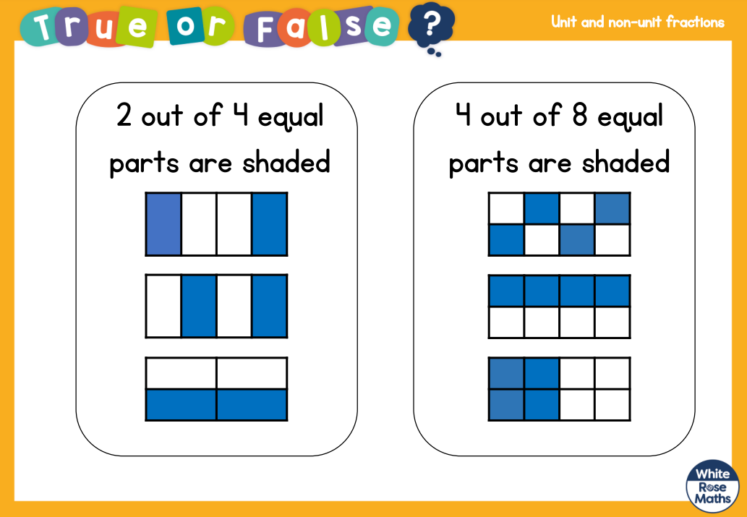
Lightbulb Challenge
Prove your answer!

Slide 19
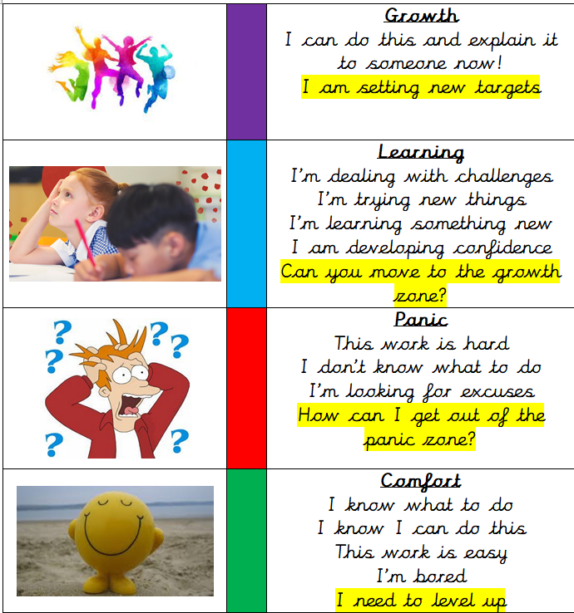
Write a reflection sentence.
Reflection:
I felt I was successful using…
I found it difficult using…
Today, it really helped me to use…
I really understood ____ this lesson…
I struggled to understand ___ this lesson…
Make sure there is a ‘zone of learning’ on the LI.
(Growth/Learning/Panic/
Comfort)

Slide 20
Write a reflection sentence. Here are some examples.
Reflection
I felt I was successful using …..
I found it difficult using ….
An effective strategy I used today was ….
Today, it really helped me to use ….
Perhaps it would have been easier if I had used/asked ….
I asked for help with question 2 because …
A top tip for (adding fractions) is …..

