Slide 2
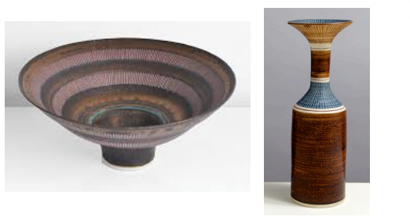
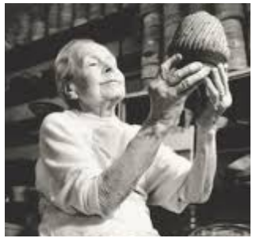
Artists who use ceramics

Slide 3
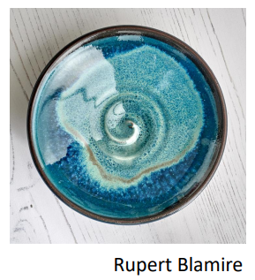
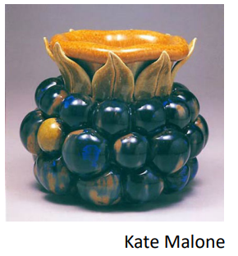
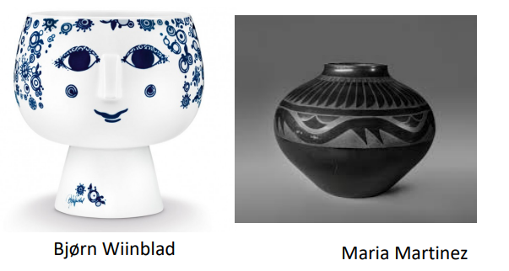
Artists who use ceramics
Here are some other examples of artists who make and use ceramics. You can research one or two of these artists to develop your ideas.
Once you have researched your chosen artists, you can observe and sketch the images in your sketch books.

Slide 4
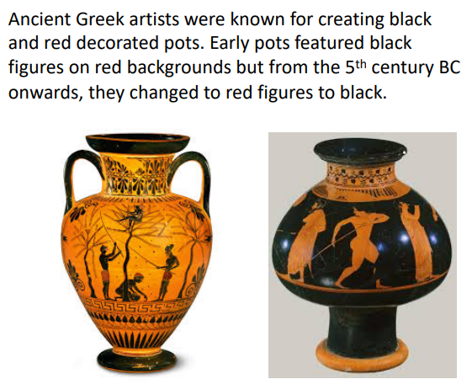
Other artists who used ceramics were the Ancient Greeks.

Slide 6
