Slide 1
LI Yr 3 Can I add and subtract 3-digit and 2-digit numbers not crossing 100?
LI Yr 4 Can I add 3-digit and 2-digit numbers crossing 100?
STS
I can work out number representations.
I can use place value charts to complete calcuations. (Yr3).
I can complete addition calculations (yr4).
Lightbulb Challenge
Spot the mistake.

Slide 2
In Focus Task

Slide 3
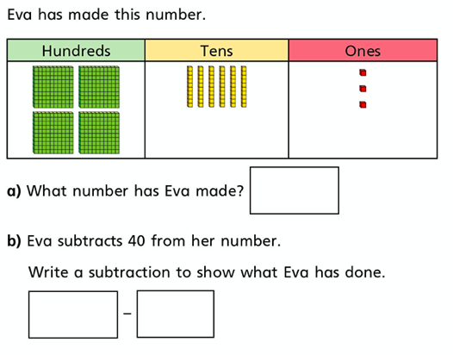
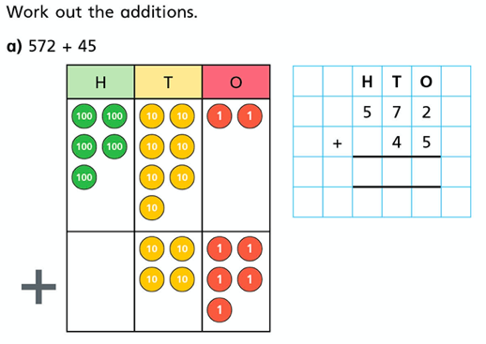
New Learning
Year 3
Year 4

Slide 4
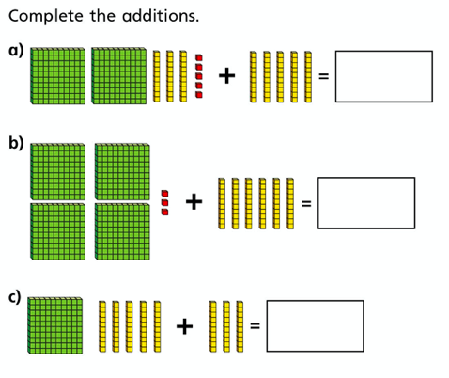
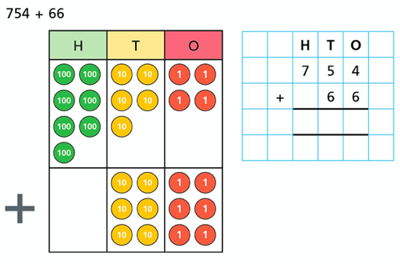
Talk Task
Year 3
Year 4

Slide 5
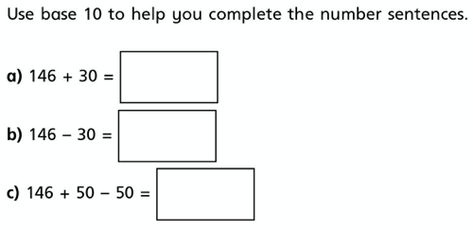
Develop learning
Year 3
Year 4

Slide 6
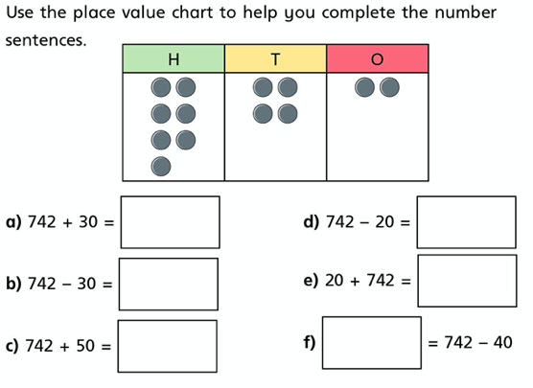
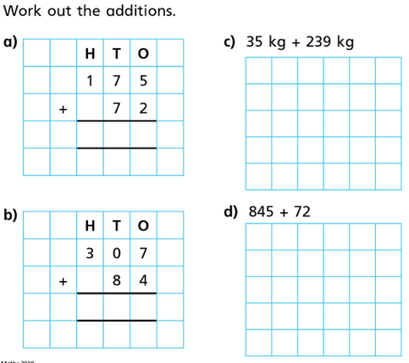
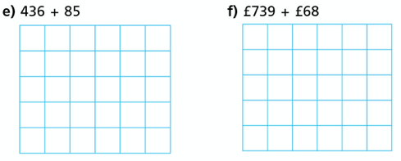
Independent task
Year 3
Year 4

Slide 7
Lightbulb Challenge

