Slide 1
The Three Little Pigs
A traditional tale
Monday 20th September 2021

Slide 2
LI: Can I write an alternative version of a traditional tale?
A traditional tale
Steps to success:
I can use the right shade of meaning;
I can use repetition for effect;
I can use precise verbs.

Slide 3
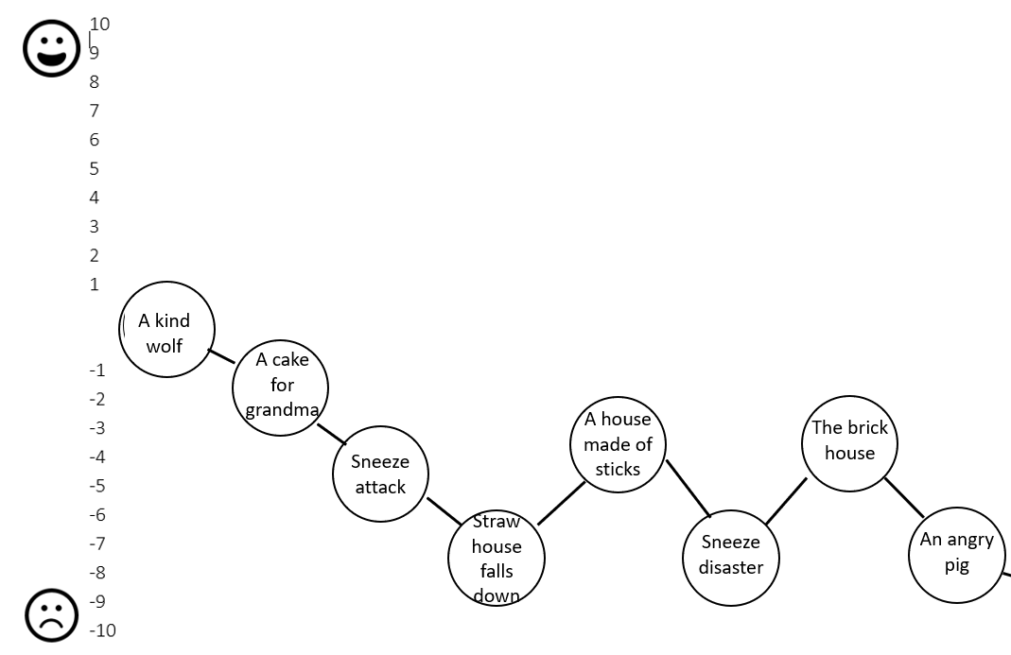
Arrest
Let’s recap what we have written so far.

Slide 4
Arrest
The wolf was angry with the pig’s reply. Let’s explore that feeling using the shade-o-meter.
+
irate, furious, angry, enraged, troubled, livid, cross
angry
Can you add any more?
1.
_

Slide 5
Arrest
Let’s gather your ideas.
Remember, tick ideas we have shared and made it on the board.
Add other people’s good ideas.
1.

Slide 6
Model sentence
The wolf was cross. The wolf was angry. The wolf was livid.
Your task:
Write short, effective sentences with the intensity of anger increasing.
Challenge: Can you deepen the moment with a metaphor or a simile?

Slide 7
Arrest
The wolf is causing a bit of a commotion. Who might come and see what is going on?
Write your ideas in the second box.
2.

Slide 8
Arrest
Let’s gather your ideas.
Remember, tick ideas we have shared and made it on the board.
Add other people’s good ideas.
These were some of my ideas:
neighbours, children, teachers, reporters, shopkeepers, police, paramedics.
2.

Slide 9
Arrest
I have some different words for commotion.
hubbub, scene, riot, drama, racket, rumpus, ruckus, furore, storm
Let’s play word tennis and throw them around the classroom.
Now, write your three favourite ones in the third box.
Can you think of any others?
3.

Slide 10
Model sentence
He caused a commotion and the neighbours came. He caused a scene and the reporters came. He caused a riot and the police came
Your task:
Use the repeated structure and good nouns to describe what happened.
Challenge: deepen the moment with
adjectives.

Slide 11
Arrest
The wolf is arrested and being pushed in a police car.
Can you think of more precise verbs for pushed? Let’s do some thesaurus thinking?
Write your ideas in the last box.
4.

Slide 12
Arrest
Let’s gather your ideas.
Remember, tick ideas we have shared and made it on the board.
Add other people’s good ideas.
These were some of my ideas:
shoved, bundled, forced, wrestled, manhandled, thrust, stuffed, rammed, crammed.
4.

Slide 13
Model sentence
The wolf was shoved into the police car because he had committed a terrible crime.
Your task:
Write a sentence, include a precise verb for ‘pushed’ and a ‘because’ clause..
Challenge: can you deepen the moment the checking lens? What could you hear with the police car driving off?

Slide 14
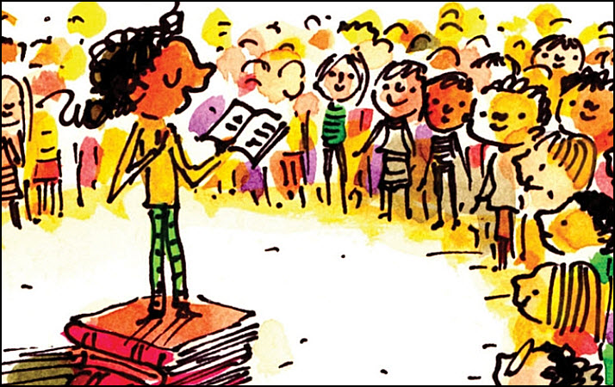
Share and feedback
Share your work
What sentence are your proud of?
What does the class think of the work?
How could we make it even better?
Which learning zone were you in today?
Write the letter in the circle on the LI.

