Slide 1
The Three Little Pigs
A traditional tale
Friday 17th September 2021

Slide 2
LI: Can I write an alternative version of a traditional tale?
A traditional tale
Steps to success:
I can use adjectives;
I can describe how a character is feeling;
I can include dialogue.

Slide 3
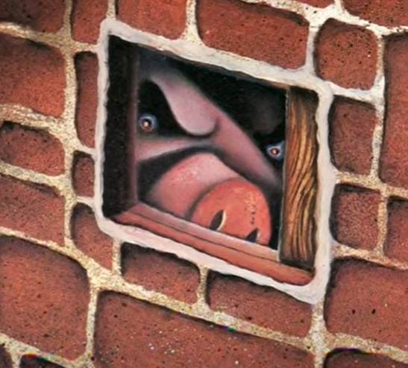
An angry pig
What do you notice about the pig’s eyes and frown?
Gather good adjectives to describe them. Write them in the first box.
1.

Slide 4
An angry pig
Let’s gather your ideas.
Remember, tick ideas we have shared and made it on the board.
Add other people’s good ideas.
Here are some of my ideas: angry, evil, dark, glaring, menacing, staring, cold, hateful.
The pig’s frown is shadowy, angry, arched, severe, fixed, harsh, unforgiving.
1.

Slide 5
Model sentence
This pig’s eyes were evil and dark; his frown was angry and harsh.
Your task:
Include two adjectives for the eyes and two adjectives for the frown or eyebrows. Make sure the verbs are in the past tense.
Challenge: Can you deepen with a simile?

Slide 6
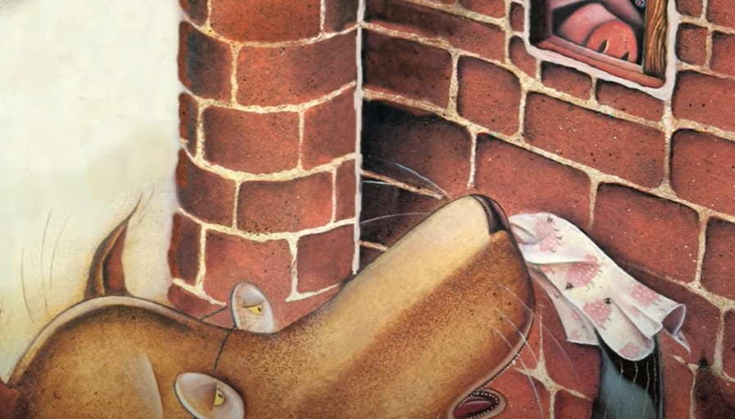
An angry pig
What can we say about the wolf’s feelings from this picture?
I think he looks a bit nervous.
Draw a shadometer and gather other ‘nervous’ feeling words in the second box.
2.

Slide 7
An angry pig
Where would you put these on the shadometer? What words did you chot?
+
worried, frightened, anxious, scared, on edge, timid, threatened
nervous
2.
_

Slide 8
Model sentence
The angry pig made the wolf feel timid.
Your task:
Use a precise feeling word to say how the wolf is feeling.
Challenge: can you choose a boomtastic lens and deepen the moment?

Slide 9
An angry pig
In yesterday’s lesson the wolf asked to be let in.
Let’s brainstorm angry replies from the feisty pig.
Write them in the third box.
3.

Slide 10
An angry pig
When we punctuate direct speech we need to use inverted commas.
What were the rules again?
“No! Not by the hairs on my chinny, chin chin.”
3.

Slide 11
Model sentence
“Go away you stupid wolf, I’m busy!” boomed the pig.
Your task:
Write your own choice of dialogue.
Challenge: can you deepen the moment using a better word for ‘shouted’?

Slide 12
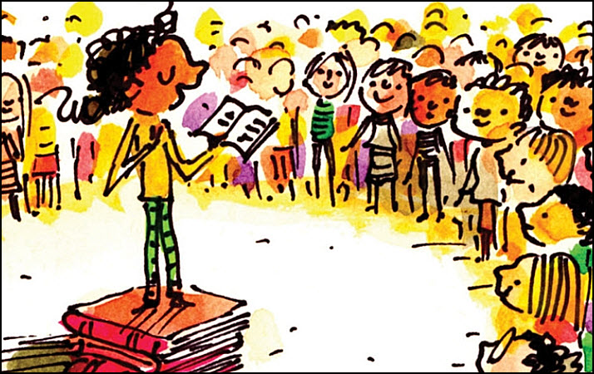
Share and feedback
Share your work
What sentence are your proud of?
What does the class think of the work?
How could we make it even better?
Which learning zone were you in today?
Write the letter in the circle on the LI.

