Slide 1
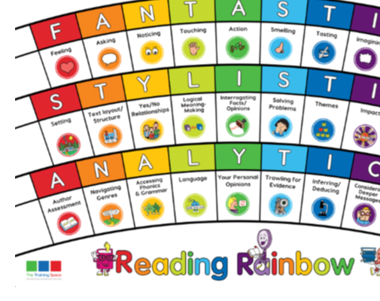
Our LIs for the week: Band 3/4 - Identify vocabulary within the text that gives the best description of the setting or character Band 3/4 - Identify main ideas drawn from more than one paragraph and summarise these
Lesson 1:
Initiate

Slide 2
Lenses:
Feeling
Consider deeper messages.
Sentence Starters:
Feeling:
The main feeling at this moment is ...
Consider deeper messages:
A deep message is explored in this book through ...

Slide 3
Lesson 2:
MODEL – please write this in the margin.

Slide 4
Feeling
On slide 13 night arrives, Jamina hears noises and settles for the night.
Together: chot down feelings Jamina might be experiencing at this point.

Slide 5
Consider deeper messages.
At the beginning of the story Jamina wants to be a hunter, at the end she says she will never be a hunter.
Together: chot down things that she sees and things that happen that make her change her mind.

Slide 6
Lesson 3:
ENABLE – please write this in the margin.

Slide 7
Session 3 – Enable (Independent comprehension)
What is the main feeling Jamina is experiencing when she settles down for the night? Why did you choose this feeling?
What message about hunting does this story give?
Feeling
The main feeling at this moment is … because ...
Deeper messages:
A deep message that is explored in this book is ...
Bonus question: Year 3
3) Why does Jamina change her mind about hunting?
Bonus question: Year 4
3) What are the similarities between what happens to the baby elephant and the child Jamina?

