Slide 1
Year 3 and 4
LI: Can I find right angles in a shape?
Steps to success:
I know that a right angle is a quarter turn.
I know that 2 right angles make a half turn.
I know that 3 right angles make a three quarter turn.
I know that 4 right angles make a complete turn.

Slide 2
In Focus Task
What do you notice?
25 | 5 | 5
7 | 7 | 1
27 | 3 | 9
48 | 6 | 8
32 | 4 | 8
24 | 4 | 6

Slide 3
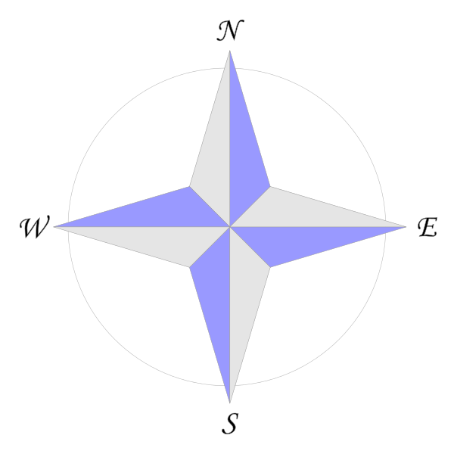
Develop Learning
Annie is facing East.
She makes a quarter turn.
Which direction could she be facing now?
2) If Annie faced West and made a half turn, which direction would she be facing?

Slide 4
Develop Learning
Annie is facing East.
She makes a quarter turn.
Which direction could she be facing now?
2) If Annie faced West and made a half turn, which direction would she be facing?
South
or North
East

Slide 5
Develop Learning
What is an angle?
We see angles where 2 straight lines meet at a point.
An angle is a measure of the amount of turn between two lines

Slide 6
Develop Learning
A quarter turn is called a right angle.

Slide 7
Develop Learning
Which pairs of lines make right angles?
Which do not make right angles?
Have a think

Slide 8
Develop Learning
Which shapes have right angles?
Have a think

Slide 9
Have a go at questions 1 – 4 on the worksheet
Independent Learning

Slide 10
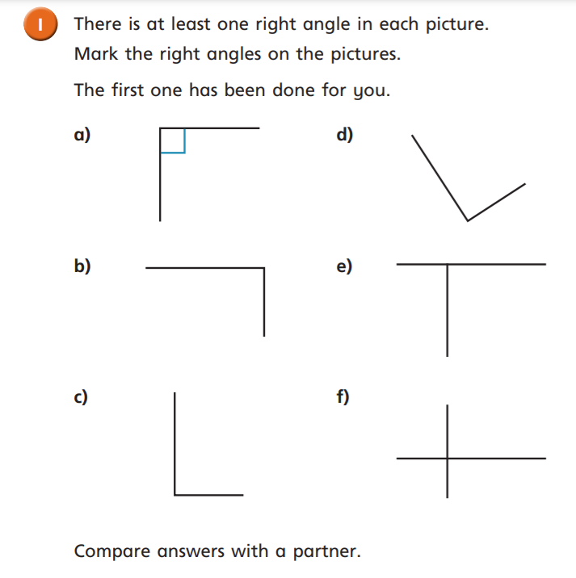
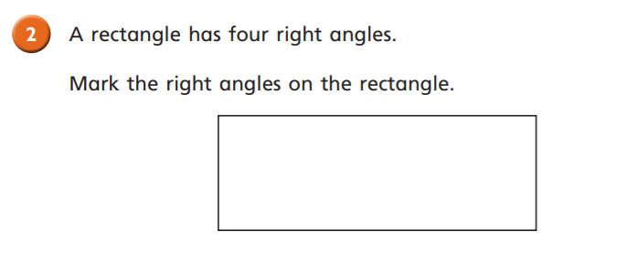

Slide 11
Develop Learning
There is 1 right angle in a quarter turn.
There are 2 right angles in a half turn.

Slide 12
Develop Learning
There is 1 right angle in a quarter turn.
There are 2 right angles in a half turn.
There are 3 right angles in a 3 quarter turn.

Slide 13
Develop Learning
There is 1 right angle in a quarter turn.
There are 2 right angles in a half turn.
There are 3 right angles in a 3 quarter turn.
There are 4 right angles in a full turn.

Slide 14
Develop Learning
How many right angles do you see?
Have a think
There are 12 right angles.

Slide 15
Have a go at the rest of the questions on the worksheet
Independent Learning

Slide 16
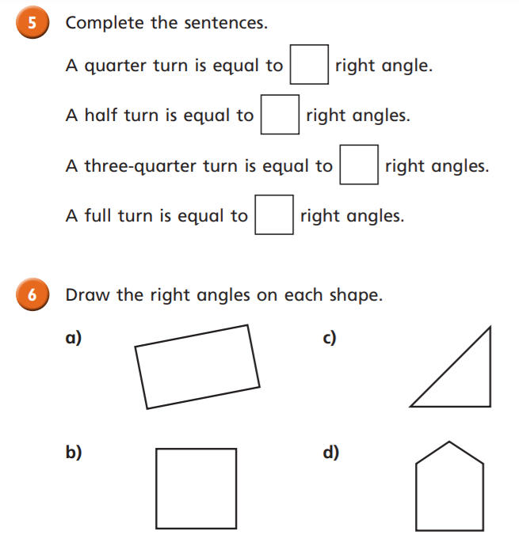
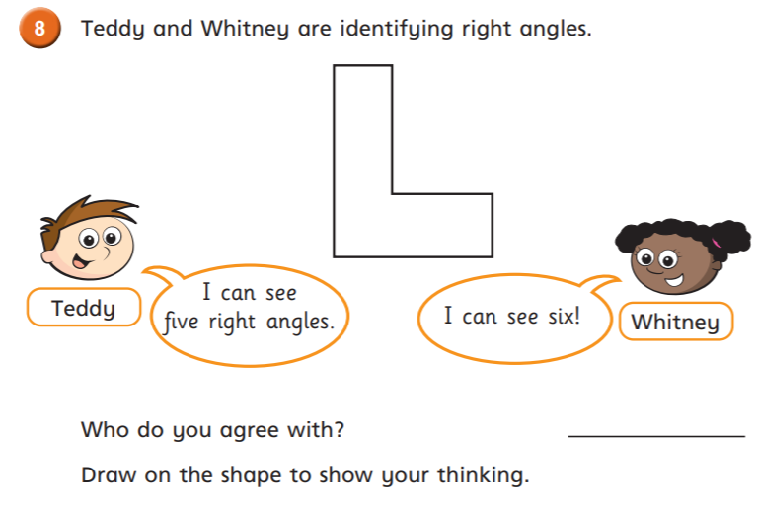
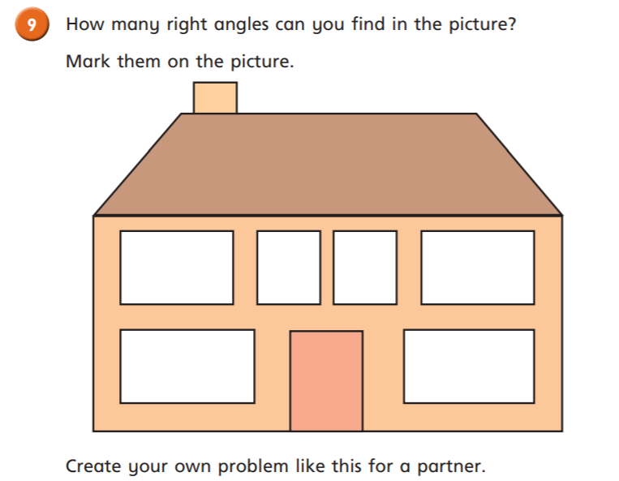
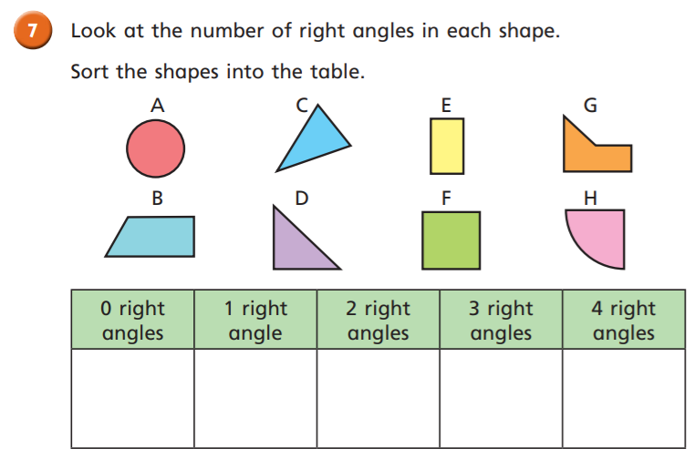
Independent Learning

