Slide 1
The Water Cycle A river journey
Explanation Text
Wednesday 16 June 2021

Slide 2
LI: Can I plan an explanation text?
Explanation Text
Steps to success:
I can gather interesting facts
I can write descriptions of the landscape
I can plan my steps to success

Slide 3
Independent write
You are going to write your own informal explanation about the journey of the river Severn from source to mouth.
Look at the shapes of your text.
It will start with a greeting and end in a big finale, like we did with the water cycle.
It will explain different stages of the journey: source, waterfall, meander, estuary and the mouth.

Slide 4
Independent write
You are going to watch this video to gather information about the river Severn’s journey.
Gather facts about the river to use in your own factual tour.
Use the noticing lens to gather good descriptions of the landscape.

Slide 5
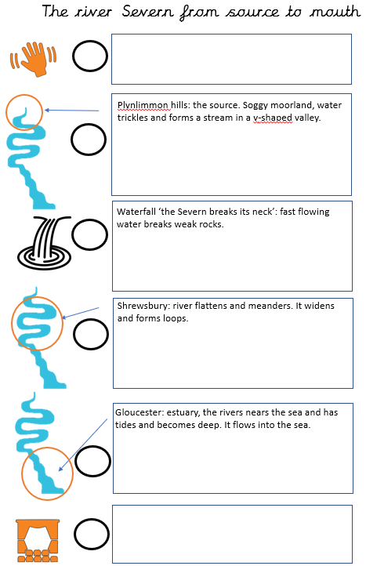
Independent write
Let’s share some of the facts we have learned and create a fact file about the river Severn.
Use (or magpie) good facts for each of the text boxes on your shape sheet.
You can use these tomorrow in your independent write.

Slide 6
Independent write
Choose your lenses. One for each shape.
These will be your steps to success.
You have to include the purpose lens.
The other lenses are your own choice.
Draw them in the circles next to the shapes.

Slide 7
Share and feedback
Share your work
What sentence are your proud of?
What does the class think of the work?
How could we make it even better?

