Slide 1
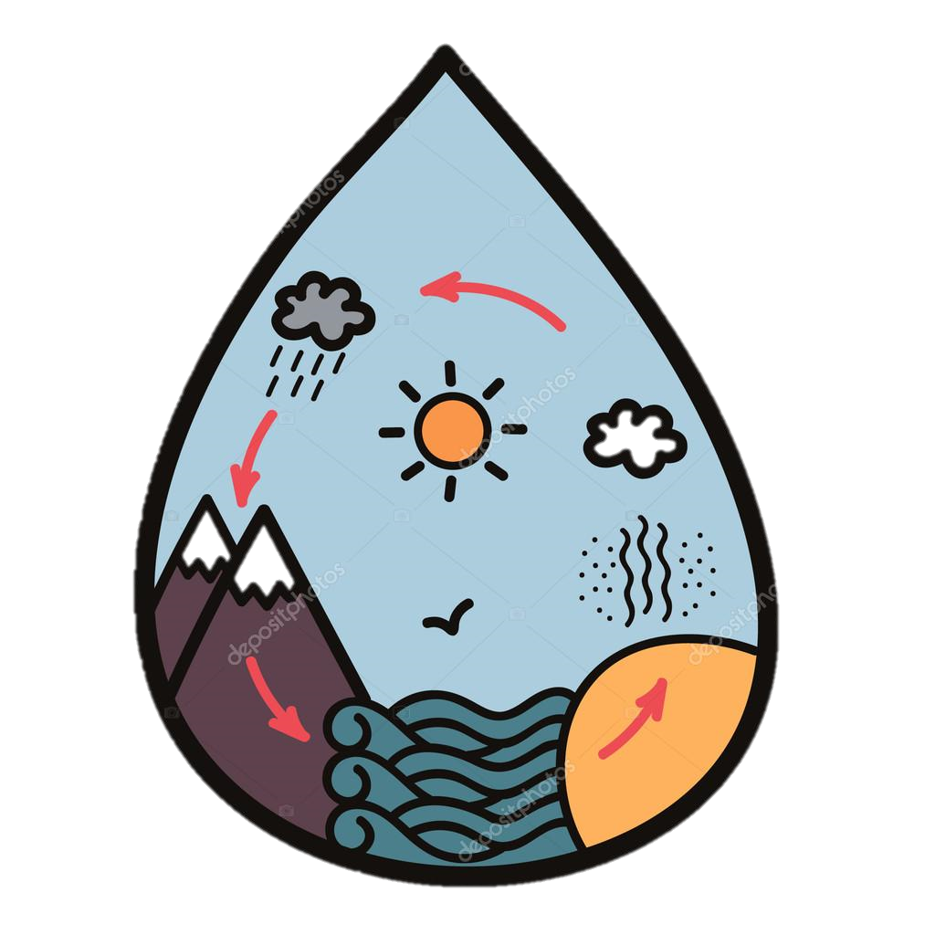
The Water Cycle
Explanation Text
Thursday 10 June 2021

Slide 2
LI: Can I draft and write an explanation text?
Explanation Text
Steps to success:
I can use direct address to engage the reader
I can use a subordinate clause
I can include a water fact

Slide 3
Condensation
Watch the first 2 minutes of this video.
The further water vapour travels from the surface of the earth, the colder it gets.
Find words that express cold, like brrr or chill, and write them in the first box.
1

Slide 4
Condensation
Here are some of my ideas.
Chill
Cool
Cold
Nippy
Shivery.
1

Slide 5
Condensation
The water vapour forms together into water drops as it condenses. They stay in a group and get carried by the wind and hot air.
What things do teachers say to keep pupils together when on a trip? Or your parents when you are walking around a new place?
Write them in the second box.
2

Slide 6
Condensation
Here are some of my ideas.
stay together
hold hands
partner up
stay in your group
2

Slide 7
Condensation
Model sentence:
Brrr! Can you feel that chill? It’s getting a little cooler up here isn’t it? We must keep together. Stay in the group.
Your task:
Use the purpose lens to engage the reader. Ask if they can feel the change in temperature. Tell the reader to form a group.
Deepen the moment:

Slide 8
Condensation
How do gas molecules move around?
They are very energetic. Write down words that have a similar meaning to energetic in the third box.
3

Slide 9
Condensation
Here are some of my ideas.
Vigorous
Lively
Bubbly
Sparky
Zippy
3

Slide 10
Condensation
Use the diagram below to explain to your partner what condensation is and how clouds are formed.

Slide 11
Condensation
We are going to write a sentence explaining what condensation is using a subordinate clause.
What is a subordinate clause?
What punctuation is important?
3

Slide 12
Condensation
Model sentence:
When you, our spritely water vapour, have cooled down, you turn into a liquid and form clouds. This is called condensation.
Your task:
Write a scientific explanation of condensation using an appropriate adjective to describe the water vapour in a subordinate clause.
Deepen the moment: Add information about how clouds are formed.

Slide 13
Condensation
What words and phrases can you use to get everyone’s attention if you were talking to a group of people?
Write them in the fourth box.
4

Slide 14
Condensation
Here are some of my ideas.
Okay
Right
Here
Follow me
Pay attention.
4

Slide 15
Condensation
Does anyone know interesting facts about clouds?
From the videos, the book or your own knowledge?
Let’s share and chot in the last box.
5

Slide 16
Condensation
Model sentence:
Right clouds, if we can get on a current, the air will move us around the globe. Stay together now. Off we go!
Your task:
Address the water droplets in a cloud. Give them an interesting fact.
Deepen the moment:
Give the group of water droplets an instruction.

Slide 17
Share and feedback
Share your work
What sentence are your proud of?
What does the class think of the work?
How could we make it even better?

