Slide 1
PSHE
RELATIONSHIPS
I AM SPECIAL

Slide 2
RELAX AND OPEN YOUR MIND
Relationships are two-way bonds and between us and another person. In this ‘Calm Me’ time we will use some breathing techniques and some visualisation to help us think carefully about the people in our lives who we really appreciate, who we are in relationships with. So let’s start by sitting up straight, spines nice and long and both feet on the floor.
Close your eyes and focus all your thoughts on your breathing. We breathe all the time, all day and all night, don’t we, but most of the time we are not aware that we are doing it...our bodies just keep breathing air in and out without us even asking them to. How amazing! So now we are going to help our minds to focus just on our breathing…take a deep and gentle breath in through your nose while you silently count to 4 1..2..3..4. When your lungs feel full up, hold your breath inside them for a moment and then gently let it flow out of your body. Can you silently count to 6 as you breathe out? 1..2..3..4..5..6. Do this several times and every time you breathe out feel any tensions or worries fizzle down through your body and out through your feet. Breathing in 1..2..3..4 and breathing out 1..2..3..4..5..6 with all your worries fizzling out through your feet.
You feel calm. So feeling calm and relaxed see if you can help your mind create a picture of YOU. It could be a picture of a happy you or a sad you. Try to build a really clear picture so you can see yourself in your own mind. You feel safe and loved… stay with these feelings as you keep imagining your special self. Aren’t we lucky to be who we are, to be so special? Can you let yourself think about how special you are and feel how much you appreciate being you with all your special qualities? Let yourself feel all the appreciation you can for being YOU. Now gently save that picture in your mind. You can come back to it any time you want to by just asking your mind to show you that picture.
Bring your attention back to your lovely breathing again and take 2 or 3 deep, gentle breaths 1..2..3..4... and out 1..2..3..4..5..6. When you feel ready to, bring your attention back to being here in the classroom here and now and give a big stretch…then open your eyes and sit quietly while you listen to the chime until you can no longer hear any sound

Slide 3
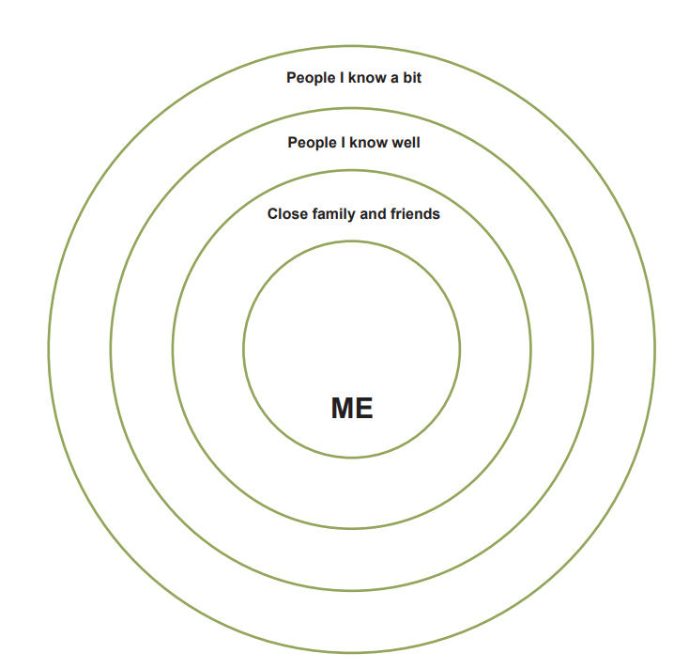
MY RELATIONSHIPS
Who do you know a bit?
Who do you know well?
Who are your close family and friends?
Complete the circle activity

Slide 4
EVERYONE IS SPECIAL
Find a friend (or two) and sit next to them
What is special about them?
What makes them great?
Tell each other good, positive things about one another.

Slide 5
ACTIVITY
Take some coloured strips (one of each colour)
Write on each strip something – a skill, talent, value, personality trait – that makes you special.
Make a piece of art with the strips by glueing them in your book.

